Slide 1
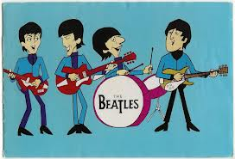
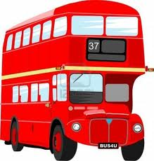
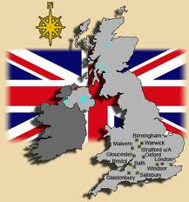

Elektronická učebnice – II. stupeň Základní škola Děčín VI, Na Stráni 879/2 – příspěvková organizace Anglický jazyk
9.1 Great Britain
The United Kingdom of Great Britain and Northern Ireland
(the official name)
The national anthem „God Save the Queen“ here: http://www.youtube.com/watch?v=tN9EC3Gy6Nk
Autor: Mgr. Jitka Šolcová

Slide 2
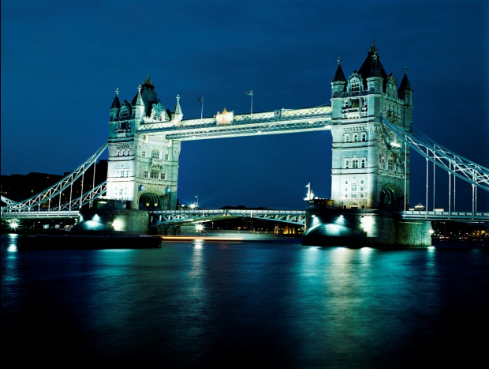
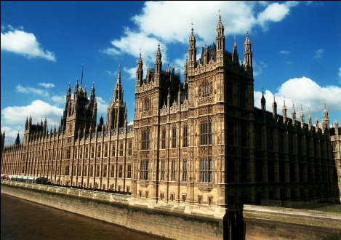
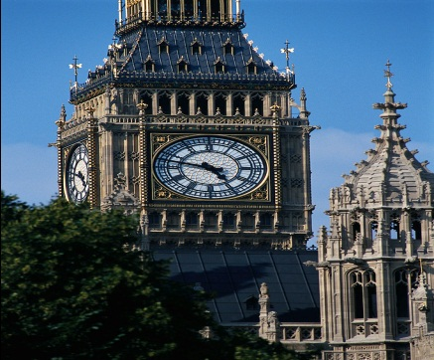
Elektronická učebnice - II. stupeň Základní škola Děčín VI, Na Stráni 879/2 – příspěvková organizace Anglický jazyk
9.2 What do we already know?
The capital is London.
It´s a monarchy. The head of state is the queen.
The national currency of the UK is the British pound.

Slide 3
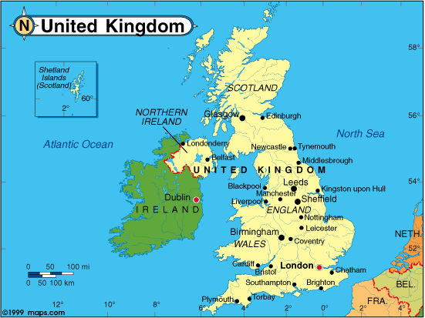
Elektronická učebnice - II. stupeň Základní škola Děčín VI, Na Stráni 879/2 – příspěvková organizace Anglický jazyk
9.3 Great Britain on the map
The United Kigdom is situated in north-west Europe on the Island of Great Britain and the northern part of the island of Ireland.
It consists of four countries:
England, Scotland, Wales and Northern Ireland.
The landscape is mostly hilly, though many of the hills are quite small. In Scotland you can find the Highlands (the Britain´s highest mountain is Ben Nevis, 1 343m). The countryside is very green, there are many fields and pastures. The longest river in the United Kingdom is the Severn, it rises in Wales. The Thames, which flows through London, is the second longest.

Slide 4
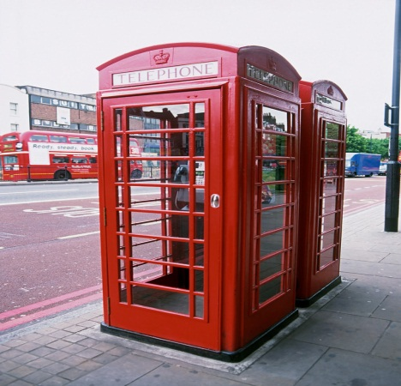
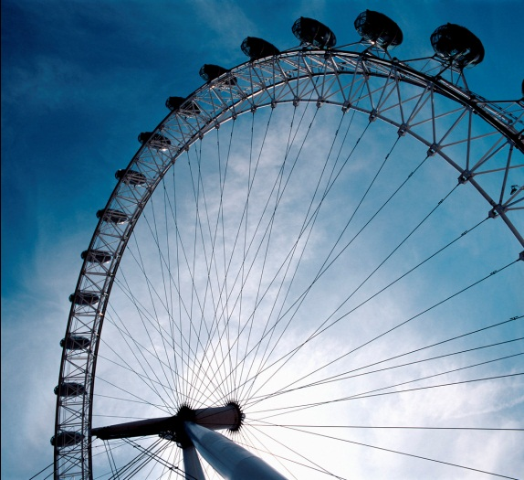
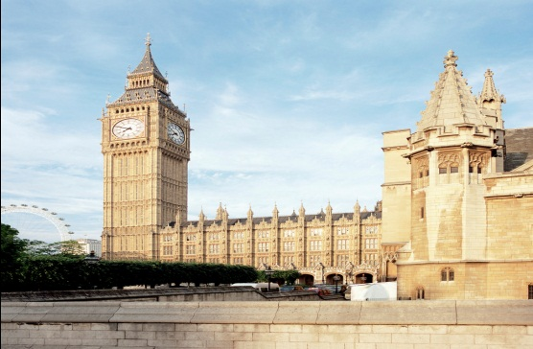
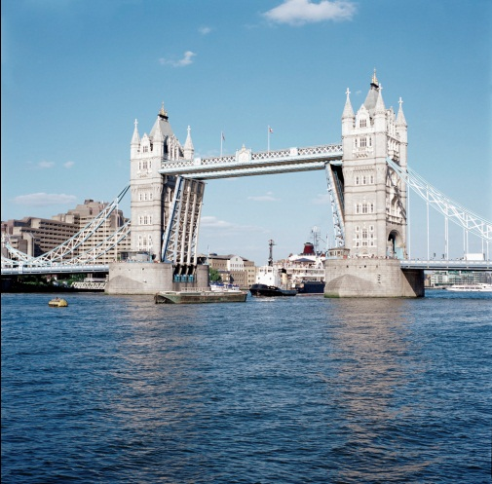
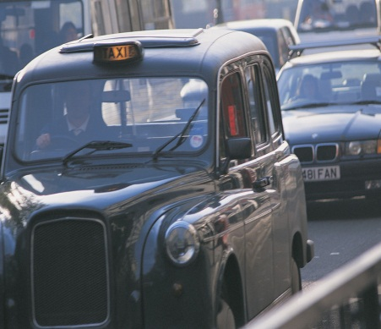
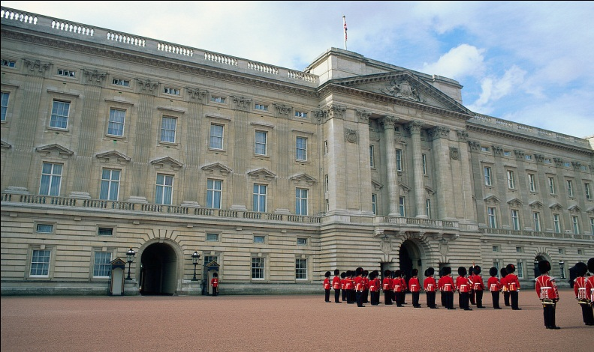
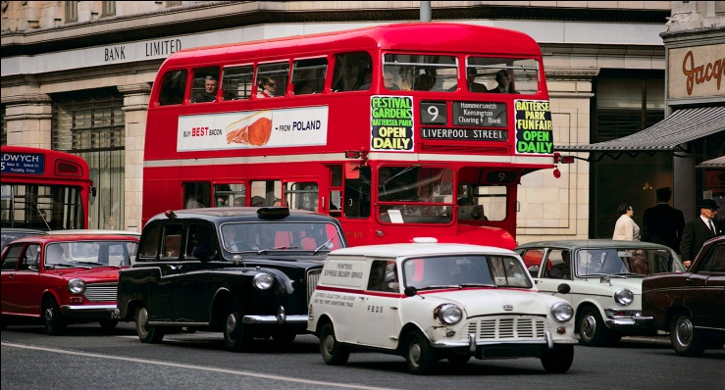
Elektronická učebnice - II. stupeň Základní škola Děčín VI, Na Stráni 879/2 – příspěvková organizace Anglický jazyk
9.4 London
Write the names to the right pictures:
Red doubledeckers The London Eye
Tower Bridge Black taxis
Buckingham Palace The Houses of Parliament Phone box

Slide 5
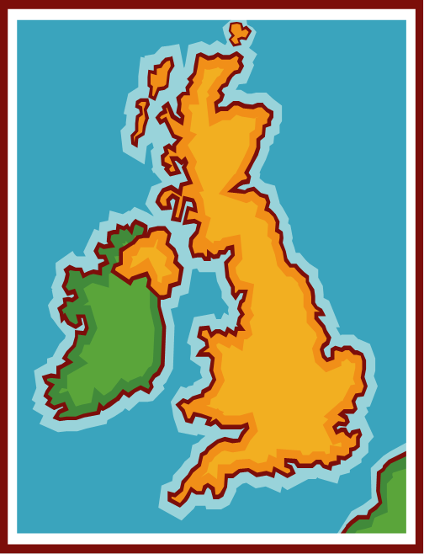
Elektronická učebnice - II. stupeň Základní škola Děčín VI, Na Stráni 879/2 – příspěvková organizace Anglický jazyk
9.5 Exercises
1) Work with the map:
Draw the borders of England, Scotland, Wales and Northern Ireland into the map. Write the names of the countries next to their location.
Draw the location and write the names of the capitals to the correct country:
London Edinburgh Cardiff Belfast
2) Answer these questions:
What basic facts do you know about the United Kingdom?
What river runs through London?
Where is Scotland?
What are some of the famous places to visit in London?

Slide 6
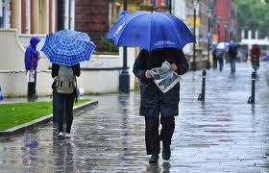
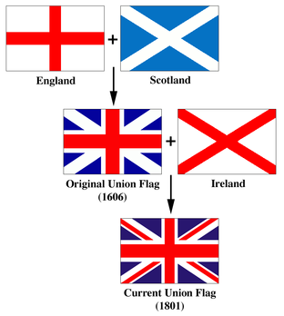
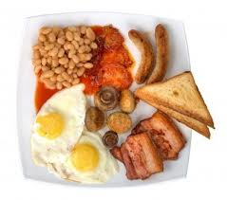
Elektronická učebnice - II. stupeň Základní škola Děčín VI, Na Stráni 879/2 – příspěvková organizace Anglický jazyk
9.6 Something more …..
The country has a temperate climate and it´s famous for its wet weather.
The national flag of the United Kingdom is called the Union Jack.
Traditional English breakfast consists of eggs, bacon, beans, sausages and toasts.

Slide 7
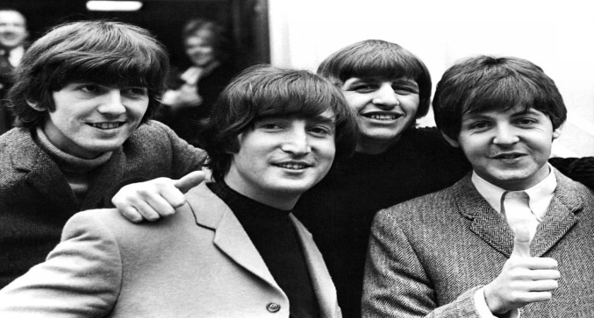
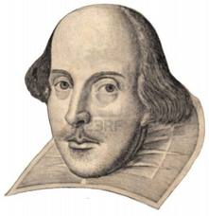
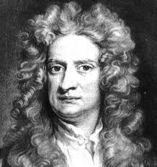
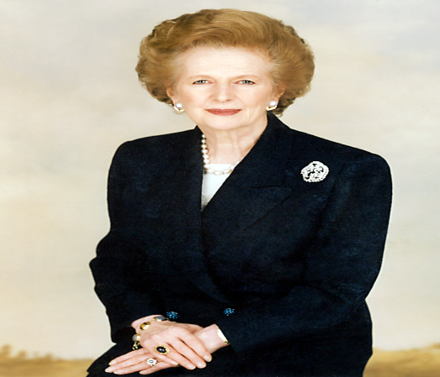
Elektronická učebnice - II. stupeň Základní škola Děčín VI, Na Stráni 879/2 – příspěvková organizace Anglický jazyk
9.7 Some famous people from the United Kingdom
The most famous playwright William Shakespeare lived in London. During his life he wrote 38 plays, 154 sonnets, two long narrative poems, and several other poems.
The Beatles were an English rock band formed in Liverpool in 1960. The group's best-known lineup consisted of John Lennon, Paul McCartney, George Harrison, and Ringo Starr.
Sir Isaac Newton was a theologian, alchemist, natural philosopher, astronomer, mathematician and physicist. He formulated the theory about the nature of life, the theory of universal gravitation and invented differential calculus.
Margaret Thatcher was the United Kingdom's first woman prime minister. She got her nickname “Iron Lady” for a reason. She was the longest-serving British prime minister of the 20th century.

Slide 8
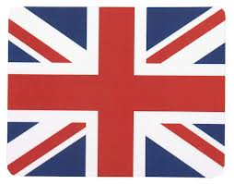

Elektronická učebnice - II. stupeň Základní škola Děčín VI, Na Stráni 879/2 – příspěvková organizace Anglický jazyk
9.8 Revision test
What´s the name of the British national flag?
  God Save the Queen
  The United Jack
  The Union Jack
  The National flag
3) Where is Wales?
  in the west of Britain
  in the north of Britain
  in the east of Britain
  It´s not a part of Britain.
2) What´s the national currency of the UK?
  the British money
  the British euro
  the Brittish dollar
  the British pound
4) What river runs through London?
  the Severn
  the Thames
  the Loch Ness
  Ben Nevis
Correct answers:
  c
  d
  c
  b

Slide 9
Elektronická učebnice - II. stupeň Základní škola Děčín VI, Na Stráni 879/2 – příspěvková organizace Anglický jazyk
9.9 Použité zdroje, citace
http://tangerine-trees-n-marmalade-skies.blogspot.cz/2010/05/beatles-in-hey-jude.html slide 1
http://www.123rf.com/photo_4073767_big-red-london-double-decker-bus-isolated-on-white.html slide 1
http://krajane.czu.cz/geografie-nab/doku.php?id=minority-vb slide 3
http://cs.wikipedia.org/wiki/Vlajka_Spojen%C3%A9ho_kr%C3%A1lovstv%C3%AD slide 6
http://www.123rf.com/photo_5542639_shakespeare-bust.html slide 7
http://slecna.info/blogy/the-beatles-klasika-ktera-te-nenecha-chladnou/ slide 7
http://schoolworkhelper.net/sir-isaac-newton-biography-contributions/ slide 7
http://en.wikipedia.org/wiki/File:Margaret_Thatcher.png slide 7
Obrázky z databáze klipart

Slide 10
Elektronická učebnice - II. stupeň Základní škola Děčín VI, Na Stráni 879/2 – příspěvková organizace Anglický jazyk
9.10 Anotace
Autor | Mgr. Jitka Šolcová
Období | 01– 6/2013
Ročník | 6. ročník
Klíčová slova | Anthem, currency, flag, Great Britain, London, monarchy, United Kingdom
Anotace | Prezentace zaměřená na základní informace o Velké Británii.

