Slide 1
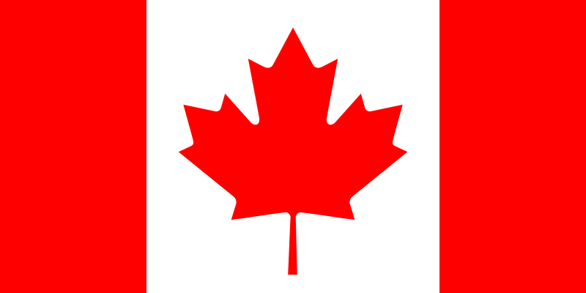
Elektronická učebnice – II. stupeň Základní škola Děčín VI, Na Stráni 879/2 – příspěvková organizace Anglický jazyk
58.1 USA & Canada
the United States of America & Canada
Autor: Mgr. Jitka Šolcová

Slide 2
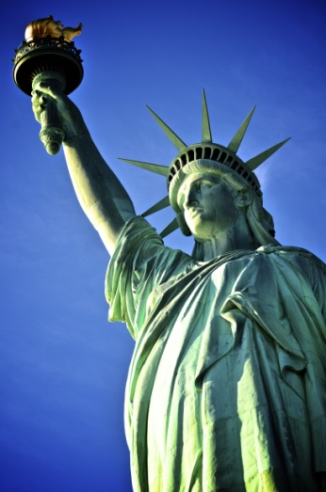
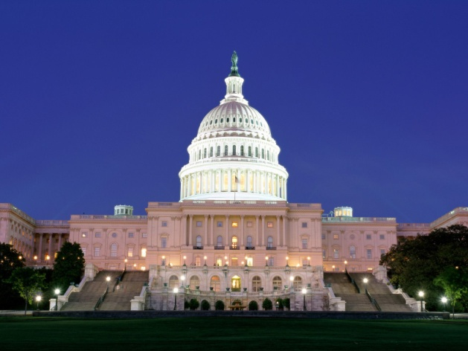
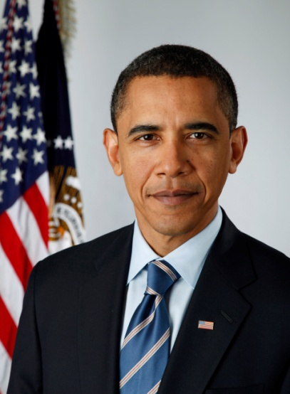
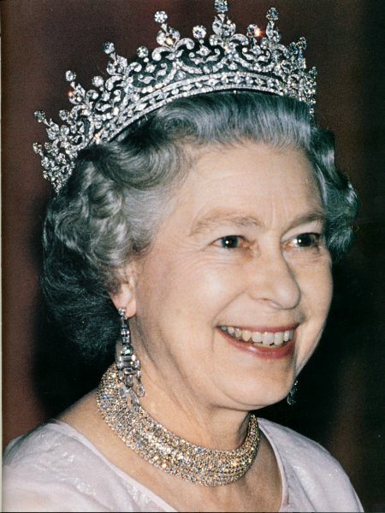
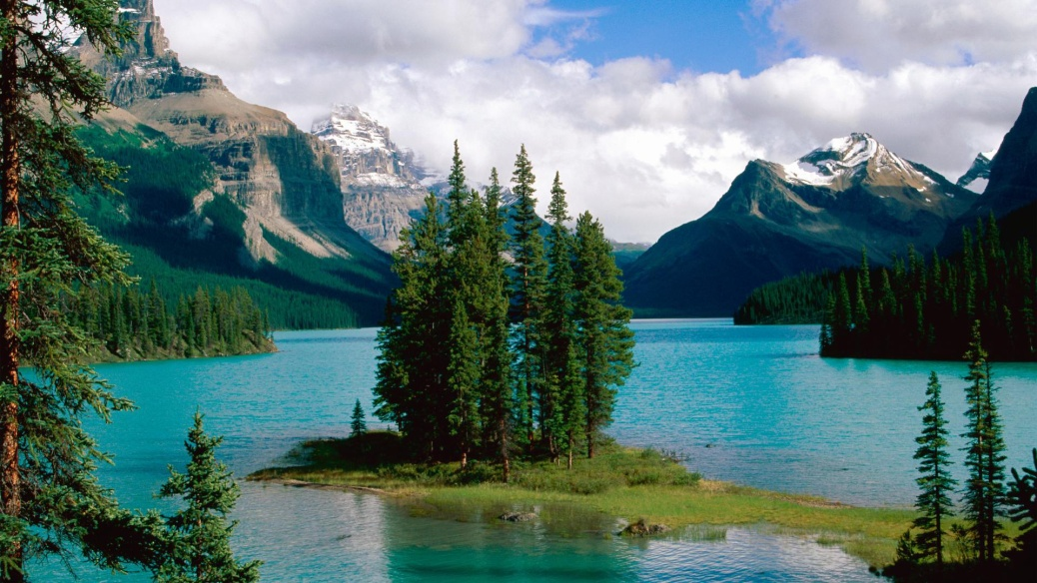
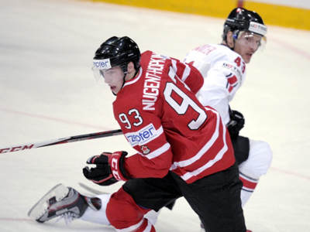
Elektronická učebnice - II. stupeň Základní škola Děčín VI, Na Stráni 879/2 – příspěvková organizace Anglický jazyk
58.2 What do we already know?
the USA
Barack Obama
White House
Statue of Liberty
CANADA
Ice hockey
Queen Elizabeth II
Beautiful nature, lakes

Slide 3
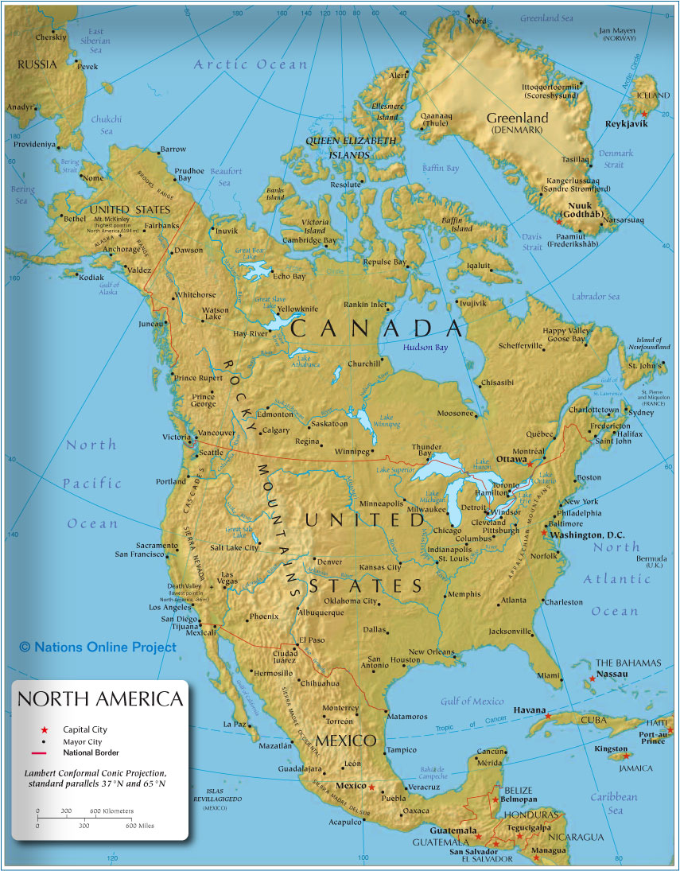
Elektronická učebnice - II. stupeň Základní škola Děčín VI, Na Stráni 879/2 – příspěvková organizace Anglický jazyk
58.3 The USA & Canada on the map
Canada and the USA are both situated in the American continent, in North America.
Canada is located in the northern part of the continent, it extends from the Atlantic to the Pacific. It is the second largest country by total area.
The USA is situated mostly in central North America. It lies between the Pacific and Atlantic Oceans, it‘s bordered by Canada to the north and by Mexico to the south.
The landscape is mostly hilly in the west. You find there mountains „Cordilleras“ which begin on Alaska ridge (highest point Mount McKinley) and extend south in two distinct zones – the Coast Range and the Rocky Mountains. You can find there many large rivers (Mississippi, Missouri, Rio Grande, Colorado, …).

Slide 4
Elektronická učebnice - II. stupeň Základní škola Děčín VI, Na Stráni 879/2 – příspěvková organizace Anglický jazyk
58.4 Something more about the countries
 | the USA | CANADA
The capital city | Washington, D.C. | Ottawa
Provinces, territories: | none, the U.S. is made up of 50 states | 10 provinces and 3 territories
Flag
National currency | United States dollar (USD) | Canadian dollar (CAD)
Head of state | President – Barack Obama (it is a republic) | Queen – Elizabeth II. (it is a monarchy)
Highest mountain | Mt McKinley – 20320 m | Mt Logan (Yukon) – 6050 m
Longest river | Missouri | Mackenzie River
Animals | deer, wolf and domestic animals | beaver, moose, reindeer, bear
Traditional food | hamburgers, hotdogs, steaks | maple syrup, mushrooms
Traditional sport | American football, baseball | ice hockey
Major cities | New York, Chicago, San Francisco Boston, Philadelphia, Washington, D.C. | Toronto, Montreal, Vancouver, Ottawa, Calgary

Slide 5
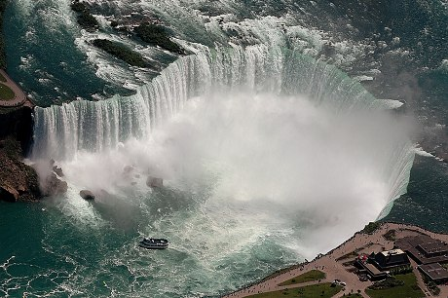
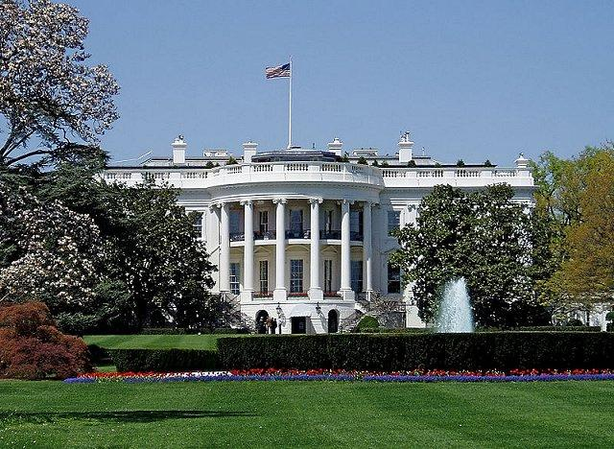
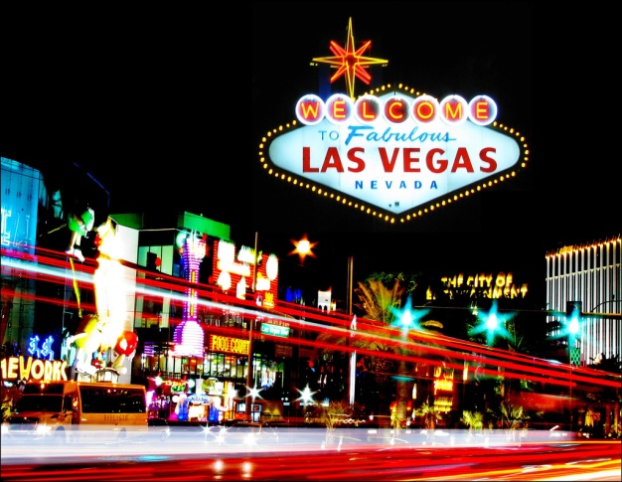
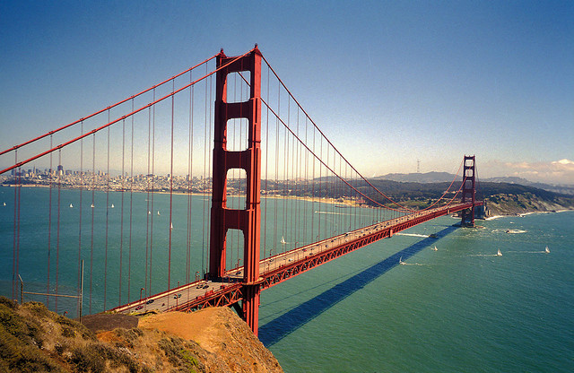
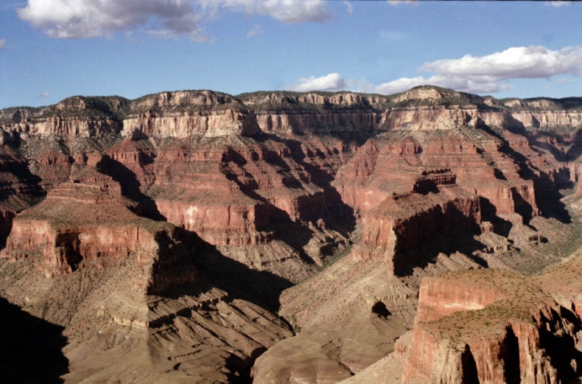
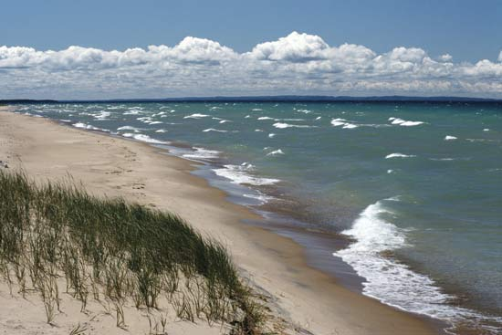
Elektronická učebnice - II. stupeň Základní škola Děčín VI, Na Stráni 879/2 – příspěvková organizace Anglický jazyk
58.5 Something typical for the countries
CANADA
the USA
Niagara Falls is one of the most spectacular natural wonders. It‘s situated between the state of New York and the province of Ontario.
The White House in Washington DC is the official residence of the President of the United States.
Las Vegas, “The gambling mecca of the world“.
The Golden Gate Bridge between San Francisco and Marin County to the north.
The Grand Canyon in northern Arizona.
The Michigan Lake is the largest fresh water lake in the world.

Slide 6
Elektronická učebnice - I. stupeň Základní škola Děčín VI, Na Stráni 879/2 – příspěvková organizace Anglický jazyk
58.6 Exercises
Put the typical words to the correct column.
the USA
CANADA
The Michigan Lake
Ottawa
Mount McKinley
The Grand Canyon
Monarchy
Hockey
Las Vegas
Statue of Liberty
Elizabeth II.
Baseball
Maple syrup
Montreal
Barack Obama
Bears
Second largest country
Mackenzie River
Alaska
Washington, D.C.
50 states
Hamburgers

Slide 7
Elektronická učebnice - I. stupeň Základní škola Děčín VI, Na Stráni 879/2 – příspěvková organizace Anglický jazyk
58.7 Something more difficult
Find :
B | O | S | T | O | N | U | I | P | V | B | L | D | Y | X | Z | I | R | P
T | U | A | S | V | W | Q | H | A | M | B | U | R | G | E | R | I | O | H
R | T | T | Z | E | W | I | O | K | B | U | L | O | P | V | D | E | T | I
M | R | T | B | A | S | E | B | A | L | L | S | L | G | Z | V | Y | E | L
U | O | T | H | J | K | B | G | U | O | R | U | H | R | U | H | J | B | A
Z | T | N | U | P | F | H | J | E | C | H | E | W | R | L | T | I | U | D
N | T | D | T | R | H | Z | B | M | H | U | Z | D | X | O | E | R | T | E
M | A | F | G | R | R | T | V | B | I | Q | Y | D | F | Y | O | H | L | L
E | W | Z | J | K | E | R | G | C | C | H | J | O | R | P | O | M | O | P
R | A | G | T | Z | D | A | H | T | A | S | Y | X | A | E | T | J | S | H
E | R | G | B | V | J | T | L | E | G | E | F | V | C | H | J | H | J | I
F | E | G | V | N | U | Z | R | T | O | R | O | N | T | O | Z | O | K | A
V | U | R | T | M | A | P | L | E | S | Y | R | U | P | E | R | C | K | L
C | I | H | F | T | S | F | R | T | Y | C | W | E | U | T | I | K | I | L
C | H | O | T | D | O | G | Z | K | R | L | G | J | D | A | S | E | R | T
H | U | E | V | B | U | R | T | C | E | R | N | L | I | S | A | Y | P | R
3 major cities from the USA
3 major cities from Canada
2 typical food from the USA
2 typical food from Canada
1 typical sport from the USA
1 typical sport from Canada

Slide 8
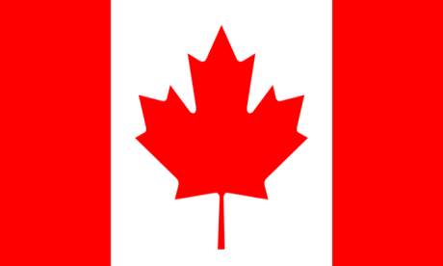
Elektronická učebnice - II. stupeň Základní škola Děčín VI, Na Stráni 879/2 – příspěvková organizace Anglický jazyk
58.8 Revision test
1. Who lives in the White House in Washington, D.C.?
Elizabeth II
President of the USA
President of Canada
Prime minister of the USA
3. What is the common nature wonder of the USA and Canada?
The Statue of Liberty
Niagara Falls
Michigan Lake
The Grand Canyon
2. What is the capital of Canada?
Vancouver
Montreal
Ottawa
Toronto
4. The USA is made up of … states.
49
52
50
30
Correct
answers:
1. b
2. c
3. b
4. c

Slide 9
Elektronická učebnice - II. stupeň Základní škola Děčín VI, Na Stráni 879/2 – příspěvková organizace Anglický jazyk
58.9 Použité zdroje, citace
http://upload.wikimedia.org/wikipedia/en/thumb/c/cf/Flag_of_Canada.svg/800px-Flag_of_Canada.svg.png (slide 1,8)
http://summitvoice.files.wordpress.com/2012/11/fema_-_39841_-_official_portrait_of_president-elect_barack_obama_on_jan-_131.jpg (slide2)
http://static.giantbomb.com/uploads/original/0/2251/969527-washington_dc.jpg (slide 2)
http://4.bp.blogspot.com/-csGWWH4muHo/T8hJm6jGNcI/AAAAAAAAAFk/ko1uQg6pdSU/s1600/Queen+Elizabeth+II.jpg (slide2)
http://www.nationsonline.org/maps/north_america_map_855.jpg (slide3)
http://keithmajor.files.wordpress.com/2011/12/the-statue-of-liberty-2.jpg (slide 3)
http://www.ourhometown.ca/images/photos/RNH_Canada_L.jpg (slide3)
http://image.vectorart5.com/63829059/Travel/Spirit-Island-Maligne-Lake-Jasper-National-Park-Alberta-Canada.jpg (slide 3)
http://resources.touropia.com/gfx/d/famous-official-residences/white_house.jpg (slide 5)
http://omimattress.files.wordpress.com/2012/01/vegas.jpg (slide 5)
http://usa.svetadily.cz/userfiles/image/clanky/usa-niagara-2.jpg (slide 5)
http://www.nps.gov/grca/images/20070921161701.jpg (slide 5)
http://media-1.web.britannica.com/eb-media/40/94740-004-26EFA325.jpg (slide5)

Slide 10
Elektronická učebnice - II. stupeň Základní škola Děčín VI, Na Stráni 879/2 – příspěvková organizace Anglický jazyk
58.10 Anotace
Autor | Mgr. Jitka Šolcová
Období | 01– 06/2013
Ročník | 6.-9. ročník
Klíčová slova | Canada, United States of America
Anotace | Prezentace zaměřená na základní informace o státech USA a Kanada.

