Slide 1
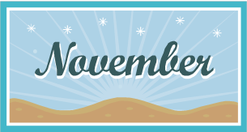
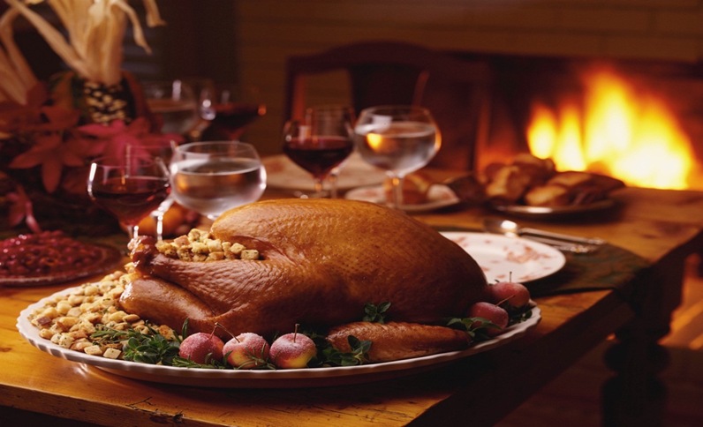

Elektronická učebnice - II. stupeň Základní škola Děčín VI, Na Stráni 879/2 – příspěvková organizace Anglický jazyk
48.1 Thanksgiving Day
last Thursday of each November
Autor: Mgr. Jitka Šolcová

Slide 2
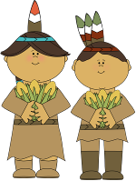
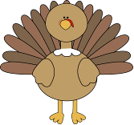
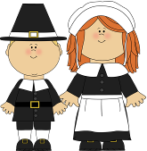

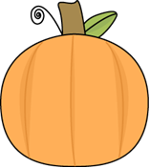
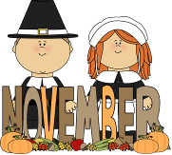
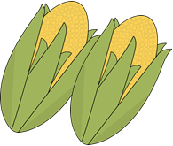
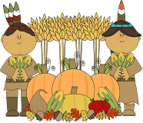
Elektronická učebnice - II. stupeň Základní škola Děčín VI, Na Stráni 879/2 – příspěvková organizace Anglický jazyk
48.2 Vocabulary
turkey
pumpkin
pilgrims
Indians
corn
November
harvest

Slide 3
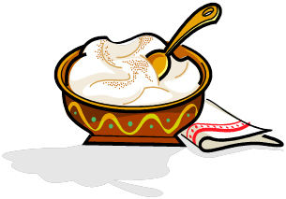
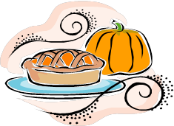
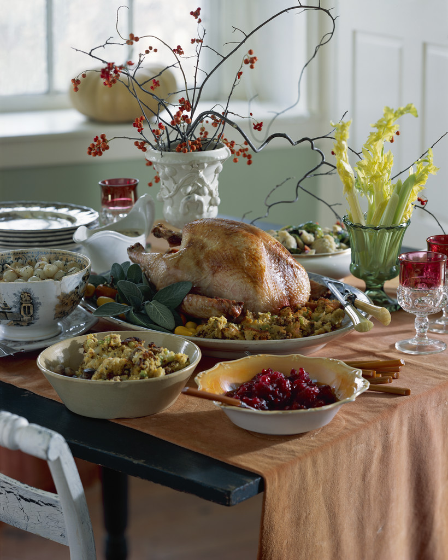
Elektronická učebnice – II. stupeň Základní škola Děčín VI, Na Stráni 879/2 – příspěvková organizace Anglický jazyk
48.3 Traditional dinner
Traditional dinner:
roast turkey
cranberry sauce
mashed potatoes
green beans
pumpkin pie
Why turkey?
Because in the 19th century this bird was cheap and could feed a big family. It was also considered a much more special meat than pork.

Slide 4
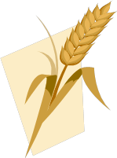
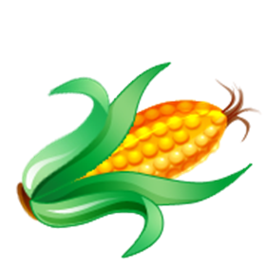
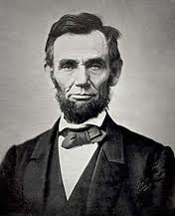
Elektronická učebnice - II. stupeň Základní škola Děčín VI, Na Stráni 879/2 – příspěvková organizace Anglický jazyk
48.4 History – the first Thanksgiving
Write the right form of the verbs in past form
In September 1620, a group of Pilgrims ………………………… (leave) England for a better life in America. They ……………………. (want) to live according to the teachings of the Bible. But when they ………………. (arrive) in the New World they ………………….. (find) that life there was also difficult. They were not prepared for a strange, unknown continent, and many of the Pilgrims ………. (die) during the first, cold winter. In the spring they ……… (have) new problem: How to grow food to eat? But the Native Americans ……… (are) friendly and helpful – they ………. (show) them how to grow corn and other crops. The main hero ………..(is) Squanto, the native American who ………(speak) English. At the end of summer all of the Pilgrims ………..(have) enough food for everyone. To thank the natives for their help, the colonists invited them to a three-day celebration and this was the first „Thanksgiving“.
In 1863 Abraham Lincoln named the Thanksgiving
an official holiday.

Slide 5
Elektronická učebnice - II. stupeň Základní škola Děčín VI, Na Stráni 879/2 – příspěvková organizace Anglický jazyk
48.5 Exercises
Write the right number to the picture:
1. Pilgrims
2. pumpkin
3. cornucopia
4. squash
5. mashed potatoes
6. scarecrow
7. native American
8. straw
9. Mayflower
10. wheelbarrow
11. harvest
12. Thanksgiving dinner
13. gravy
14. turkey
15. cranberry
16. corn

Slide 6

..
Elektronická učebnice - II. stupeň Základní škola Děčín VI, Na Stráni 879/2 – příspěvková organizace Anglický jazyk
48.6 Something more difficult
Listen to the video and answer the following questions http://www.youtube.com/watch?v=wFDSobNnfQs
The first Thanksgiving story
1.- Why did many English people emigrate to Holland?
2.- What happened in Holland?
3.- What was the name of the ship they took to go to America? …………………………………..........................
4.- There were about ……………….….. people aboard the tiny ship. It was ……………….………., …………………..…… and ……………………
5.- In which month did they arrive in America?
6.- How did they feel after the long journey?
7.- By spring time almost ………………………….. of the people died.
8.- What did Squanto (one of the Indians who had visited them during the winter) do?
9. Why did they decide to have a grand Thanksgiving party?
10. They prepared wild ………………………… and geese and great wild ………………..……… There was deer meat, …………………………. and cakes, the fish and the crabs from sea nearby.
12. What were the Indians wearing? (name one)
13. Before they ate the Indians and the pilgrims thanked God together for all their…………………….

Slide 7
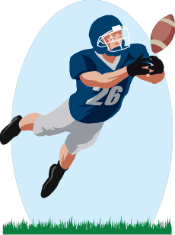
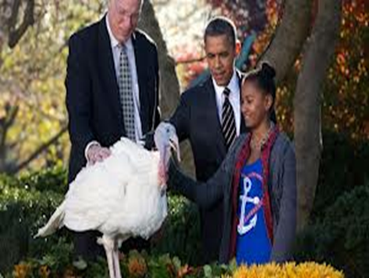
Elektronická učebnice - II. stupeň Základní škola Děčín VI, Na Stráni 879/2 – příspěvková organizace Anglický jazyk
48.7 Modern Thanksgiving traditions
People spend time with their family a friends.
They are thankfull for everything they have in their lives.
It´s time to remember people in need.
Every year the US president „pardons“ one turkey and saves it from death.
Men spend the day watching Ameican football.
The Friday after Thanksgiving is a holiday and people start Christmas shopping.

Slide 8
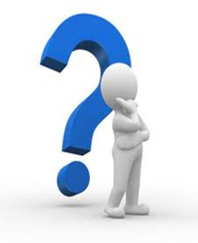
Elektronická učebnice - II. stupeň Základní škola Děčín VI, Na Stráni 879/2 – příspěvková organizace Anglický jazyk
48.8 Revision test
When is Thanksgiving celebrated?
a) the first Thursday in November
b) the last Tuesday in October
c) the first Thursday in October
d) the last Thursday in November
When did Americans start to celebrate the Thanksgiving as an national holiday?
a) in 18th century
b) in 19th century
c) in 20th century
d) it isn´t national holiday
What is not traditional Thanksgiving dinner?
a) apple pie
b) pumpkin pie
c) mashed potatoes
d) roast turkey
4) Why did Pilgrims leave England?
a) for a new adventure
b) for new friends
c) for better meal
d) for a better life
Correct answers:
1)d 2)a 3)b 4)d

Slide 9
Elektronická učebnice - II. stupeň Základní škola Děčín VI, Na Stráni 879/2 – příspěvková organizace Anglický jazyk
48.9 Použité zdroje, citace
http://en.wikipedia.org/wiki/Abraham_Lincoln slide 4
http://en.islcollective.com/worksheets/worksheet_page?id=35747 slide 1
Obrázky z databáze klipart

Slide 10
Elektronická učebnice - II. stupeň Základní škola Děčín VI, Na Stráni 879/2 – příspěvková organizace Anglický jazyk
48.10 Anotace
Autor | Mgr. Jitka Šolcová
Období | 01– 6/2013
Ročník | 6. – 9. ročník
Klíčová slova | Corn, harvest, Indians,November, pilgrims, pumpkin, thanksgiving, Thursday, turkey.
Anotace | Prezentace zaměřená na americký státní svátek Thanksgiving Day.

