Slide 1



Elektronická učebnice - II. stupeň Základní škola Děčín VI, Na Stráni 879/2 – příspěvková organizace Anglický jazyk
45.1 Tense review
(souhrn časů - zásobník)
Can you see the difference between these two words?
TIME
What´s the time?
Time is up.
Time is money.
Time heals all wounds.
It´s time to go.
It is a matter of time.
spend / save / waste your time
B) TENSE
Tense is a grammar concept.
E.g. Present tense doesn´t always refer to present time.
If it rains tomorrow, I will not come.
(rains is in present tense but it refers to the future)
Autor: Mgr. Michaela Kaplanová

Slide 2

Elektronická učebnice - II. stupeň Základní škola Děčín VI, Na Stráni 879/2 – příspěvková organizace Anglický jazyk
45.2 Present simple
USE
- General truths (It snows in winter.)
- Permanent situations (I love chocolate.)
- Repeated actions (I sometimes visit him at home.)
- First and zero conditionals (If I find the key, I will let you know.)
- Scheduled future actions (The train leaves at 9.30)
Signal words
adverbs of frequency (sometimes, usually, never…)
every week
on Mondays
FORM (auxiliary and modal verbs = exceptions)
+ -s ending in the 3rd person sg.
- don´t / doesn´t + main verb
? Do / Does + subject + main verb
short answers Yes, I do. No, I don´t. Yes, he does. No, he doesn´t.
SPELLING EXCEPTIONS
Verbs ending in o, ch, sh, s, x add -ES (not –S) in the 3rd person sg.
wash - washes
go - goes
do - does
SEE DUM number 5

Slide 3
Elektronická učebnice - II. stupeň Základní škola Děčín VI, Na Stráni 879/2 – příspěvková organizace Anglický jazyk
45.3 Present continuous
USE
- Activities happening now (He is watching TV at the moment.)
- Activities happening around present moment (I am reading an interesting book.)
- Planned events in the future (I am meeting Joe on Friday.)
- Describing pictures / photos (He is driving a car in this photo.)
SEE DUM number 12
Signal words
at the moment
(right) now
Listen!
Look!
In this photo / picture
FORM
+ the verb to be and the main verb + ing
- Negative form of the verb to be
? to be + subject + ing form of the main verb
short answers Yes, I am. No, I am not. Yes, he is. Etc.
SPELLING EXCEPTIONS
consonant after a short, stressed vowel at the end of the word – double the consonant
hit – hitting, put – putting, sit - sitting
one -e at the end of the word – leave out the –e
dance – dancing, write - writing
verbs ending in –ie - change ie to y
lie – lying, die - dying

Slide 4
Elektronická učebnice - II. stupeň Základní škola Děčín VI, Na Stráni 879/2 – příspěvková organizace Anglický jazyk
45.4 Past simple
SEE DUM number 22, 24
USE
- Completed action in the past (I saw him yesterday.)
- More completed actions in the past (I came home, opened the window and switched on the TV.)
- Past simple interrupted an action which was in progress in the past (past continuous). (She was having dinner when the telephone rang.)
Signal words
yesterday
in 2001
a week ago
last summer
on Wednesday
last year
FORM
+ main verb + -ed (regular verbs)
- didn´t + main verb in the present form
? Did + subject + present form of the main verb
short answers Yes, I did. No, I didn´t.
MIND THE EXCEPTIONS
e.g. modal verbs, the verb to be…
REVISE THE IRREGULAR VERBS!!!
SPELLING EXCEPTIONS (regular verbs)
consonant after a short, stressed vowel at the end of the word – double the consonant
stop – stopped, plan - planned
one -e at the end of the word – leave out the –e
dance – danced
verbs ending consonant + y – change
–y to –i
hurry - hurried

Slide 5
Elektronická učebnice - II. stupeň Základní škola Děčín VI, Na Stráni 879/2 – příspěvková organizace Anglický jazyk
45.5 Past continuous
SEE DUM number 26
USE
Specific time in the past (Yesterday at 6 I was writing my homework.) – I was in the middle of the action.
Interrupted action in the past (I was having lunch when he called.)
Two longer actions happening at the same time in the past (I was watching TV while he was studying for the test.)
Signal words
When
While
As long as
FORM
+ was/were and the main verb + ing
- wasn´t/weren´t and the main verb + ing
? Was/were + subject + ing form of the main verb
short answers Yes, I was. No, I wasn´t. Yes, you were. Etc.
SPELLING EXCEPTIONS – see slide 3

Slide 6
Elektronická učebnice - II. stupeň Základní škola Děčín VI, Na Stráni 879/2 – příspěvková organizace Anglický jazyk
45.6 Future with WILL and BE GOING TO
USE – WILL
offers (nabídky)
I will help you with the bags.
decisions (rozhodnutí)
We will go by bus.
predictions (předpovědi)
You will like my friend.
(BUT we are not sure!!!)
USE – BE GOING TO
- planned future (plánovaná budoucnost)
I´m going to visit my parents tomorrow.
- more certain predictions (jistější předpovědi, na základě známé okolnosti)
There are dark clouds, it´s going to rain.
FORM – BE GOING TO
+ the verb to be + going to + main verb
- neg. form of the verb to be + going to + main verb
? the verb to be + subject + going to + main verb
short answers Yes, I am. No, I am not.
Yes, you are. No, you are not (aren´t).
FORM - WILL
+ will + main verb
- will not (won´t) + main verb
? Will + subject + main verb
short answers Yes, I will. No, I wasn´t.
For other ways how to express future see DUM number 20.

Slide 7
Elektronická učebnice - II. stupeň Základní škola Děčín VI, Na Stráni 879/2 – příspěvková organizace Anglický jazyk
45.7 Present perfect
SEE DUM number 30, 31
USE
- Past event – the exact time is not important (I have already met him.)
- Past event with the result in the present (I have lost my keys. – I haven´t got them.)
- Event beginning in the past and continuing up to present (We have known each other since 2005.)
- Recently completed actions (I have just eaten my lunch.)
FORM
+ have (has) + past participle
- haven´t (hasn´t) + past participle
? Have (has) + subject + past participle
short answers Yes, I have. No, I haven´t. Yes, he has. Etc.
Signal words
Just
Already
Yet
Ever
Never
For
Since
How long… ?
How many times…?
for SPELLING EXCEPTIONS (regular verbs) see slide 4
REVISE THE IRREGULAR VERBS
written
done
seen
spoken
been
gone

Slide 8
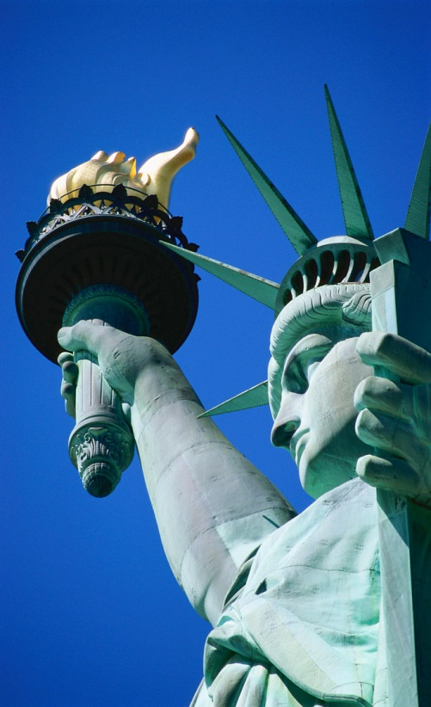
Elektronická učebnice - II. stupeň Základní škola Děčín VI, Na Stráni 879/2 – příspěvková organizace Anglický jazyk
Elektronická učebnice - II. stupeň Základní škola Děčín VI, Na Stráni 879/2 – příspěvková organizace Anglický jazyk
45.8 Past perfect
SEE DUM number 41
USE
- Completed action before another action in the past (I had never seen such a beautiful woman before I met you.)
- Action that started in the past and continued up till another past event ( They had lived in Boston before they moved to New York.)
- 3rd conditional (If I had seen him I would have talked to him.)
FORM
+ had + past participle
- hadn´t + past participle
? Had + subject + past participle
short answers Yes, I had. No, I hadn´t. Yes, he had. Etc.
Signal words
Just
Already
Never
For
Since
How long… ?
WITH REFERENCE TO THE PAST, NOT TO THE PRESENT!!!
for SPELLING EXCEPTIONS (regular verbs) see slide 4

Slide 9
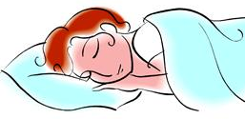
Elektronická učebnice - II. stupeň Základní škola Děčín VI, Na Stráni 879/2 – příspěvková organizace Anglický jazyk
45.9 Revision
Prepare a crossword with past simple forms of the following verbs:
Describe in 150 words:
- what you were doing yesterday afternoon
- your favourite fairy tale
- your daily habits
- your plans for next summer
- what you are doing at this moment
- something that you have never done
- something that you had done before you had breakfast this morning

Slide 10
Elektronická učebnice - II. stupeň Základní škola Děčín VI, Na Stráni 879/2 – příspěvková organizace Anglický jazyk
45.10 Použité zdroje, citace
Obrázky z databáze klipart

Slide 11
Elektronická učebnice - II. stupeň Základní škola Děčín VI, Na Stráni 879/2 – příspěvková organizace Anglický jazyk
45.11 Anotace
Autor | Mgr. Michaela Kaplanová
Období | 01 – 06/2013
Ročník | 6.-9. ročník
Klíčová slova | Tenses, present, past, future
Anotace | Prezentace shrnující všechny slovesné časy, se kterými se žáci setkali na 2. stupni ZŠ.

