Slide 1
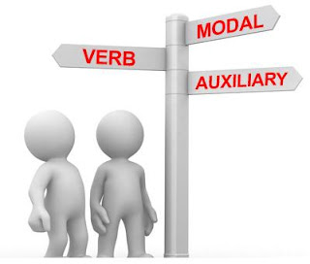
Elektronická učebnice - II. stupeň Základní škola Děčín VI, Na Stráni 879/2 – příspěvková organizace Anglický jazyk
44.1 Auxiliary and modal verbs
(pomocná a modální slovesa)
HAVE
DO
BE
WILL
SHOULD
Any more questions? Check THIS.
etc…
Autor: Mgr. Michaela Kaplanová

Slide 2
Elektronická učebnice - II. stupeň Základní škola Děčín VI, Na Stráni 879/2 – příspěvková organizace Anglický jazyk
44.2 What do we already know?
1.
We know the following verb forms using auxiliary verbs:
Continuous (progressive) tenses
PRESENT - All my friends are swimming in our swimming pool at the moment.
PAST – The dogs were running in the garden yesterday afternoon.
2. Perfect tenses
PRESENT – I have never cooked dinner for my family.
PAST – My boyfriend had given me a beautiful ring.
Passive voice
PRESENT – I´m invited to a party by my friends.
PAST – The book was written by a famous author.
2.
We can form negatives and questions using DO/DID.
3.
We know some of the modal verbs (can, must, should, will…).

Slide 3
Elektronická učebnice - II. stupeň Základní škola Děčín VI, Na Stráni 879/2 – příspěvková organizace Anglický jazyk
44.3 New terms
auxiliary verbs – pomocná slovesa
modal verbs – způsobová (modální) slovesa
Modal verb is a type of auxiliary verb.
progressive (continuous) – průběhový
etc – a tak dále
main verb – (plno)významové sloveso
carry the meaning – nést význam
own - vlastní
Modal verbs have the same form for all persons.
Modal verbs are followed by the basic form of the main verb.
obligation - povinnost
ability - schopnost
advice - rada
opinion - názor
prohibition – zákaz
possibility – možnost
permission – povolení
probability - pravděpodobnost
Modal verbs express:
obligation
ability
advice
opinion
prohibition…

Slide 4
Elektronická učebnice - II. stupeň Základní škola Děčín VI, Na Stráni 879/2 – příspěvková organizace Anglický jazyk
44.4 Auxiliary verbs – BE, DO, HAVE
They don´t carry the meaning, the meaning goes with the main verb.
The verbs BE, DO, HAVE can be main verbs as well, then they have its own meaning. E.g.:
I am your friend.
Let´s do your homework.
I have a cousin in the USA.
I am working.
We have done it .
He didn´t go to school.
I was writing the letter.
It is paid by him.
AUX.
VERB
MAIN VERB

Slide 5
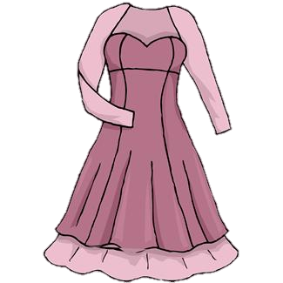
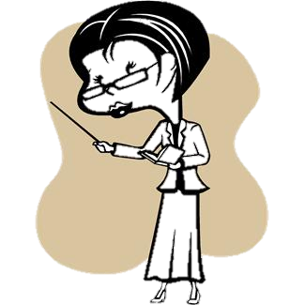
Elektronická učebnice - II. stupeň Základní škola Děčín VI, Na Stráni 879/2 – příspěvková organizace Anglický jazyk
44.5 Exercises
Decide whether the verb be, do or have is main or auxiliary:
My uncle has seen the new car.
You did your homework, didn´t you?
They were working the whole afternoon yesterday.
We were in the shopping centre yesterday.
Do you really think I am clever?
I have a nice dress for the party tonight.
Fill in the correct auxiliary verb:
The game ______ played by the whole class.
The woman ______ shown me the glasses before I went in.
______ he go to school on Wednesday?
My teacher ______ like when we are late.
I ______ seen my aunt since 1995.

Slide 6
Elektronická učebnice - II. stupeň Základní škola Děčín VI, Na Stráni 879/2 – příspěvková organizace Anglický jazyk
44.6 Something more difficult – MODAL VERBS
1.
CAN (COULD)
COULD = past tense
Similar meaning - BE ABLE TO (possibility, ability)
- BE ALLOWED TO (permission)
2.
MUST (obligation)
Only in the present tense
HAVE TO in past and future tenses
MUST – muset
MUSTN´T – nesmět
DON´T HAVE TO - nemuset
3.
WILL (WOULD)
Future or suggestion (Will you marry me?)
WOULD = bych (podmínka)
MODAL VERBS
4.
SHOULD (giving advice)
Similar meaning – OUGHT TO
don´t take –s in the 3rd person sg.
use NOT to make them negative
some can´t be used in past or future tense
5.
MAY (MIGHT)
We are not sure → maybe
MIGHT – less probable
She might be at home.

Slide 7
Elektronická učebnice - II. stupeň Základní škola Děčín VI, Na Stráni 879/2 – příspěvková organizace Anglický jazyk
44.7 CLIL
Find the auxiliary or modal verb and find out the name of the school subject
I really don´t know what happened in this year.
You must run very fast to be the winner.
You can use the dictionary to find the meaning of the word.
1620
You should clean the desk after you draw the picture.
It might be difficult to find this city on the map.
I have already switched off the computer.

Slide 8
Elektronická učebnice - II. stupeň Základní škola Děčín VI, Na Stráni 879/2 – příspěvková organizace Anglický jazyk
44.8 Test
3. In which sentence is not an auxiliary verb?
I haven´t been ill since 1999.
We were smiling all the time.
I wouldn´t do that.
It is said that she knows her.
Choose the correct auxiliary verb:
The flowers ______ watered by the gardener.
have
were
have to
was
2. Which verb is not modal?
could
must
would
was
4. Which sentence contains both an auxiliary and a main verb?
What do you do?
I can´t swim.
She likes watching movies.
They might have a baby.
Correct answers: 1b, 2d, 3c, 4a

Slide 9
Elektronická učebnice - II. stupeň Základní škola Děčín VI, Na Stráni 879/2 – příspěvková organizace Anglický jazyk
44.9 Použité zdroje, citace
http://nidiacolors.blogspot.com/ - slide 1
Obrázky z databáze klipart

Slide 10
Elektronická učebnice - II. stupeň Základní škola Děčín VI, Na Stráni 879/2 – příspěvková organizace Anglický jazyk
44.10 Anotace
Autor | Mgr. Michaela Kaplanová
Období | 01 – 06/2012
Ročník | 7.- 9. ročník
Klíčová slova | Auxiliary verbs, be, do, have, modal verbs
Anotace | Prezentace shrnující užití, významy a tvary základních pomocných a modálních sloves v angličtině.

