Slide 1


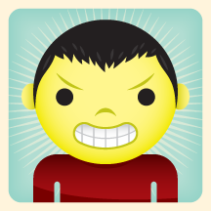

Elektronická učebnice - II. stupeň Základní škola Děčín VI, Na Stráni 879/2 – příspěvková organizace Anglický jazyk
43.1 Reported questions, reported commands, eating out
What do these people say?
Use the direct speech to give your suggestions.
Autor: Mgr. Michaela Kaplanová

Slide 2
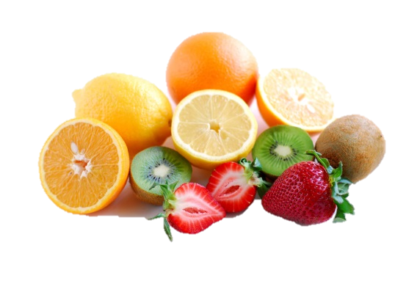
Elektronická učebnice - II. stupeň Základní škola Děčín VI, Na Stráni 879/2 – příspěvková organizace Anglický jazyk
43.2 What do we already know?
REPORTED STATEMENTS (see DUM 42)
He told me that…
She said that…
REVISE THE TENSE CHANGES!
FORMING QUESTIONS
Do you like…?
Has he got…?
Are you…?
Can Katie…?
Will you…?
…
OBJECT PRONOUNS (see DUM 19)
Your father told me…
He ordered you…
She asked him…
He told her…
They ordered us…
I asked them…
THE IMPERATIVE
Don´t do that!
Go away!
Sit down.
Don´t waste your time.
FOOD AND EATING VOCABULARY (see e.g. DUM 15)
Look here. How many words can you remember after one minute?

Slide 3
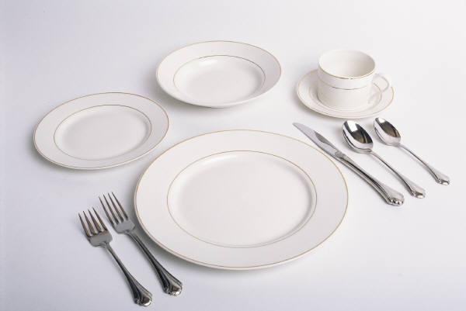
Elektronická učebnice - II. stupeň Základní škola Děčín VI, Na Stráni 879/2 – příspěvková organizace Anglický jazyk
43.3 New terms - Eating out - vocabulary
cup
saucer
bowl
knife
plate
soup spoon
The meal is…
delicious
tasty
salty
nice
just right
burnt
overdone
fresh
spicy
superb
fork
dessert spoon
teaspoon
side plate
jug
pepper
napkin
glass
salt

Slide 4
Elektronická učebnice - II. stupeň Základní škola Děčín VI, Na Stráni 879/2 – příspěvková organizace Anglický jazyk
43.4 Reported questions, Reported commands
Reported questions
"Do you speak English, Tom?" => I asked Tom if he spoke English.
"What is your mother doing, Harry?" => I asked Harry what his mother was doing.
"Did you meet your sister, Kate?" => I asked Kate if she had met her sister.
!!! Mind the tense change and the change of pronouns !!!
!!! The word order in reported questions is the same as in affirmative sentences !!!
!!! We don´t use DO / DOES in reported questions ( see the first example) !!!
Reported commands
"Sit down, Tom." => I told Tom to sit down.
"Be quiet." => He ordered me to be quiet.
"Don´t go there!" => She told him not to go there.
The form of the reported command is:
subject + told, asked, ordered… + object + (not) to + base form of the verb
He asked me (not) to buy the tickets.
For the reporting verbs (tell, ask, order…) see slide 6.

Slide 5
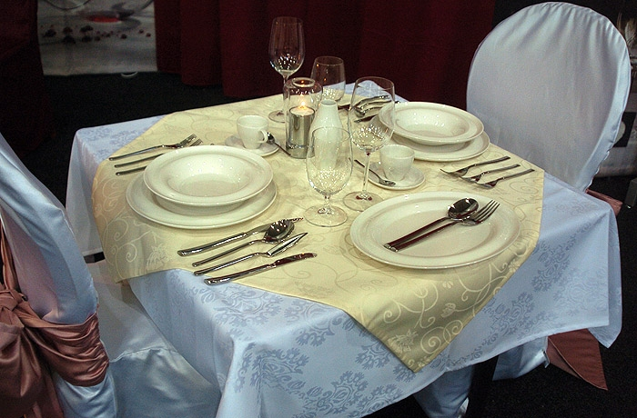
Elektronická učebnice - II. stupeň Základní škola Děčín VI, Na Stráni 879/2 – příspěvková organizace Anglický jazyk
43.5 Exercises
Transform these sentences into reported commands and questions. Use different reporting verbs.
I => he
Can you swim?
You => your friend
Stop it.
She => I
What´s your name?
The teacher => they
What was the homework?
The teacher => she
Don´t copy during the test!
My parents => I
Wash your hands.
Describe the table in whole sentences.
Write a short paragraph about your eating habits.
going to the restaurant
food in the school canteen
you and cooking
fast food …

Slide 6
Elektronická učebnice - II. stupeň Základní škola Děčín VI, Na Stráni 879/2 – příspěvková organizace Anglický jazyk
43.6 Something more difficult
REPORTING VERBS for REPORTED COMMANDS
He ordered...
He asked...
He advised...
He commanded...
He reminded…
He warned…
Phrase changes in direct and reported speech
Direct Speech | Reported Speech
now | then
this, these | that, those
here | there
today | that day
this afternoon | that afternoon
tonight | that night
next week | the following week
yesterday | the day before
last night, last week | the night before, the week before
two weeks ago | two weeks before
REPORTING VERBS for REPORTED QUESTIONS
He asked...
He wanted to know...
He wondered...
He enquired...

Slide 7
Elektronická učebnice - II. stupeň Základní škola Děčín VI, Na Stráni 879/2 – příspěvková organizace Anglický jazyk
43.7 Revise the indirect speech with The Little Red Riding Hood
Change this part of the fairy tale into indirect speech. Use different reporting verbs. You can check it here.
The Little Red Riding hood came into the forest and met a hungry wolf.
"Where are you going?" the wolf asked.
"I'm going to my Grandma. It's her birthday today and so I'm taking her this basket with a cake and wine," she replied.
"Mmmm," thought the wolf. "Perhaps I could eat the little girl and her grandmother." Then he got an idea. "Can you see those nice flowers?" he asked.
"Yes," said the girl.
"Does your grandma like flowers?"
"I think so," the girl answered.
"Then go and pick some for her," the wolf said. "I'm sure she will
love them."
"Umm, I don't know," Red Riding Hood said. "My mother told me not
to leave the road."
"But you can always come back to the road later," the wolf tried.
"Okay, then," the girl said.

Slide 8
Elektronická učebnice - II. stupeň Základní škola Děčín VI, Na Stráni 879/2 – příspěvková organizace Anglický jazyk
Elektronická učebnice - II. stupeň Základní škola Děčín VI, Na Stráni 879/2 – příspěvková organizace Anglický jazyk
43.8 Test
Which reporting verb doesn´t belong to the others (mind the meaning)?
order
shout
warn
say
3. Fill in the missing words:
Direct speech: Did you visit your grandparents?
Reported speech: He asked me ____ I ____ visited ___ grandparents.
where, had, her
if, have, his
if, had, my
when, have, mine
2. Can you find a mistake in one of the sentences?
She asked they if they liked the movie.
He asked me what the teacher was talking about.
The soldier ordered me not to go there.
They told him to be more polite.
4. Odd one out
saucer
tire
napkin
jug
Correct answers: 1d, 2a, 3c, 4b

Slide 9
Elektronická učebnice - II. stupeň Základní škola Děčín VI, Na Stráni 879/2 – příspěvková organizace Anglický jazyk
43.9 Použité zdroje, citace
Obrázky z databáze klipart
http://www.novinky.cz/bydleni/tipy-a-trendy/139050-obrazem-moderni-talire-pro-vas-stul.html - slide 5
http://www.helpforenglish.cz/article/2006032601-neprima-rec-2 - slide 7

Slide 10
Elektronická učebnice - II. stupeň Základní škola Děčín VI, Na Stráni 879/2 – příspěvková organizace Anglický jazyk
43.10 Anotace
Autor | Mgr. Michaela Kaplanová
Období | 01 – 06/2013
Ročník | 9. ročník
Klíčová slova | Reported commands, reported questions, eating out
Anotace | Prezentace rozšiřující znalosti žáka o nepřímé řeči, soustřeďující se na nepřímé otázky a nepřímé příkazy a prezentující slovní zásobu na téma stolování.

