Slide 1
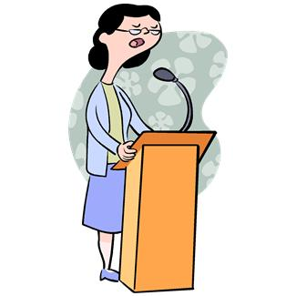
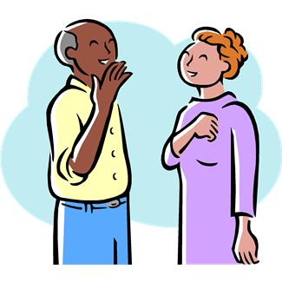
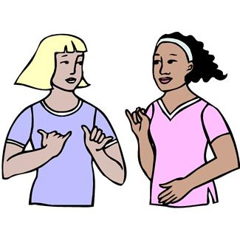
Elektronická učebnice - II. stupeň Základní škola Děčín VI, Na Stráni 879/2 – příspěvková organizace Anglický jazyk
42.1 Reported statements
(Nepřímá řeč)
What are these people talking about?
What did they say?
What have they said?
What are they going to say?
Any more questions? Check THIS.
Autor: Mgr. Michaela Kaplanová

Slide 2
Elektronická učebnice - II. stupeň Základní škola Děčín VI, Na Stráni 879/2 – příspěvková organizace Anglický jazyk
42.2 What do we already know?
We know the following tenses:
Present simple
Present continuous – DUM # 12
Future simple (will) – DUM # 20
Future with going to – DUM # 20
Past simple – DUM # 22, 24
Past continuous – DUM # 26
Present perfect – DUM # 30, 31
Past perfect – DUM # 41
We know how to use direct and indirect speech in the Czech language.

Slide 3
Elektronická učebnice - II. stupeň Základní škola Děčín VI, Na Stráni 879/2 – příspěvková organizace Anglický jazyk
42.3 New terms
REPORTING VERBS – uvozovací slovesa
say – říci (něco)
tell – říci (někomu něco)
ADVANCED REPORTING VERBS pokročilá uvozovací slovesa
order - nařídit
ask – zeptat se, poprosit
promise - slíbit
shout - křičet
offer - nabídnout
admit - připustit
agree - souhlasit
suggest - navrhnout
advise - poradit
explain - vysvětlit
recommend – doporučit
warn - varovat
direct speech – přímá řeč
indirect speech – nepřímá řeč
reported speech – nepřímá řeč

Slide 4
Elektronická učebnice - II. stupeň Základní škola Děčín VI, Na Stráni 879/2 – příspěvková organizace Anglický jazyk
42.4 Reported statements
IS => WAS
Study this chart and focus on the TIME CHANGES
HAVE => HAD
GO => WENT
SAW => HAD SEEN
WILL => WOULD
HAD GONE => HAD GONE
CAN => COULD
HAVE DONE => HAD DONE
WAS => HAD BEEN

Slide 5
Elektronická učebnice - II. stupeň Základní škola Děčín VI, Na Stráni 879/2 – příspěvková organizace Anglický jazyk
42.5 Exercises
She said that…
Carol is very talkative. What did she say?
" Tim has a new girlfriend. "
" The party is over. "
" There is a storm coming. "
" My cousin went home. "
" A new planet has been discovered ".
" They are winning 7:3 ".
" We are best friends. "
" There will be a sale on Friday. "
" I can speak French. "

Slide 6
Elektronická učebnice - II. stupeň Základní škola Děčín VI, Na Stráni 879/2 – příspěvková organizace Anglický jazyk
42.6 Something more difficult
1.
REPORTING VERBS
Tell + object (to whom we speak)
I told the boy that he was my best friend.
The teacher told his pupil that he couldn´t behave like that.
Say (+ to + object)
I said that he was my best friend.
The teacher said to the pupil that he couldn´t behave like that.
2.
There are no tense changes if the reporting verb is in the present tense.
My mother: "I don´t want to go shopping."
My mother says that she doesn´t want to go shopping.
3.
We CAN but DON´T HAVE TO use the word that in reported speech.
She said that she couldn´t swim. = She said she couldn´t swim.
4.
Mind the logical changes:
"My grandparents gave me a lot of money."
He said that his grandparents had given him a lot of money.

Slide 7
Elektronická učebnice - II. stupeň Základní škola Děčín VI, Na Stráni 879/2 – příspěvková organizace Anglický jazyk
42.7 Reported speech – songs
What is the direct speech and what is the name of the interpreter?
1.
He said he wanted to break free.
4.
She said if she had been a boy even just for a day she would have rolled out of bed in the morning.
2.
She said every night in her dreams she saw him she felt him.
5.
They said they were the champions.
3.
She said that she had been cheated by him since she didn´t know when.
6.
He said somebody had once told him the world was gonna roll him.
Queen
Celine Dion
Abba
Beyonce
Queen
Smash Mouth

Slide 8
Elektronická učebnice - II. stupeň Základní škola Děčín VI, Na Stráni 879/2 – příspěvková organizace Anglický jazyk
42.8 Test
Choose the correct reported speech:
My boyfriend: „I don´t love you anymore."
He said that he doesn´t loved me anymore.
He said he didn´t love me anymore.
He told me that he didn´t loved me anymore.
He told that he didn´t love me anymore.
3. What is NOT the direct speech for this sentence – He admited that his cousin had been ill?
My cousin is ill.
My cousin had been ill.
My cousin was ill.
My cousin have been ill.
4. Which verb change is NOT correct?
was => had been
will => would
can => could
am working => were working
2. Which verb CAN´T be used as a reporting verb?
shout
bring
explain
suggest
Correct answers: 1b, 2b, 3a, 4d

Slide 9
Elektronická učebnice - II. stupeň Základní škola Děčín VI, Na Stráni 879/2 – příspěvková organizace Anglický jazyk
42.9 Zdroje, citace
http://brenesbrains.blogspot.com/2012/03/reported-speech.html - slide 4
Obrázky z databáze klipart

Slide 10
Elektronická učebnice - II. stupeň Základní škola Děčín VI, Na Stráni 879/2 – příspěvková organizace Anglický jazyk
42.10 Anotace
Autor | Mgr. Michaela Kaplanová
Období | 01 – 06/2012
Ročník | 9. ročník
Klíčová slova | Nepřímá řeč, say, tell
Anotace | Prezentace vysvětlující změny při převodu přímé řeči na nepřímou a uvádějící nejčastější uvozovací slovesa.

