Slide 1
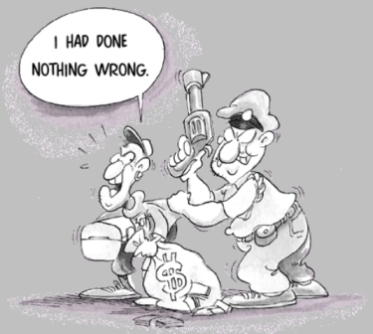
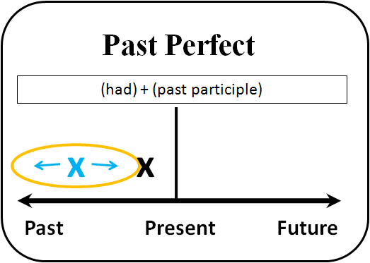

Elektronická učebnice - II. stupeň Základní škola Děčín VI, Na Stráni 879/2 – příspěvková organizace Anglický jazyk
41.1 Past perfect tense, town and country
(předminulý čas, město a venkov)
You can study THIS VIDEO to learn more abou past perfect.
Autor: Mgr. Michaela Kaplanová

Slide 2
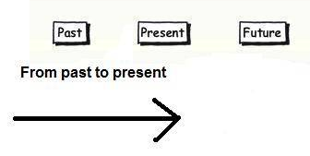
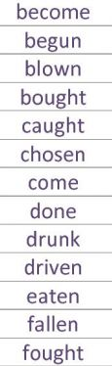
Elektronická učebnice - II. stupeň Základní škola Děčín VI, Na Stráni 879/2 – příspěvková organizace Anglický jazyk
41.2 What do we already know?
PRESENT PERFECT
I have already done my homework.
Has she visited her cousin yet?
I have never been to Italy.
2. PAST PARTICIPLE forms
Town and country VOCABULARY
barn
pond
street
cowshed
detached house
garden
donkey
roof
block of flats
stable
flat

Slide 3
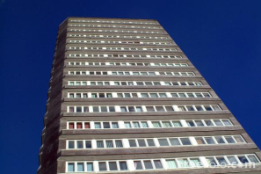
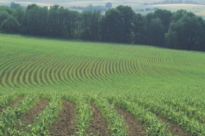
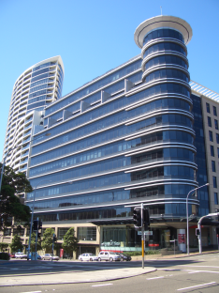
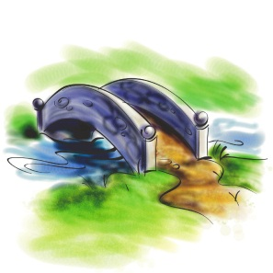
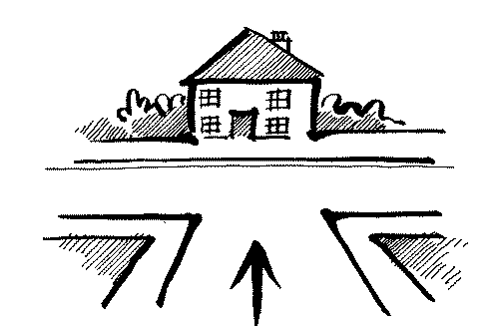
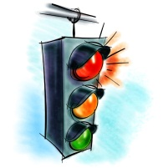

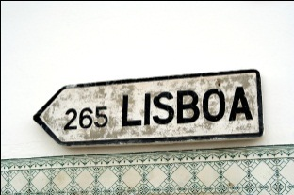
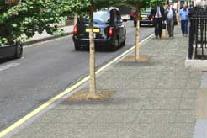

Elektronická učebnice - II. stupeň Základní škola Děčín VI, Na Stráni 879/2 – příspěvková organizace Anglický jazyk
41.3 New terms
TOWN
2. COUNTRY
field
stream
T-junction
tower block
roundabout
hedge
pavement
bus stop
bridge
traffic lights
gate
office block
footpath
crossroads
signpost
zebra crossing
cycle lane
lamp post

Slide 4
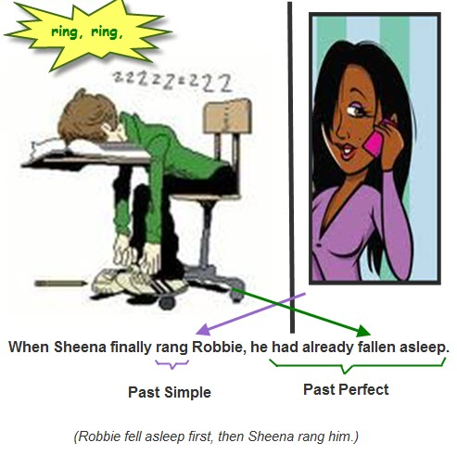
Elektronická učebnice - II. stupeň Základní škola Děčín VI, Na Stráni 879/2 – příspěvková organizace Anglický jazyk
41.4 Past perfect
We USE past perfect to talk about a past action that happened before another action in the past.
We FORM past perfect with
+
e.g. had done, had been, had seen…
HAD
PAST PARTICIPLE
NEGATIVES
hadn´t (= had not) + past participle
EXAMPLE SENTENCES
I had gone home before she came.
When we arrived, the bus had already left.
She hadn´t talked about it.
Had they known about it before she told them?
QUESTIONS
Had + subject + past participle
==> Yes, I had. No, I hadn´t.

Slide 5
Elektronická učebnice - II. stupeň Základní škola Děčín VI, Na Stráni 879/2 – příspěvková organizace Anglický jazyk
41.5 Exercises – past simple x past perfect
Choose the correct verb and tense and fill in the verb forms.
1.When I__________ to the office, the meeting __________ already __________ . (start-get)
2. Even though she __________ hard, Joan __________ the exam. (study- not pass)
3. By the time she __________ the invitation, the Smiths __________ they wouldn't go. (send- decide)
4. It __________ a good story, but I __________ it before. (hear-be)
5. When David __________ sure the children were asleep, he __________ his task. (make-do)
6. By the time Bob __________ the second joke, Hillary __________ the first one. (tell- not understand)
7. He __________ at Brenda and for a moment he __________ whether she __________ him the truth. (look- tell-doubt)
8. When his boss __________ him, he __________ already __________ it . (call-know)
9. He __________ around wondering where he __________ the the keys. (leave-look)
!!! CHALLENGING EXERCISE !!!

Slide 6
Elektronická učebnice - II. stupeň Základní škola Děčín VI, Na Stráni 879/2 – příspěvková organizace Anglický jazyk
41.6 Something more difficult – Past perfect x Past simple
How do you know when to use past perfect tense?
What is the difference between these two sentences?
They finished their dinner when she came.
past simple
past simple
They had finished their dinner when she came.
past participle
past simple
Signal words: AFTER, WHEN, BEFORE, BY THE TIME, ALREADY

Slide 7



Elektronická učebnice - II. stupeň Základní škola Děčín VI, Na Stráni 879/2 – příspěvková organizace Anglický jazyk
41.7 CLIL
Fill in the past participle form and write the name of the school subject.
The teacher __________ the experiment before the last pupil came. (do)
By the time the teacher came to the gym, the boys __________ . (leave)
The pupils _____________ all the computers when the teacher entered
the PC room. (switch off)

Slide 8

Elektronická učebnice - II. stupeň Základní škola Děčín VI, Na Stráni 879/2 – příspěvková organizace Anglický jazyk
41.8 Test
Which verb form doesn´t exist?
had had
had gone
had saw
had been
3. Where should we use past perfect?
I _____ him for 10 years. (know)
I ____ never ____ him before I met him. (see)
I _______ there last summer. (be)
I ________ them next Sunday. (meet)
2. Which word is not spelled correctly?
raundabout
crossroads
signpost
pavement
4. Which word can´t be used with past perfect?
already
before
by the time
tommorow
Correct answers: 1c, 2a, 3b, 4d

Slide 9
Elektronická učebnice - II. stupeň Základní škola Děčín VI, Na Stráni 879/2 – příspěvková organizace Anglický jazyk
41.9 Použité zdroje, citace
http://jpiantavinha-centroidiomas.blogspot.com/2011/11/past-perfect-simple-and-past-perfect.html - slide 1
http://www.youtube.com/watch?v=qGuwFtqlZ10 – slide 1
http://phanmemhoctienganh.info/exprerience/past-perfect - slide 1
http://www.freefoto.com/preview/04-25-8/Tower-Block--Sunderland - slide 3
http://www.feng-shui-tips-for-wealth.com/house-facing-a-t-junction.html - slide 3
http://en.wikipedia.org/wiki/File:St_Leonards_Forum_Office_Block.JPG – slide 3
http://englishdailyworkout.blogspot.com/2011/04/past-simple-past-perfect-execise-1.html - slide 4,5
Obrázky z databáze klipart

Slide 10
Elektronická učebnice - II. stupeň Základní škola Děčín VI, Na Stráni 879/2 – příspěvková organizace Anglický jazyk
41.10 Anotace
Autor | Mgr. Michaela Kaplanová
Období | 01 – 06/2012
Ročník | 9. ročník
Klíčová slova | Předminulý čas, signální slova, město, venkov
Anotace | Prezentace zaměřující se na formu a správné užití předminulého času, časová vyjádření s ním užívaná a slovní zásobu z tématu město a venkov.

