Slide 1
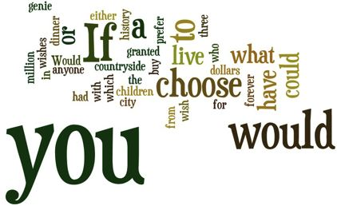

Elektronická učebnice - II. stupeň Základní školěčín VI, Na Stráni 879/2 – příspěvková organizace Anglický jazyk
40.1 If clauses - 2nd and 3rd conditional
(Podmínkové věty 2. a 3. typu)
Conditional sentences – type1,2,3
Autor: Mgr. Michaela Kaplanová

Slide 2
Elektronická učebnice - II. stupeň Základní škola Děčín VI, Na Stráni 879/2 – příspěvková organizace Anglický jazyk
40.2 What do we already know?
We know how we form the other CONDITIONALS (type 0 and 1)
For example: If you drop an orange, it falls. (type 0 – general truths)
If I see him, I will tell him about it. (type 1 – very probable situation)
We know how to use the verb WOULD
For example: I would like to be rich.
I would like a cup of coffee.
We know PAST SIMPLE tense
For example: My parents went to visit their friends.
I didn´t see him yesterday.
Did your sister call him?
D) We know the verb forms in PAST PARTICIPLE
For example: gone, come, written, had, made, done…
E) We know PRESENT PERFECT (have done) and PAST PERFECT (had done) tenses

Slide 3
Elektronická učebnice - II. stupeň Základní škola Děčín VI, Na Stráni 879/2 – příspěvková organizace Anglický jazyk
40.3 New terms
second conditional | druhý kondicionál
third conditional | třetí kondicionál
if | jestli, pokud
clause | věta
general truth | všeobecná pravda
probable situation | pravděpodobná, předpokládaná situace

Slide 4
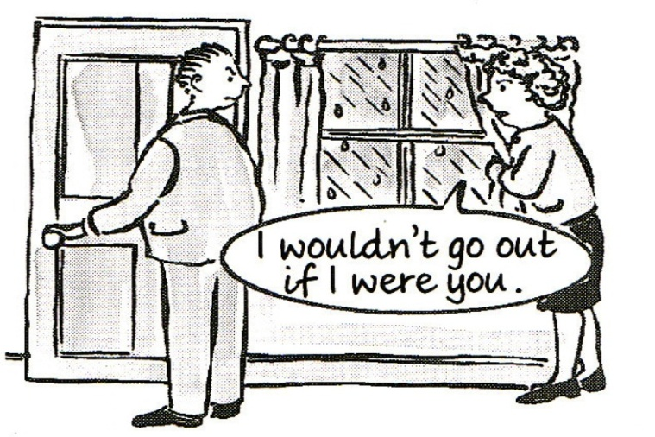
Elektronická učebnice - II. stupeň Základní škola Děčín VI, Na Stráni 879/2 – příspěvková organizace Anglický jazyk
40.4 Second conditional
We use it to - talk about a situation which is UNLIKELY to happen, but it CAN happen.
(If you found one million dollars, what would you do with it?)
- give advice
(If I were you, I wouldn´t go there)
How do we form it?
IF I WERE YOU, I WOULD CALL HER.
!!!You can change the order of the two clauses:!!!
I would call her if I were you. (NO COMMA!)
!!!We use the phrase IF I WERE YOU instead of
IF I WAS YOU!!!
IF
Past simple
WOULD
Base form

Slide 5

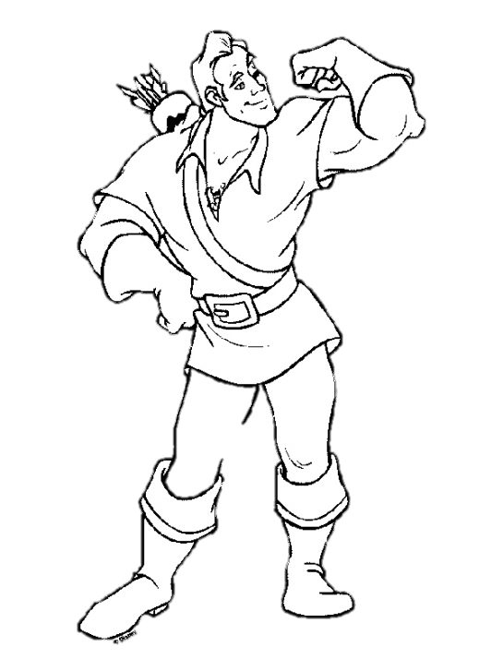
Elektronická učebnice - II. stupeň Základní škola Děčín VI, Na Stráni 879/2 – příspěvková organizace Anglický jazyk
40.5 Exercises
1. Try to do this on-line exercise
2. Finish the following sentences:
If I were you, ____________________________ .
_______________________, he wouldn´t do that.
If she didn´t see that, __________________________ .
The world would be a better place if __________________________ .
If I had more friends, ___________________________________ .
3. Fill in the verbs in this exercise
4. Describe this picture using the second conditional
5. You can also download and play this board game

Slide 6
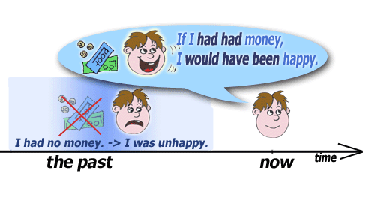
Elektronická učebnice - II. stupeň Základní škola Děčín VI, Na Stráni 879/2 – příspěvková organizace Anglický jazyk
40.6 Something more difficult – the THIRD conditional
We use it to talk about situations that could happen but they didn´t happen.
e.g. If I had seen him, I would have told him. (but I didn´t see him.) => we talk about the past situation
We form the third conditinal with:
IF you HAD GONE there, I WOULD HAVE BEEN happy.
IF
Past perfect
Would
Present perfect
Try to find the song
“ Cotton Eye Joe“ ☺

Slide 7
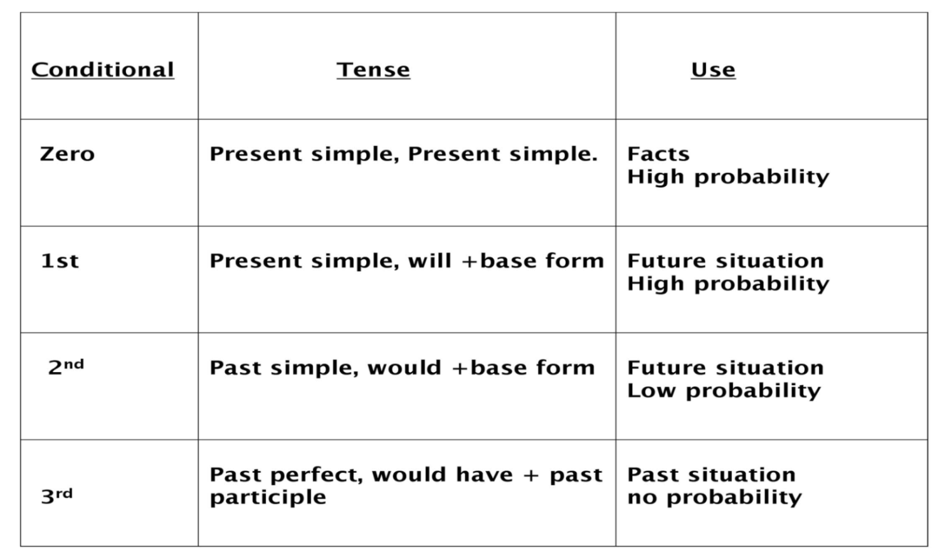
Elektronická učebnice - II. stupeň Základní škola Děčín VI, Na Stráni 879/2 – příspěvková organizace Anglický jazyk
40.7 Conditional sentences – revision
Make sure that you understand the following explanation and fill in the example sentences to each conditional type.
Beyonce – If I Were A Boy – which conditional type can you hear in this song?
Joan Osborne – One Of Us – and in this one?

Slide 8
Elektronická učebnice - II. stupeň Základní škola Děčín VI, Na Stráni 879/2 – příspěvková organizace Anglický jazyk
40.8 Test
1. We use the second conditional to:
say that something is not true
express that something is possible but not probable to happen
say that somebody has to do something
something is impossible to happen
2. Which sentence is in the second conditional?
a) If I married him, I would be happy.
b) If you see him, give me a call.
c) If I had studied harder, I would have passed the exam.
d) If it doesn´t rain tomorrow, I will go to Prague.
3. Finish the sentence in the second conditional: If it snowed, …
…what would we do?
…I will stay at home.
…he had been happy.
…I stay at home.
4. Find the third conditional:
If I had won the money, I would have bought a car.
If I were you, I wouldn´t do that.
Have you ever been there?
What would you do with it?
Correct answers: 1b, 2a, 3a, 4a

Slide 9
Elektronická učebnice - II. stupeň Základní škola Děčín VI, Na Stráni 879/2 – příspěvková organizace Anglický jazyk
40.9 Použité zdroje, citace
http://www.oskole.sk/?id_cat=9&clanok=4324
http://www.helpforenglish.cz/gramatika/vedlejsi-vety/podminkove/c2007051002-smisene-kondicionaly--mixed-conditionals-.html

Slide 10
Elektronická učebnice - II. stupeň Základní škola Děčín VI, Na Stráni 879/2 – příspěvková organizace Anglický jazyk
40.10 Anotace
Autor | Mgr. Michaela Kaplanová
Období | 07 – 12/2011
Ročník | 9. ročník
Klíčová slova | Second conditional, third conditional, if, clause, general truth, probable situation
Anotace | Prezentace popisující tvoření a použití podmínkových vět 2. a 3. typu

