Slide 1
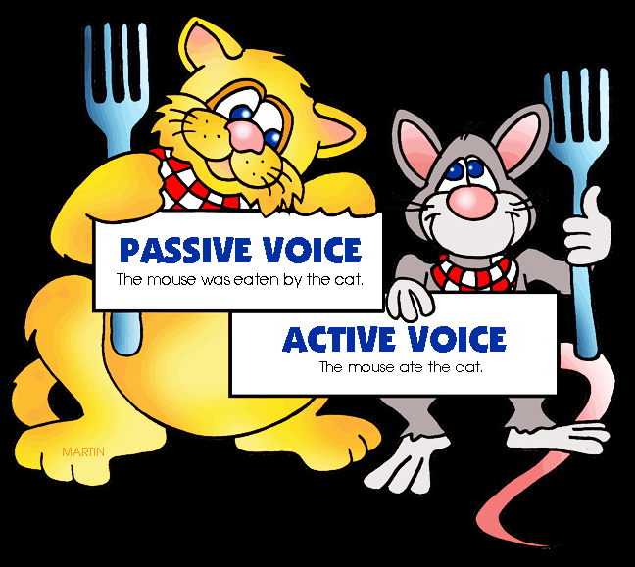

Elektronická učebnice - II. stupeň Základní škola Děčín VI, Na Stráni 879/2 – příspěvková organizace Anglický jazyk
38.1 Present simple passive, past simple passive
(trpný rod v přítomném a minulém prostém čase)
The mouse was eaten by the cat
The cat ate the mouse
You can practise this topic HERE
Autor: Mgr. Michaela Kaplanová

Slide 2
Elektronická učebnice - II. stupeň Základní škola Děčín VI, Na Stráni 879/2 – příspěvková organizace Anglický jazyk
38.2 What do we already know?
1. We know present simple tense.
2. We know past simple tense.
ARE
WERE
3. We know how to use the verb "to be"
AM
IS
4. We know the past participle form of irregular verbs.
WAS
BUILT
GONE
BROKEN
BEEN
TOLD
DONE
SEEN
CUT
TAKEN
CHOSEN
SAID
BOUGHT

Slide 3
Elektronická učebnice - II. stupeň Základní škola Děčín VI, Na Stráni 879/2 – příspěvková organizace Anglický jazyk
38.3 New terms
SUBJECT
OBJECT
passive voice – trpný rod
active voice – činný rod
subject – podmět
object – předmět
disagree – nesouhlasit
action – děj
rules – pravidla
allow – dovolit, povolit
past participle – příčestí minulé
e.g. - například
Active sentence: They built the hospital.
Passive sentence: The hospital was built by them.

Slide 4
Elektronická učebnice - II. stupeň Základní škola Děčín VI, Na Stráni 879/2 – příspěvková organizace Anglický jazyk
38.4 Passive voice
1. USE: We use the passive voice to stress the action more than the person who does it.
e.g. The letter is written. The homework is done every day.
We often use it to express the rules.
e.g. Dogs are allowed in this park.
2. FORM: BE + PAST PARTICIPLE (done, been, written, seen…)
Present tense
(am, is, are)
It is done.
Past tense
(was, were)
It was seen.
Some more examples:
Affirmative sentences: I´m taken home. The doors are locked. The house is built.
The mistake was made. We were invited to the party.
Negative sentences: We aren´t allowed to smoke here. Apples aren´t grown in this town.
The packet wasn´t sent. The wallet wasn´t found in the street.
Questions: Is it done? Are they collected?
Was it said? Were they bought?
!!! To say who does (did) the action, we use BY (It was written by my teacher.) !!!

Slide 5

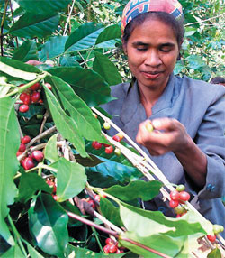
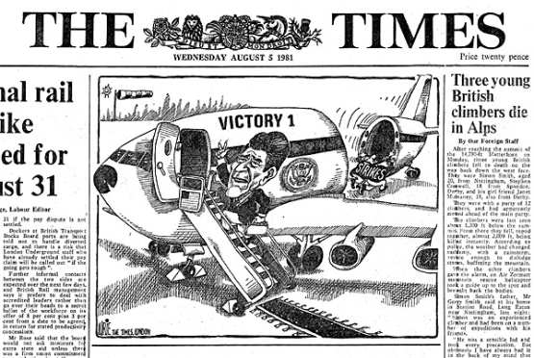
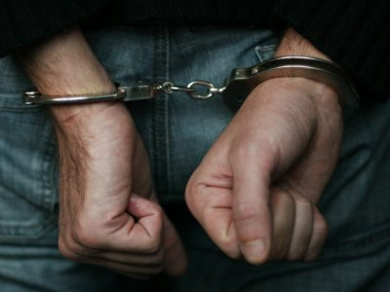
Elektronická učebnice - II. stupeň Základní škola Děčín VI, Na Stráni 879/2 – příspěvková organizace Anglický jazyk
38.5 Exercises
Change the sentences from active to passive:
They grow coffee in Kenya.
They publish The Times newspaper in London.
They transport oranges from Valencia to Germany.
The shark ate the man.
The police took him away.
They didn't punish him for what he did.
The boy killed the spider.
The woodcutter cuts the trees.
Columbus discovered America.
The police arrested the thief.
The boys make kites.
He wrote a novel.
The hunter shoots the tiger.
He made a discovery.
Everybody loves him.
My cousin drew a beautiful picture.
Somebody stole my wallet.

Slide 6
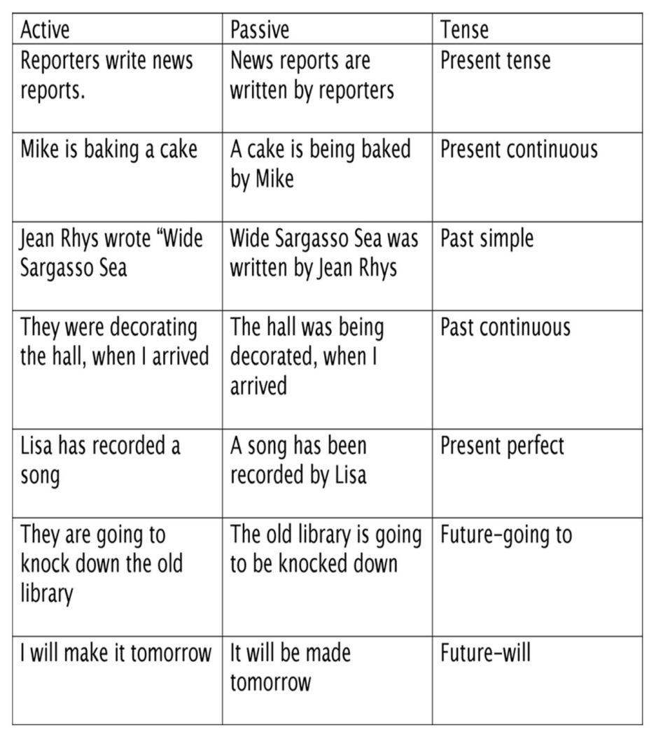
Elektronická učebnice - II. stupeň Základní škola Děčín VI, Na Stráni 879/2 – příspěvková organizace Anglický jazyk
38.6 Something more difficult
Find the passive examples in this text.
Study how the passive voice is used in other tenses.
My Hometown
Many years ago, I was born in Seattle, Washington USA. Seattle is located in the Northwest corner of the USA. Recently, Seattle has become the focus of much international attention. Many films have been made there, probably the most famous of which is Sleepless in Seattle starring Meg Ryan and Tom Hanks. Seattle is also known as the birthplace of "Grunge" music; both Pearl Jam and Nirvana are from Seattle. For older people like me, it should be noted that Jimi Hendrix was born in Seattle! NBA fans know Seattle for the "Seattle Supersonics", a team that has played basketball in Seattle for more than 30 years. Unfortunately, Seattle is also famous for its bad weather. I can remember weeks and weeks of grey, wet weather when I was growing up.

Slide 7


Elektronická učebnice - II. stupeň Základní škola Děčín VI, Na Stráni 879/2 – příspěvková organizace Anglický jazyk
38.7 CLIL
Czech language
Art
Write similar passive sentences for these subjects:
Chemistry, English, Maths, Physical education, History, Geography

Slide 8
Elektronická učebnice - II. stupeň Základní škola Děčín VI, Na Stráni 879/2 – příspěvková organizace Anglický jazyk
38.8 Test
3. What is the active sentence:
English is spoken by many people.
All the people speak English.
English was spoken by the people.
People spoke English.
Many people speak English.
Write the passive sentence:
I buy the car.
I am bought the car.
The car was bought.
The car is bought.
I was bought by the car.
2. Which verb form can´t be a part of the passive voice?
did
done
seen
invited
4. Find an incorrect sentence:
A new cinema was build.
It was seen yesterday.
The plate was broken.
The flower is planted.
Correct answers: 1c, 2a, 3d, 4a

Slide 9
Elektronická učebnice - II. stupeň Základní škola Děčín VI, Na Stráni 879/2 – příspěvková organizace Anglický jazyk
38.9 Zdroje, citace
http://storiesofthedrakon.blogspot.com/2011/04/word-was-passive-writing.html (1)
http://www.englisch-hilfen.de/en/exercises_list/passiv.htm (1)
http://perso.wanadoo.es/autoenglish/gr.pas.p.htm (5)
http://www.usaid.gov/stories/easttimor/fp_easttimor_coffee.html (5)
http://lurieunaward.com/photo_gallery/LondonTimes01.htm (5)
http://www.photosof.org/view/fresh_oranges-other.html (5)
http://www.englishgrammar.org/passive-voice-exercise/ (5)
http://publicrecordssearchonline.org/arrest-records-free/ (5)
http://teslden.com/passive-voice/ (6)
http://esl.about.com/od/teachinggrammar/a/Lesson-Plan-Integrating-Passive-Voice_2.htm (6)
http://khandsuren.blog.gogo.mn/?label=32455 (7)

Slide 10
Elektronická učebnice - II. stupeň Základní škola Děčín VI, Na Stráni 879/2 – příspěvková organizace Anglický jazyk
38.10 Anotace
Autor | Mgr. Michaela Kaplanová
Období | 07 – 12/2011
Ročník | 9. ročník
Klíčová slova | Passive voice, present simple passive, past simple passive
Anotace | Prezentace vysvětlující užití trpného rodu v přítomném a minulém čase.

