Slide 1

Elektronická učebnice - II. stupeň Základní škola Děčín VI, Na Stráni 879/2 – příspěvková organizace Anglický jazyk
37.1 Relative pronouns, house contents
(vztažná zájmena, vybavení domácnosti)
Living area –
guess the meanings
radiator
wide screen TV
DVD player
cushions
music system
armchair
sofa
carpet
fireplace
Do you know any other similar words?
Autor: Mgr. Michaela Kaplanová

Slide 2
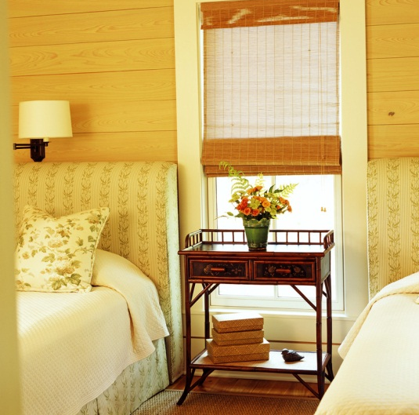

Elektronická učebnice - II. stupeň Základní škola Děčín VI, Na Stráni 879/2 – příspěvková organizace Anglický jazyk
37.2 What do we already know?
We know the Wh- question words:
We can describe the rooms:
WHAT
are you doing here?
WHERE
are you from?
WHEN
do you get up?
WHY
are you smiling?
WHO
is this boy?
There is…
in the …
There are…
in the …

Slide 3

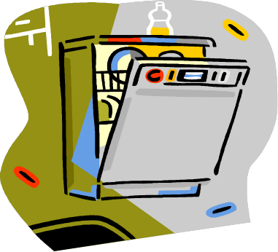
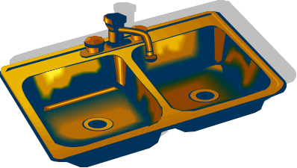

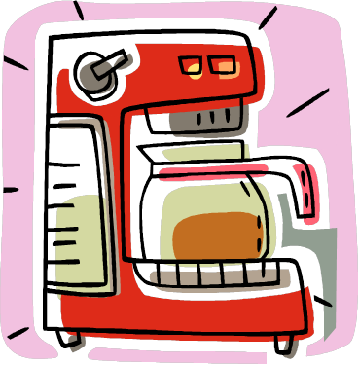
Elektronická učebnice - II. stupeň Základní škola Děčín VI, Na Stráni 879/2 – příspěvková organizace Anglický jazyk
37.3 New terms
IN THE KITCHEN
find the correct meaning
food processor
washing machine
microwave
toaster
dishwasher
coffee machine
central heating control
tap
sink
kettle
blind
fridge
cooker
oven
freezer
?
?
How many words can you remember after 1 minute?
?
?

Slide 4

Elektronická učebnice - II. stupeň Základní škola Děčín VI, Na Stráni 879/2 – příspěvková organizace Anglický jazyk
37.4 Relative pronouns (vztažná zájmena)
We use relative pronouns to join two clauses.
e.g. I know the boy. He was at the party last night. I know the boy who was at the
party last night.
WHO
We use WHO for people
e.g. I have a brother.
He lives in Spain.
I have a brother who lives in Spain.
WHICH
We use WHICH for
things or animals
e.g. They have a dog.
It barks every night.
They have a dog which barks every night.
THAT
We use THAT for things or animals
e.g. I bought a dress.
It fits me.
I bought a dress that fits me.

Slide 5
Elektronická učebnice - II. stupeň Základní škola Děčín VI, Na Stráni 879/2 – příspěvková organizace Anglický jazyk
37.5 Exercises
Guess what is explained:
…… is something that we use to keep fire in our house.
…… is something which is used to boil water in it.
…… is something that we use to keep our food fresh.
Explain the pictures in a similar way. (Give a definition of what is in the picture.)
Try other exercises HERE

Slide 6
Elektronická učebnice - II. stupeň Základní škola Děčín VI, Na Stráni 879/2 – příspěvková organizace Anglický jazyk
37.6 Something more difficult
SUBJECT – it is followed by the verb, it can´t be left out!!!
e.g. I know the teacher who teaches Maths in Prague.
RELATIVE PRONOUNS
OBJECT – it is followed by the subject of the second clause, it can be left out!!!
e.g. What´s the name of the movie (that) we saw yesterday?
WHERE
We use it for PLACES
e.g. We visited the camp. We stayed there last summer. = We visited the camp where we stayed last summer.
OTHER RELATIVE PRONOUNS
WHOSE
We use it for POSSESSION
e.g. I met the girl. Her father is a taxi
driver. = I met the girl whose father is
a taxi driver.
Have fun with this video ☺

Slide 7
Elektronická učebnice - II. stupeň Základní škola Děčín VI, Na Stráni 879/2 – příspěvková organizace Anglický jazyk
37.7 Crossword
Use the clues with relative pronouns to answer the crossword questions.
 |  |  |  |  |  |  | 1 |  |  |  |  |  | 2
 |  | 3 |  |  |  |  |  |  | 4
5
 |  |  |  |  | 6
 |  |  |  |  | 7
8
9
 | 10
Across
5. A modern mobile phone which has wifi access
7. The feeling of someone who is very surprised
8. A place where you can walk, play games, relax or have a picnic
9. A machine which keeps your food very cold
10. A machine which you can use to clean your floor (2 Words)
Across
1. A person whose job is to write books
2. An old machine which plays music (older than CD players!) (2 Words)
3. Things which you use to power electronic equipment/devices
4. A person who doesn't like to use computers or new technology
6. A person whose job is to protect or prosecute people in court
Correct answers:
1. Author, 2. Cassette player, 3. Batteries, 4. Technophobe, 5. Smartphone, 6. Lawyer,
7. Astonished, 8. Park, 9. Freezer, 10. Vacuum cleaner

Slide 8
Elektronická učebnice - II. stupeň Základní škola Děčín VI, Na Stráni 879/2 – příspěvková organizace Anglický jazyk
Elektronická učebnice - II. stupeň Základní škola Děčín VI, Na Stráni 879/2 – příspěvková organizace Anglický jazyk
37.8 Test
What is the correct relative pronoun? The man stole the bike _______ he had found in front of the supermarket.
whom
where
which
who
3. What can´t be found in the kitchen?
kettle
oven
tap
cushions
4. Which word can be used with the pronoun WHO?
teenager
food processor
hamster
sink
2. Where could be the relative pronoun
WHOSE ?
We went to the city _____ is the capital of this country.
I saw the girl _____ father is a professor.
I don´t know any other place _____ you can find this animal.
This is the man _____ can´t read.
Correct answers: 1c, 2b, 3d, 4a

Slide 9
Elektronická učebnice - II. stupeň Základní škola Děčín VI, Na Stráni 879/2 – příspěvková organizace Anglický jazyk
37.9 Použité zdroje, citace
http://www.armoredpenguin.com/crossword/Data/2012.03/0622/06222745.000.html - slide 7
Obrázky z databáze klipart

Slide 10
Elektronická učebnice - II. stupeň Základní škola Děčín VI, Na Stráni 879/2 – příspěvková organizace Anglický jazyk
37.10 Anotace
Autor | Mgr. Michaela Kaplanová
Období | 01 – 06/2012
Ročník | 9.
Klíčová slova | Relative pronouns, who, which, that, where, whose, house contents
Anotace | Prezentace představující základní vztažná zájmena a slovní zásobu z tématu vybavení domácnosti.

