Slide 1
Elektronická učebnice - II. stupeň Základní škola Děčín VI, Na Stráni 879/2 – příspěvková organizace Anglický jazyk
36.1 VERBS - to infinitives, -ing forms, used to, jobs
You can study more here
Autor: Mgr. Michaela Kaplanová

Slide 2
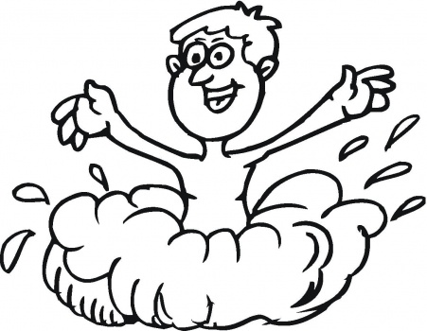
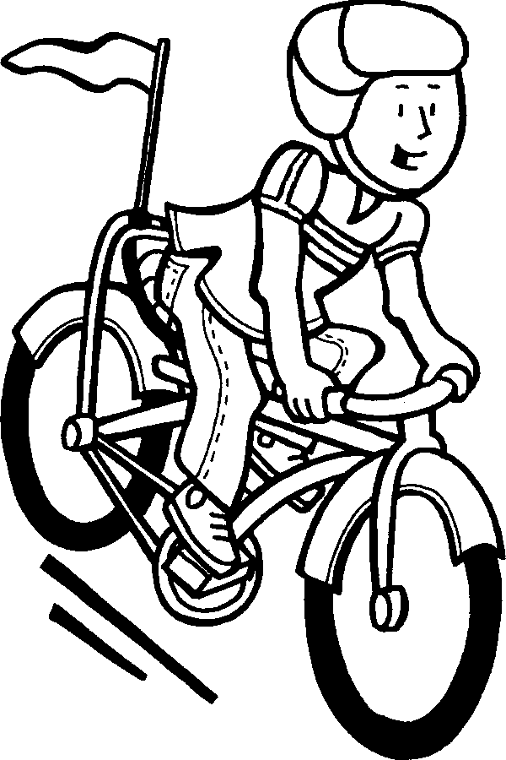
Elektronická učebnice - II. stupeň Základní škola Děčín VI, Na Stráni 879/2 – příspěvková organizace Anglický jazyk
36.2 What do we already know?
We know the present and past CONTINUOUS tense:
e.g. I am SWIMMING in the sea.
He was TALKING on the phone.
2. We know the verb LIKE and how to use it:
e.g. I like RIDING a bike.
She likes READING books.
3. We know the phrase I WOULD LIKE TO…
e.g. I would like TO BE your friend.
My father would like TO SEE the photo.

Slide 3
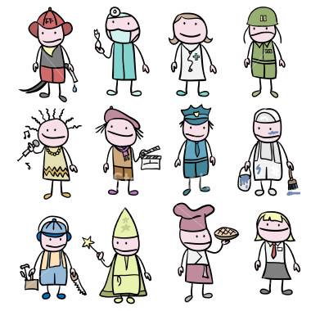
Elektronická učebnice - II. stupeň Základní škola Děčín VI, Na Stráni 879/2 – příspěvková organizace Anglický jazyk
36.3 New terms
gerund – gerundium, -ing tvar
used to (be, walk…) – býval, chodíval
flight attendant
nurse
police officer
jockey
sales assistant
hairdresser
chef
scientist
architect
TV presenter
actor/actress
firefighter
vet
rock musician
dentist
interpreter/translator
journalist
photographer
lifeguard
zoo-keeper
tourist guide
professional sportsman/sportswoman

Slide 4
Elektronická učebnice - II. stupeň Základní škola Děčín VI, Na Stráni 879/2 – příspěvková organizace Anglický jazyk
36.4 Gerunds and infinitives
Infinitive of purpose
(why someone does something)
I went out to meet my friends.
I called him to ask about the party.
She studied hard to get a good mark.
We go to the post office to post the packet.
Verbs + gerund
enjoy, fancy, finish, give up, look forward to, (not) mind
e.g. I enjoy watching TV.
I give up smoking.
Adjectives + to infinitive
easy, difficult, hard, interesting, boring, nice, dangerous, good, bad, exciting, safe, silly, great, impossible…
e.g. It´s boring to sit at school.
It´s easy to study English
EXPRESSING OPINIONS
Verbs + to infinitive
expect, hope, learn, need, plan, try, want, would like
e.g. I need to find him.
I want to go home.

Slide 5
Elektronická učebnice - II. stupeň Základní škola Děčín VI, Na Stráni 879/2 – příspěvková organizace Anglický jazyk
36.5 Exercises
Finish the sentences:
9. I study English to…
10. I go to school to…
11. I eat vegetables to…
12. I do my homework to…
I enjoy…
I expect…
I would like…
I hope…
5. It´s funny…
6. It´s boring…
7. It´s exciting…
8. It´s interesting…
Fill in the correct form of the verb:
LEND, THINK, DO, WRITE, COPY
Yesterday I was at school. I needed __________ my homework so I asked my friend __________ me his workbook. I finished __________ the exercise and the teacher came in. It was silly __________ that the teacher won´t find out that I´ve copied it. I expected __________ a bad mark but the teacher just said that it´s not fair __________ my homework.

Slide 6
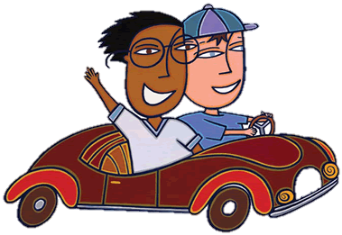
Elektronická učebnice - II. stupeň Základní škola Děčín VI, Na Stráni 879/2 – příspěvková organizace Anglický jazyk
36.6 Something more difficult – USED TO + infinitive
We use USED TO + infinitive to talk about past habits, which don´t exist now.
I used to ride my bike every day, now I go by car.
She used to study in the Czech republic, now she studies in Australia.
She didn´t use to play golf.
Did she use to work here?
Yes, she did.
No, she didn´t.
NEGATIVES
QUESTIONS
SHORT ANSWERS

Slide 7
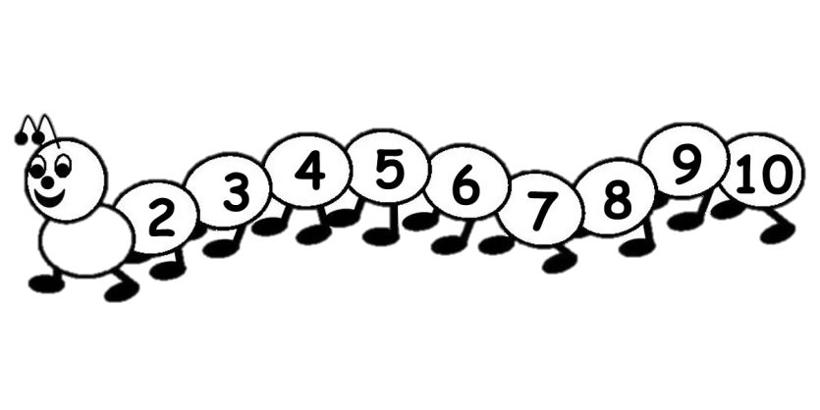
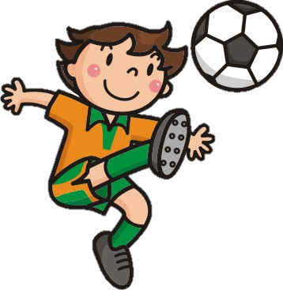
Elektronická učebnice - II. stupeň Základní škola Děčín VI, Na Stráni 879/2 – příspěvková organizace Anglický jazyk
36.7 CLIL – School subjects and verb forms
Fill in the correct words
Maths – It´s ________ to get a good mark when you can´t count.
Czech language - I study hard _________ where is I and where Y. (know)
Chemistry – I look forward ___________ some chemical experiment. (do)
P.E. – I need _________ fast to be a good football player. (run)
Art – I enjoy __________ people. (draw)
Music – I would like ___________ better. (sing)

Slide 8
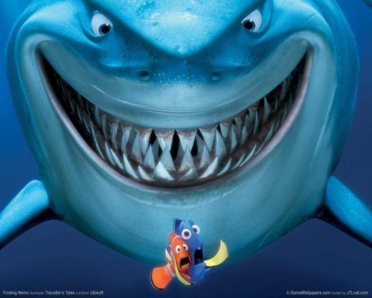
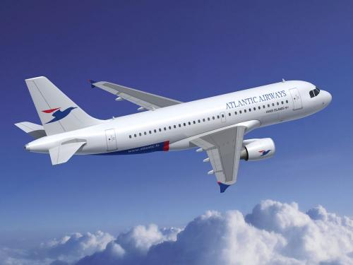
Elektronická učebnice - II. stupeň Základní škola Děčín VI, Na Stráni 879/2 – příspěvková organizace Anglický jazyk
36.8 Test
It´s dangerous…
…to swim with the sharks.
…swimming with the sharks.
…to swimming with the sharks.
…swim with the sharks.
2. A flight attendant is someone who:
a) flies the plane
b) constructs planes
c) helps the passengers in the plane
d) works at the airport
3. I don´t mind…
…going to the party.
…to go to the party.
…to going to the party.
…go to the party.
4. A scientist is someone who:
works in a shop
works in a laboratory
works in a museum
works in a sports centre
Correct answers: 1a, 2c, 3a, 4b

Slide 9
Elektronická učebnice - II. stupeň Základní škola Děčín VI, Na Stráni 879/2 – příspěvková organizace Anglický jazyk
36.9 Použité zdroje, citace
http://theback40k.blogspot.com/2011/09/mail-bag-professions-for-real-this-time.html
http://academic.cuesta.edu/acasupp/as/0GUIDES.HTM
http://abeubpuby.blog.cz/1109/dvd-finding-nemo-online
http://www.in.cz/clanky/cestovatele/usmevem-se-nic-nezkazi-aneb-vitame-vas-na-palube-naseho-hhf.htm
http://inspiringdesigns.org/2010/02/25/infuse-color/
http://www.supercoloring.com/pages/sing-a-song-together/

Slide 10
Elektronická učebnice - II. stupeň Základní škola Děčín VI, Na Stráni 879/2 – příspěvková organizace Anglický jazyk
36.10 Anotace
Autor | Mgr. Michaela Kaplanová
Období | 07 – 12/2011
Ročník | 9. ročník
Klíčová slova | to infinitive, gerunds, infinitive of purpose, used to, jobs
Anotace | Prezentace zaměřená na užívání infinitivu s to a gerundia a na slovní zásobu povolání.

