Slide 1


Elektronická učebnice - II. stupeň Základní škola Děčín VI, Na Stráni 879/2 – příspěvková organizace Anglický jazyk
34.1 If clauses 0+1, On the farm
(Podmínkové věty typu 0 a 1, Na farmě)
you heat ice, it becomes water.
he doesn´t hurry, he will be late.
Autor: Mgr. Michaela Kaplanová

Slide 2
Elektronická učebnice - II. stupeň Základní škola Děčín VI, Na Stráni 879/2 – příspěvková organizace Anglický jazyk
34.2 What do we already know?
1. Present simple tense
Future with will
 | affirmative | negative | question
3rd person sg. | He works. | He doesn´t work. | Does he work?
all other persons | I work. | They don´t work. | Do you work?
affirmative | negative | question
I will go. | I will not (won´t) go. | Will you go?

Slide 3







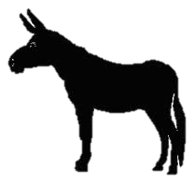


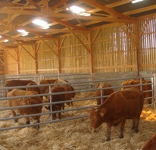
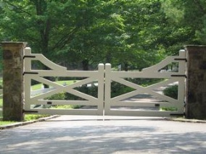
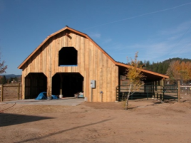
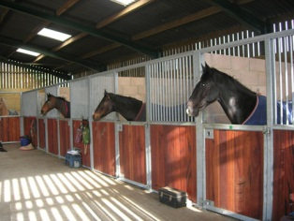
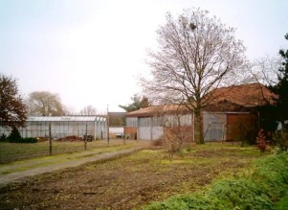
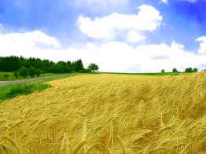
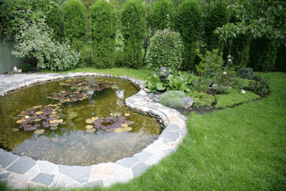
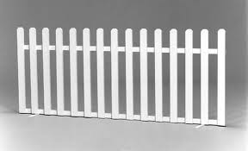
Elektronická učebnice - II. stupeň Základní škola Děčín VI, Na Stráni 879/2 – příspěvková organizace Anglický jazyk
34.3 New terms
clause | věta
conditional | podmiňovací způsob
if | když, pokud, jestli
when | když, kdy
may | možná, snad, moci (+ sloveso), vyjádření možnosti
might | mohl(a/o) by, podmíněná možnost
comma | čárka (v souvětí)
bull goat rabbit kitten fox goose donkey hen puppy duck
field cowshed gate barn stable yard fence pond

Slide 4
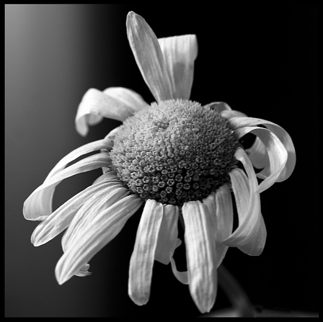
Elektronická učebnice - II. stupeň Základní škola Děčín VI, Na Stráni 879/2 – příspěvková organizace Anglický jazyk
34.5 Exercises
Make conditional sentences (type 0) with these words:
You – not – eat – you – die
It – not – rain – the flowers – not – grow
You – eat – much chocolate – you – be fat
You – heat – water – it – boil
Finish the sentences, use your own ideas (type 1)
If I have his number, _________________________ .
If it is sunny, _________________________ .
I will go there _________________________ .
If you tell him the news, _________________________ .
My parents will be angry _________________________ .
If I go there, _________________________ .
Fill in the verbs (type 1)
If I (find)______________ your earring, I (give)__________ it back to you.
Ïf you (study)___________ this grammar, you (improve)___________ your English.
If I (buy)____________ a cheap ticket, I (go) ________________ to the concert.

Slide 5
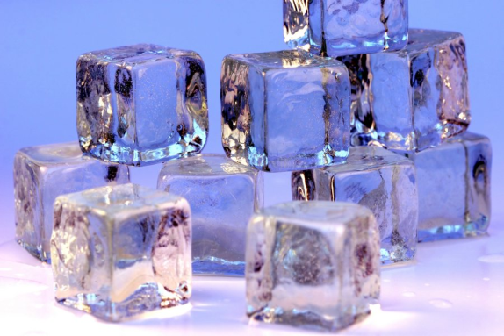

Elektronická učebnice - II. stupeň Základní škola Děčín VI, Na Stráni 879/2 – příspěvková organizace Anglický jazyk
34.4 If clauses 0+1
If clauses – type 0
We use type 0 to talk about - things which are always true.
e.g. If you put water in the freezer, it becomes ice.
- logical consequences
e.g. If you open the window, fresh air gets in.
2. If clauses – type 1
We use type 1 for possible situations in the future.
e.g. If it is nice weather tomorrow, we´ll have a picnic.
If you tell him the secret, she will be very angry.
!!! Never put IF and WILL in one clause!!!
TENSES
 | Type 0 | Type 1
If clause | Present simple | Present simple
Main clause | Present simple | Future with will

Slide 6
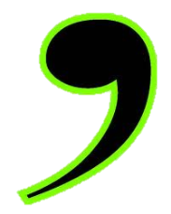
Elektronická učebnice - II. stupeň Základní škola Děčín VI, Na Stráni 879/2 – příspěvková organizace Anglický jazyk
34.6 Something more difficult
If clause with may and might
In the first conditional, we can use may/might instead of will in the main clause
=> something is possible but not certain (maybe).
If I get the money, I will buy the present. = If I get the money, I may buy the present.
Commas in if clauses
In all conditional sentences, we can change the order of the main clause and the
if clause. When the if clause is first, they are separated by a comma(,).
,
If it is sunny , I will go swimming.
I will go swimming if it is sunny.
If clause
main clause
Main clause
if clause

Slide 7
Elektronická učebnice - II. stupeň Základní škola Děčín VI, Na Stráni 879/2 – příspěvková organizace Anglický jazyk
34.7 CLIL - Songs
There are 3 songs that include one of the conditional types.
Read the parts and guess which one.
1.
2.
3.
If We Ever Meet Again - Timbaland
Ill never be the same
(if we ever meet again)
Wont let you get away
(say if we ever meet again)
This free fall (ahh),
got me so (ohh),
kiss me all night
Don't ever let me go.
Ill never be the same
(if we ever meet again)
If You Don´t Know Me By Now – Simply Red
If you don't know me by now (If you don't know me)
You will never never never know me
(No you won't)
If you don't know me by now
You will never never never know me
If You Leave Me Now –
Chicago
If you leave me now,
you'll take away the biggest part of me
No baby please don't go
If you leave me now,
you'll take away the very heart of me
No baby please don't go

Slide 8
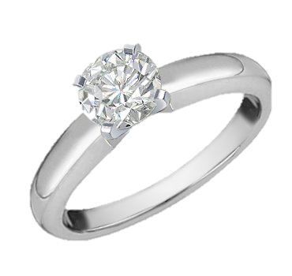

Elektronická učebnice - II. stupeň Základní škola Děčín VI, Na Stráni 879/2 – příspěvková organizace Anglický jazyk
34.8 Test
1. Finish the sentence: If you put ice in hot water…
… it will melt.
… it melts.
…it would melt.
… it won´t melt.
2. Which sentence is not correct?
If it´s sunny, we might have a picnic.
If it´s sunny, we may have a picnic.
If it´s sunny, we will have a picnic.
If it´s sunny, we have a picnic.
3. Finish the sentence: She will be happy…
… if you give her the ring.
… if you gave her the ring.
… if you will give her the ring.
… if you would give her the ring.
4. Which sentence is correct?
If I drink coffee, I won´t sleep.
If I drink coffee, I wouldn´t sleep.
If I drink coffee, I sleep.
If I drink coffee, I slept.

Slide 9
Elektronická učebnice - II. stupeň Základní škola Děčín VI, Na Stráni 879/2 – příspěvková organizace Anglický jazyk
34.9 Použité zdroje, citace
http://thecrazyteacher.altervista.org/if-clauses-or/
http://www.infobarrel.com/Media/A_Beautiful_Picture_Of_Ice_Cubes_That_Will_Destroy_Your_Teeth
http://atuleirus.weblog.com.pt/arquivo/2006/06/pic_nic
http://www.cksinfo.com/nature/weather/sun/index.html

Slide 10
Elektronická učebnice - II. stupeň Základní škola Děčín VI, Na Stráni 879/2 – příspěvková organizace Anglický jazyk
34.10 Anotace
Autor | Mgr. Michaela Kaplanová
Období | 07 – 12/2011
Ročník | 9. ročník
Klíčová slova | Clause, conditional, if, when, may, might, comma
Anotace | Prezentace popisující tvoření a použití podmínkových vět typu 0 a 1

