Slide 1

Elektronická učebnice - II. stupeň Základní škola Děčín VI, Na Stráni 879/2 – příspěvková organizace Anglický jazyk
33.1 Present perfect x past simple
(předpřítomný x minulý prostý čas)
yet
ever
yesterday
since
few days ago
How long…?
How do we call these words and expressions?
last summer
in 1992
never
on Tuesday
How many times?…?
for
Autor: Mgr. Michaela Kaplanová

Slide 2
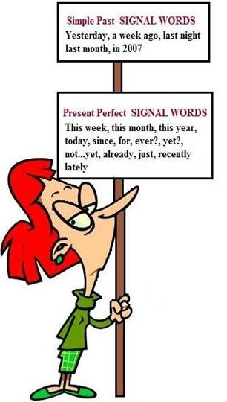

Elektronická učebnice - II. stupeň Základní škola Děčín VI, Na Stráni 879/2 – příspěvková organizace Anglický jazyk
33.2 What do we already know?
We know the use and form of:
PAST SIMPLE
PRESENT PERFECT
Revise :
Spelling exceptions
Irregular verbs
Signal words
Still not sure? Study THIS!

Slide 3
Elektronická učebnice - II. stupeň Základní škola Děčín VI, Na Stráni 879/2 – příspěvková organizace Anglický jazyk
33.3 Irregular verbs
Revise the irregular verbs by deciding what is a past simple form of the verb and what is a past participle form. What are the other forms of the verbs?
1. been 2. saw 3. told 4. found 5. come 6. became 7. knew 8. put 9. had 10. done 11. spoke 12. forgot 13. eaten 14. went 15. paid 16. given 17. swum 18. got 19. taken 20. slept
INFINITIVE | SIMPLE PAST | PAST PARTICIPLE
1.
2.
3.
4.
5.
6.
7.
8.
9.
10.
INFINITIVE | SIMPLE PAST | PAST PARTICIPLE
11.
12.
13.
14.
15.
16.
17.
18.
19.
20.

Slide 4
Elektronická učebnice - II. stupeň Základní škola Děčín VI, Na Stráni 879/2 – příspěvková organizace Anglický jazyk
33.4 Past simple x Present perfect – USE
Compare the following:
PAST SIMPLE
Finished actions
e.g. Shakespeare wrote many plays.
Emphasis on action
e.g. I wrote a letter.
Finished time word
e.g. last week
Specific time
e.g. We travelled through Europe last year.
PRESENT PERFECT
Unfinished actions
e.g. I have written two poems.
Emphasis on result
e.g. I have written a letter.
Unfinished time word
e.g. this week
Time is not specified
e.g. They have travelled through Europe a lot.
Print and play THIS GAME ☺

Slide 5
Elektronická učebnice - II. stupeň Základní škola Děčín VI, Na Stráni 879/2 – příspěvková organizace Anglický jazyk
33.5 Exercises
What is the correct form of the verb?
1. He ..... there when he was a child. (live)
2. I ........ her since last year. (not see)
3. They ......... a few minutes ago. (leave)
4. She .......... unemployed since she left school. (not be)
5. The film .......... Yet. (not start)
6. She ........ ill since Thursday. (be)
7. I ........ the project last night. (finish)
8. Look- someone ....... their handbag in the room. (leave)
9. I can't get into my house because I ........ my keys. (lose)
10. Nobody ....... the phone when it rang. (answer)
11. I ......... up smoking last year. (give up)
12. You can't see her because she ......... home. (go)
13. It's the first time I ........ caviar. (eat)
14. The first time we ......... was just the other day. (speak)
15. He's in hospital because he ............. leg. (break)
16. I've known her since we ......... at school together. (be)
17. It's been ages since we ........ from Dave. (hear)
18. I just ........ the time to go to the cinema recently. (have)
19. I ........ just Meg and Brian at the party. (see)
20. I ........ busy for the past fortnight. (be)
21. She ......... away for the last two weeks. (be)
22. ......... to the concert on Friday? (go)
23. This is the first time I ........ here. (be)
24. I ....... them since my schooldays. (know)
25. He ......... yet. (not arrive)
26. They ........... the contract yet. (not sign)
27. He ...... during the war. (die)
28. John's nervous because he .......... such a difficult test before. (never take)
29. I .......... a holiday for ages. (not have)
30. We ....... out on Saturday night. (not go)
31. I ....... it last week. (buy)
32. I .......... to water-ski in 1993. (learn)

Slide 6
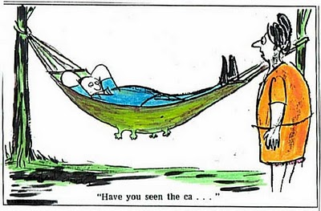
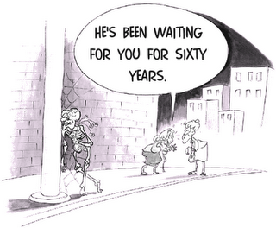
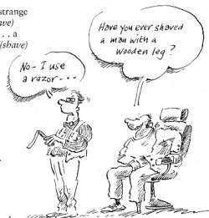
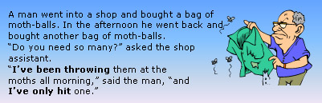
Elektronická učebnice - II. stupeň Základní škola Děčín VI, Na Stráni 879/2 – příspěvková organizace Anglický jazyk
33.6 Something more difficult
Describe the pictures. Can you explain the jokes in English?
Have you seen the cat?
What´s a MOTH?

Slide 7
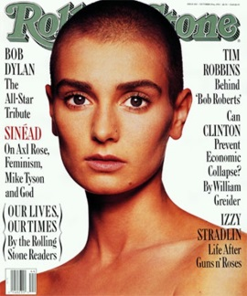
Elektronická učebnice - II. stupeň Základní škola Děčín VI, Na Stráni 879/2 – příspěvková organizace Anglický jazyk
33.7 Nothing compares to you – Sinead O´Connor
Find the examples of past simple and present perfect in this song. Can you name find and name any other tenses?
It's been seven hours and fifteen days
Since you took your love away
I go out every night and sleep all day
Since you took your love away
Since you been gone I can do whatever I want
I can see whomever I choose
I can eat my dinner in a fancy restaurant
But nothing
I said nothing can take away these blues
`Cause nothing compares
Nothing compares to you
It's been so lonely without you here
Like a bird without a song
Nothing can stop these lonely tears from falling
Tell me baby where did I go wrong
I could put my arms around every boy I see
But they'd only remind me of you
I went to the doctor n'guess what he told me
Guess what he told me
He said girl u better try to have fun
No matter what you do
But he's a fool
`Cause nothing compares
Nothing compares to you
All the flowers that you planted, mama
In the back yard
All died when you went away
I know that living with you baby was sometimes hard
But I'm willing to give it another try
Nothing compares
Nothing compares to you
Listen to the song HERE

Slide 8
Elektronická učebnice - II. stupeň Základní škola Děčín VI, Na Stráni 879/2 – příspěvková organizace Anglický jazyk
Elektronická učebnice - II. stupeň Základní škola Děčín VI, Na Stráni 879/2 – příspěvková organizace Anglický jazyk
33.8 Test
Odd one out
written, done, been
come, put, cut
saw, did, was
brought, drunk, driven
3. My car _______ down three times this week.
already
break
broke
has broken
2. I think I ________ that movie before.
saw
have seen
see
will see
4. Odd one out
last week
since
yesterday
in 1897
Correct answers: 1c, 2b, 3d, 4b

Slide 9
Elektronická učebnice - II. stupeň Základní škola Děčín VI, Na Stráni 879/2 – příspěvková organizace Anglický jazyk
33.9 Použité zdroje, citace
Obrázky z databáze klipart
http://tx.english-ch.com/teacher/jocelyn/level-b/present-perfect-or-past-simple/ - slide 2
http://www.usingenglish.com/quizzes/228.html - slide 5
http://magdalena-englishforall.blogspot.cz/2011/01/past-simple-and-present-perfect_2411.html - slide 6
http://campus.belgrano.ort.edu.ar/ingles/ciclobasico/2012-1EFGH-Teens-4-B - slide 6
http://members.chello.at/dan.funk/present_perfect.html - slide 6
http://www.the-beheld.com/2011/09/i-do-not-want-what-i-havent-got-sinead.html - slide 7

Slide 10
Elektronická učebnice - II. stupeň Základní škola Děčín VI, Na Stráni 879/2 – příspěvková organizace Anglický jazyk
33.10 Anotace
Autor | Mgr. Michaela Kaplanová
Období | 01 – 06/2013
Ročník | 8.-9. ročník
Klíčová slova | Past simple, present perfect
Anotace | Prezentace srovnávající užití dvou problémových časů v angličtině, minulého prostého a předpřítomného času.

