Slide 1
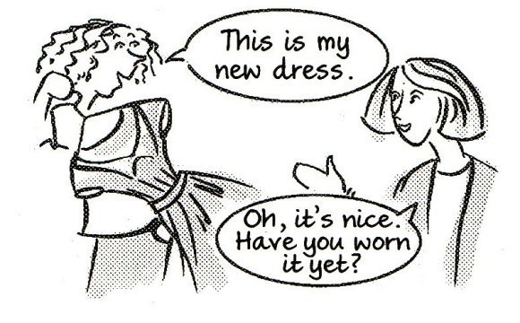
Elektronická učebnice - II. stupeň Základní škola Děčín VI, Na Stráni 879/2 – příspěvková organizace Anglický jazyk
31.1 Present perfect II – signal words
(just, already, yet, ever, never, for, since, once, twice, how long, how many times)
(Předpřítomný čas – signální slova)
Autor: Mgr. Michaela Kaplanová

Slide 2
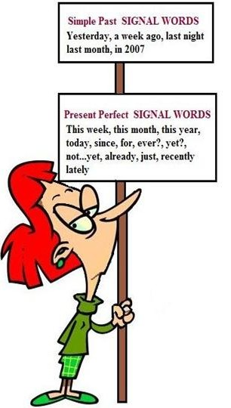
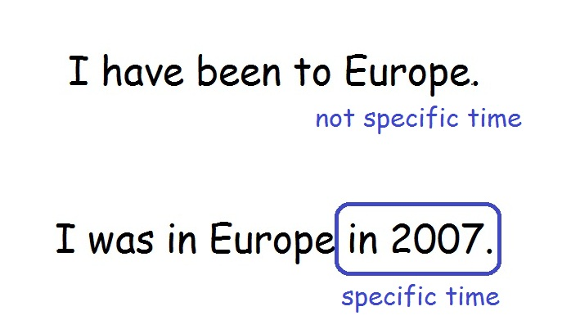
Elektronická učebnice - II. stupeň Základní škola Děčín VI, Na Stráni 879/2 – příspěvková organizace Anglický jazyk
31.2 What do we already know?
Form and use of present perfect
e.g. She has done her homework
(-> The homework is ready now.)
The difference between past simple and present perfect.
Signal words for past simple
last year, on Friday, two days ago, in January

Slide 3
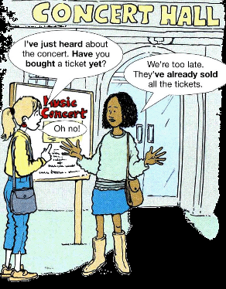
Elektronická učebnice - II. stupeň Základní škola Děčín VI, Na Stráni 879/2 – příspěvková organizace Anglický jazyk
31.3 New terms
just – právě, zrovna
already – již
yet – ještě ne, již (v otázkách)
ever – někdy (v otázkách)
never – nikdy
for – po dobu…
since – od
once – jednou
twice – dvakrát
three times – třikrát
how long – jak dlouho
how many times - kolikrát

Slide 4
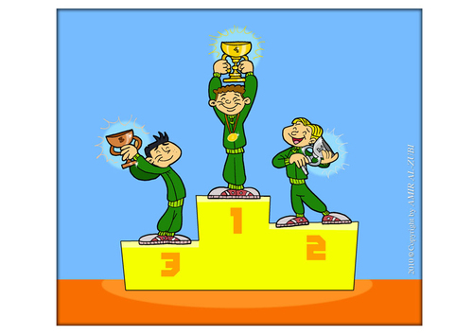
Elektronická učebnice - II. stupeň Základní škola Děčín VI, Na Stráni 879/2 – příspěvková organizace Anglický jazyk
31.4 Present perfect – signal words
JUST – when something happened a short time ago
e.g. I don´t want coffee. I have JUST had one.
ALREADY – when something happened before we expected
e.g. She´s not here. She has ALREADY gone home.
YET - when something has not happened (in negative sentences)
- to ask whether something happened or not ( in questions)
e.g. I haven´t done my homework YET.
Have you bought the ticket YET?
EVER – we use it in questions
e.g. Have you ever won a competition?
NEVER – when something hasn´t happened yet
e.g. I have never seen anything like that.
It is always at the end of the sentence!!!
!!! BEWARE OF THE POSITION IN THE SENTENCE !!!
??? What is the difference between ALREADY and YET???

Slide 5
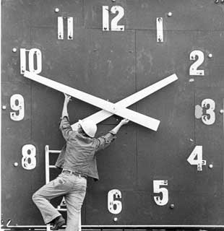
Elektronická učebnice - II. stupeň Základní škola Děčín VI, Na Stráni 879/2 – příspěvková organizace Anglický jazyk
31.5 Exercises
FOR or SINCE ?
1. I haven't phoned home ______ Christmas.
2. We've been here ______ six o'clock.
3. I have worked for this company ______ more than
eight years.
4. I haven't visited my home town ______ I left school.
5. I haven't been to the cinema ______ ages.
6. I have studied non-stop ______ 9.15.
7. I have had a driving licence ______ I was eighteen.
8. Tim has been in England ______ more than two
weeks now.
JUST, ALREADY, YET
EVER and NEVER
1. he / meet / his friend. (just)
2. you / not drink / your glass of Coke. (yet)
3. I / make / my bed. (already)
4. The director / talk / to him. (already)
5. I / write / the e-mail. (just)
6. Paul / not pay / for the dinner. (yet)
1. you/ridden/horse/a/have/ever
2. never/we/won/´ve/competition/a
3. ´s/ghost/he/seen/never/a
4. your/has/ever/in/teacher/flown/plane/a
5. something/have/done/you/crazy/ever
6. place/I/visited/never/have/this/like/a

Slide 6
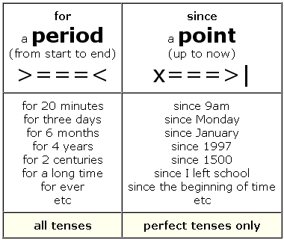
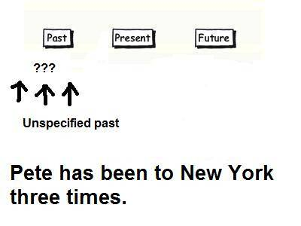
Elektronická učebnice - II. stupeň Základní škola Děčín VI, Na Stráni 879/2 – příspěvková organizace Anglický jazyk
31.6 Something more difficult –
Other expressions used with present perfect
HOW LONG have you known him?
HOW MANY TIMES has he been there?
I have known him FOR ages.
I have known him SINCE 2002.
ONCE
1x
TWICE
2x
THREE TIMES
3x

Slide 7
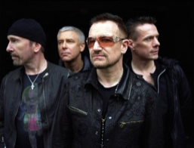
Elektronická učebnice - II. stupeň Základní škola Děčín VI, Na Stráni 879/2 – příspěvková organizace Anglický jazyk
31.7 I Still Haven't Found What I'm Looking For – U2
Fill in the missing words and find present perfect examples:
I have __________ the highest mountain
I have run through the __________
Only to be with you
Only to be with you
I have __________, I have crawled
I have scaled these city walls
These city walls
Only to be with you
But I still haven't found what I'm looking for
But I still haven't found what I'm looking for
I have __________ honey lips
Felt the healing in her fingertips
It burned like fire
This burning __________
I have spoke with the tongue of __________
I have held the hand of a __________
It was warm in the night
I was cold as a __________
But I still haven't found what I'm looking for – 2x
I believe in the __________ come
Then all the colors will bleed into one
Bleed into one
Well, yes, I'm still running
You broke the bonds and you
Loosed the __________
Carried the cross
And my shame
All my shame
You know I __________ it
But I still haven't found what I'm looking for
Correct answers: climbed, fields, run, kissed,
fire, desire, angels, devil, stone, kingdom, chains, believed

Slide 8
Elektronická učebnice - II. stupeň Základní škola Děčín VI, Na Stráni 879/2 – příspěvková organizace Anglický jazyk
31.8 Test
Which sentence is NOT correct?
Have you sent the letter yet?
I have ever cooked dinner for my family.
How long has he known those people?
How many times has she been to Paris?
3. Do you know anything about him?
Yes, I have ________ spoken to him on the phone.
just
already
never
yet
2. Have you seen the new movie?
just
already
yet
ever
4. Which word can´t be used with present perfect?
since
yesterday
recently
for
Correct answers: 1b, 2c, 3a, 4b

Slide 9
Elektronická učebnice - II. stupeň Základní škola Děčín VI, Na Stráni 879/2 – příspěvková organizace Anglický jazyk
31.9 Zdroje, citace
http://www.oskole.sk/?id_cat=9&clanok=4598 – slide 1
http://englishincarballo.blogspot.com/2011/02/intermediate-1-present-perfect-vs-past.html - slide 2
http://thegrammarblog.blogspot.com/2010/04/present-perfect.html - slide 2
http://deg.zahodi-ka.ru/13_present_perfect_2.html - slide 3
http://www.edupics.com/image-to-win-a-competition-i22236.html - slide 4
http://oddballfilms.blogspot.com/2012/02/conscious-clock-perspectives-on-time.html -slide 5
http://ilex5-jahp.blogspot.com/2011/05/since-and-for.html - slide 6
http://esl.about.com/od/grammarstructures/ig/Tenses-Chart/presperf3.htm - slide 6
http://www.tunesmate.com/blog/tag/u2/ - slide 7

Slide 10
Elektronická učebnice - II. stupeň Základní škola Děčín VI, Na Stráni 879/2 – příspěvková organizace Anglický jazyk
31.10 Anotace
Autor | Mgr. Michaela Kaplanová
Období | 01 – 06/2012
Ročník | 8. ročník
Klíčová slova | Předpřítomný čas, signální slova
Anotace | Prezentace objasňující správné užití předpřítomného času a uvádějící slova a slovní spojení nejčastěji s ním užívaná.

