Slide 1
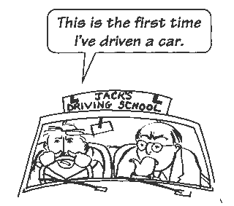
Elektronická učebnice - II. stupeň Základní škola Děčín VI, Na Stráni 879/2 – příspěvková organizace Anglický jazyk
30.1 Present perfect I (Předpřítomný čas)
http://www.englishpage.com/verbpage/presentperfect.html
http://www.ego4u.com/en/cram-up/grammar/present-perfect-simple
Autor: Mgr. Michaela Kaplanová

Slide 2
Elektronická učebnice - II. stupeň Základní škola Děčín VI, Na Stráni 879/2 – příspěvková organizace Anglický jazyk
30.2 What do we already know?
We know how and when we use past simple tense
For example: I went to the supermarket on Monday
My parents wanted to go to the cinema.
Did you see this girl yesterday?
They didn´t want to hurt you.
We can use the verb ´to have´ in present simple (I have x she has
have x haven´t)
We know the irregular verbs (past simple and past participle)
For example:
Present | Past simple | Past participle
see | saw | seen
be | was/were | been
know | knew | known
do | did | done
break | broke | broken

Slide 3
Elektronická učebnice - II. stupeň Základní škola Děčín VI, Na Stráni 879/2 – příspěvková organizace Anglický jazyk
30.3 New terms
Present perfect – předpřítomný čas
Past participle – příčestí minulé („3. sloupec“ slovesného tvaru)
For the list of irregular verbs see this page
Result – výsledek, důsledek
Recently - nedávno

Slide 4
Elektronická učebnice - II. stupeň Základní škola Děčín VI, Na Stráni 879/2 – příspěvková organizace Anglický jazyk
30.4 Present perfect – form and use
Use
We use the present perfect to talk about past actions that have a result in the present.
I´ve written a letter. => The letter is ready to be sent.
We use it also to talk about actions, that have happened RECENTLY, not a long time ago.
I´ve just bought a new skirt.
Form
We form the present perfect with HAVE (has) + PAST PARTICIPLE
In NEGATIVE sentences we put HAVE NOT (haven´t) or HAS NOT (hasn´t).
I haven´t done the homework.
My father hasn´t seen the bad mark yet.
In QUESTIONS we put HAVE (has) at the beginning.
Have you been there? (Yes, I have. x No, I haven´t.)
Has she gone to the party? (Yes, she has. x No, she hasn´t.)
I
She
have (´ve)
has (´s)
been
to New York twice.

Slide 5
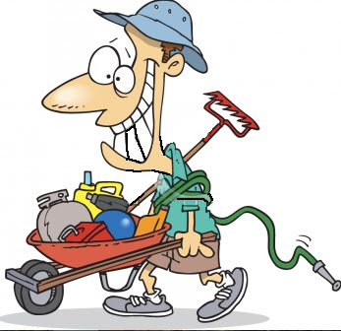
Elektronická učebnice - II. stupeň Základní škola Děčín VI, Na Stráni 879/2 – příspěvková organizace Anglický jazyk
30.5 Exercises Change the verbs in past simple into present perfect
I went to China.
My mum saw the girl in the morning.
She looked at me in a strange way.
I didn´t want to hurt you.
He didn´t come to see us.
Did you work in the garden?
Did you find the papers?
Find one mistake in each sentence
She have been at work.
You have seen the girl?
We havn´t done it yet.
My cousin hasen´t written the homework.

Slide 6
Elektronická učebnice - II. stupeň Základní škola Děčín VI, Na Stráni 879/2 – příspěvková organizace Anglický jazyk
30.6 Something more difficult - BEEN and GONE
Past participle
Infinitive Past simple
We use BEEN when someone has gone away but has come back.
e.g. I saw David in the supermarket. He has been to Mexico. (=> He is home
again )
We use GONE when someone has gone away and hasn´t come back yet.
e.g. My father has gone to the USA. (=> He is still in the USA)
BEEN
GO
WENT
GONE

Slide 7
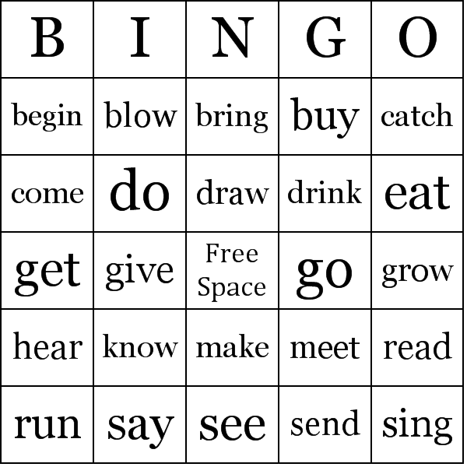
Elektronická učebnice - II. stupeň Základní škola Děčín VI, Na Stráni 879/2 – příspěvková organizace Anglický jazyk
30.7 Play the game
Rewrite these verbs in a chart like this in PAST PARTICIPLE and CHANGE the ORDER. Then listen to the teacher and cross out the verbs that your teacher mentions. If you are the first one who has the whole row or column, you are the winner.

Slide 8
30.8 Test
Elektronická učebnice - II. stupeň Základní škola Děčín VI, Na Stráni 879/2 – příspěvková organizace Anglický jazyk
Find the past participle forms of the verbs
been, done, written, known
seen, wrote, was, grew
had, went, put, cut
saw, listened, taken, taught
2. Which sentence is correct?
Have you been to China?
My sister has wrote the letter.
My teacher haven´t spoken to me.
Did you seen the news?
3. Which verb form is not used
with present perfect?
had had
have had
has had
haven´t had
4. What is the signal word for
present perfect?
a) yesterday
b) tomorrow
c) at the moment
d) recently
Correct answers: 1a, 2a, 3a, 4d

Slide 9
Elektronická učebnice - II. stupeň Základní škola Děčín VI, Na Stráni 879/2 – příspěvková organizace Anglický jazyk
30.9 Anotace
http://www.langust.ru/unit_in/unit008i.shtml
http://ginnyp11.wordpress.com/page/10/
http://ginnyp11.wordpress.com/page/10/
http://thebingomaker.com/index.php/bingo-cards/grammar-bingo-cards/english-irregular-verbs-bingo-cards.html

Slide 10
Elektronická učebnice - II. stupeň Základní škola Děčín VI, Na Stráni 879/2 – příspěvková organizace Anglický jazyk
30.10 Anotace
Autor | Mgr. Michaela Kaplanová
Období | 07 – 12/2011
Ročník | 8. ročník
Klíčová slova | Present perfect, past participle, result, recently
Anotace | Prezentace popisující tvoření a použití předpřítomného času

