Slide 1
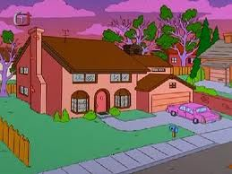
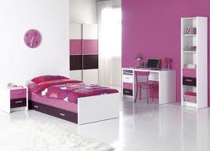
Elektronická učebnice - II. stupeň Základní škola Děčín VI, Na Stráni 879/2 – příspěvková organizace Anglický jazyk
3.1 My house and my room
http://www.youtube.com/watch?v=J3KePdi2ObM&feature=BFa&list=PL39C76E0870D3785F&lf=results_main
Autor: Mgr. Jitka Šolcová

Slide 2
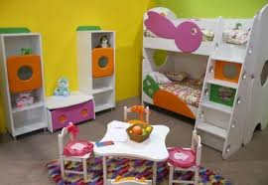
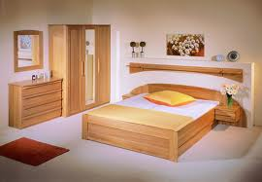
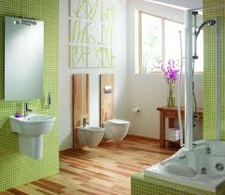
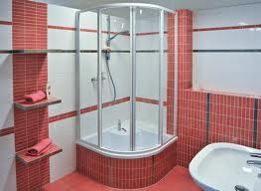
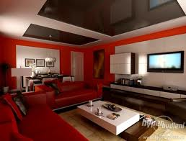
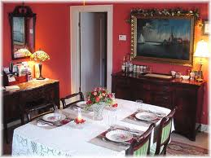
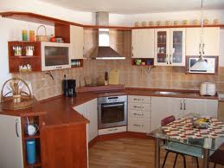
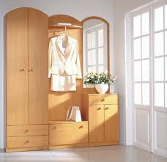
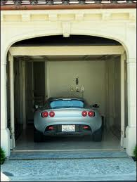
Elektronická učebnice - II. stupeň Základní škola Děčín VI, Na Stráni 879/2 – příspěvková organizace Anglický jazyk
3.2 What do we already know?
bedroom
bedroom
bathroom
shower room
living room
dining room
kitchen
garage
hall

Slide 3
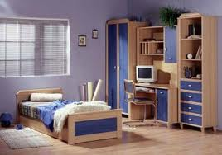
Elektronická učebnice - II. stupeň Základní škola Děčín VI, Na Stráni 879/2 – příspěvková organizace Anglický jazyk
3.3 Describing rooms and furniture
This is my room. I share it with my brother, Mike, and his hamster, Billy. Our room is blue. There is a bed, a desk with computer, a wardrobe and a bookcase. There is a small carpet on the floor. There is a big window but there isn´t a curtain. There aren´t any shelves in my room but there are some pictures on the wall. There is Billy´s cage next to the door.
Is there a chair? – Yes, there is.
Is there a TV ? – No, there isn´t.
Are there any flowers? – Yes, there are.
Are there any posters? – No, there aren´t.
We use „there is“ with a singular noun and „there are“ with plural nouns.
( There is a bed. There are some pictures.)
2. We use „some“ + plural noun in affirmative sentences.
(There are some pictures on the wall.)
We use „any“ + plural noun in negative sentences and questions.
(There aren´t any shelves in my room.)
We use the possessives ´s and s´ with people and animals to show who something
belongs to. (e.g. Billy´s cage is next to the door.)

Slide 4
Elektronická učebnice - II. stupeň Základní škola Děčín VI, Na Stráni 879/2 – příspěvková organizace Anglický jazyk
3.4 Possessive adjectives
Subject pronoun | Possessive adjective
I | my
you | your
she | her
he | his
it | its
we | our
you | your
they | their
I´ve got a TV in my bedroom.
Lucy, where is your school bag?
Emily is in her bedroom.
Mr. Cameron is in his car.
The hamster is in its cage.
Our group is in Room 18.
Open your books, Tim and Tom.
Mum and dad have got their CDs in the living room.
Possessive adjective | Pronoun + verb be
your | you´re (= you are)
its | it´s (= it is)
their | they´re (= they are)
Make sure you spell possessive adjective correctly. These pairs of words sound the same but they have got different spelling and meanings:

Slide 5
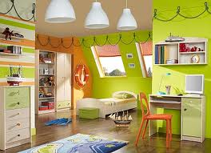
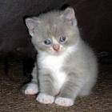
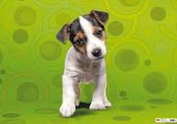
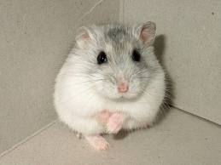
Elektronická učebnice - II. stupeň Základní škola Děčín VI, Na Stráni 879/2 – příspěvková organizace Anglický jazyk
3.5 Exercises
2. Circle the correct word(s).
(Is there/Are there) a TV in your classroom?
I´m sorry but (there isn´t/there aren´t) a clock in this room.
(There isn´t/There aren´t) any CDs on the shelf.
(There is/There are) some sweets in my bag
There aren´t (any/some) pictures on the wall.
There are (any/some) books in the bookcase.
Are there (any/some) toys in your room?
1. Describe this picture
(use there is/there are).
.
3. Who do these animals belong to?
• Mike
• Sara
• brother

Slide 6
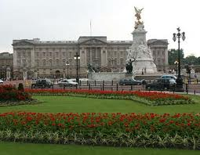
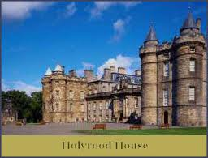
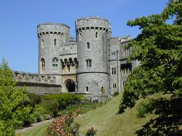
Elektronická učebnice - II. stupeň Základní škola Děčín VI, Na Stráni 879/2 – příspěvková organizace Anglický jazyk
3.6 Something more difficult
Buckingham Palace
Buckingham palace is about two hundred and fifty years old. It´s got six hundred rooms. They´ve all got beautiful old furniture in them. The palace has also got a cinema, a swimming pool and a very big garden. One dining room in the palace is 50 metres long. It´s called the Gallery Room and it´s got hundred of pictures on the walls. Every day in August and September there are thousands of visitors to Buckingham Palace.
Read the text then correct the mistakes in the sentences.
Buckingham Palace is in New York.
It´s about 350 years old.
There aren´t any pictures in the Gallery Room.
There are 6,000 rooms in the palace.
The Queen has got four other homes. Do you know the names?
- O - Y - - - D - - U S –
- I - D - - R C - - T - E

Slide 7
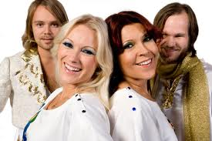
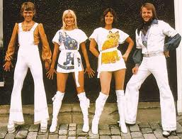
Elektronická učebnice - II. stupeň Základní škola Děčín VI, Na Stráni 879/2 – příspěvková organizace Anglický jazyk
3.7 CLIL - Song
S.O.S by ABBA
http://www.youtube.com/watch?v=ivm908utmRE
Where are those _________ days? they seem so hard to find? I try to reach for you but you have closed your mind whatever happened to our love? I wish I understood it used to be so __________ it used to be so good
Chorus So when you’re near me darling can’t you hear me SOS the love you gave me nothing else can save me SOS
when you’re gone how can I even __________ to go on when you’re gone though I try how can I carry on You seem so far away though you are standing ___________ you made me feel alive but something died I fear I really tried to make it out I wish I understood what happened to our love? It used to be so good
Chorus

Slide 8
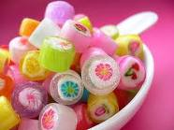
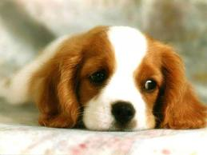
Elektronická učebnice - II. stupeň Základní škola Děčín VI, Na Stráni 879/2 – příspěvková organizace Anglický jazyk
3.8 Revision test
1. There are ……. sweets in this bag.
a) some
b) any
c) no
d) a
3. This is my uncle. ………. name is Simon.
a) Her
b) He´s
c) His
d) He is
2. Her ………. name is Buster.
a) dog´s
b) dogs´
c) dog is
d) dog are
4. There ……. 1000 metres in a kilometre.
a) is
b) are
c) isn´t
d) aren´t
Correct answers:
a)
a)
c)
b)

Slide 9
Elektronická učebnice - II. stupeň Základní škola Děčín VI, Na Stráni 879/2 – příspěvková organizace Anglický jazyk
3.9 Zdroje, citace http://ireport.cz/news/9436-abba-planuje-comeback.html
http://www.supermusic.sk/skupina.php?idskupiny=383
http://www.wazbicsimpsonovi.estranky.cz/clanky/dum-simpsonu.html
http://www.nabytek-aldo.cz/detsky-pokoj-v-ruzovem/
http://www.jub.cz/poradna/barevna-inspirace/barvy-v-interieru/detsky-pokoj/
http://www.nabytek-jicin.cz/nabytek/detske-pokoje/
http://www.kuchynepinos.cz/index.php?id=18
http://m.modernipanelak.cz/panelovy-byt/inspirace-a-styl/mala-velka-koupelna-v-panelaku
http://www.realt.cz/bydleni/113-funkci-a-pohodlna-koupelna
http://www.jelinek.eu/produkty-loznice-loznice-pavla
http://www.bytmax.cz/predsin_cs42
http://www.interiery-krnov.cz/index.php?obyvak
http://sweethomeideas.com/elements-furniture-dining-room/
http://gadgets.vtm.zive.cz/doprava/sc-249/default.aspx?pgnum=27
http://travelling2011.com/the-windsor-castle/
http://www.englishmonarchs.co.uk/holyrood_house.html
http://www.tvoje-matrace.cz/detsky-pokoj-basic-det-504-91-2-90-91.html
Johnston, O.: Workbook TEMPO 1, Macmillan Publishers 2005

Slide 10
Elektronická učebnice - II. stupeň Základní škola Děčín VI, Na Stráni 879/2 – příspěvková organizace Anglický jazyk
3.10 Anotace
Autor | Mgr. Jitka Šolcová
Období | 07 – 12/2011
Ročník | 6. ročník
Klíčová slova | House, room, some x any, possessive pronouns
Anotace | Prezentace zaměřená na popis pokoje užitím vazby there is/there are, přivlastňovací a neurčitá zájmena.

