Slide 1

Elektronická učebnice - II. stupeň Základní škola Děčín VI, Na Stráni 879/2 – příspěvková organizace Anglický jazyk
26.1 Past continuous, reflexive pronouns
(minulý čas průběhový, zvratná zájmena)
I did it MYSELF.
What did these people do THEMSELVES?
Autor: Mgr. Michaela Kaplanová

Slide 2
Elektronická učebnice - II. stupeň Základní škola Děčín VI, Na Stráni 879/2 – příspěvková organizace Anglický jazyk
26.2 What do we already know?
Name some examples for these kinds of pronouns:
We could know the meanings of these words:
(In case you don´t, use the dictionary to help you.)
SUBJECT (podmětná)
POSSESSIVE
(přivlastňovací)
OBJECT
(předmětná)
SELF-ASSURED
SELF-CENTRED
SELF-CONFIDENT
SELF-CONTROL
SELF-DEFENCE
SELFISH
SELF-PORTRAIT
SELF-RESPECT
SELF-SERVICE
What do they have in common?
What are the names of the following tenses?:
They will help you.
I don´t play football.
I am writing a shopping list.
We are going to visit our grandma.
Our class went to the park to have a picnic.

Slide 3
Elektronická učebnice - II. stupeň Základní škola Děčín VI, Na Stráni 879/2 – příspěvková organizace Anglický jazyk
26.3 New terms – Reflexive pronouns (zvratná zájmena)
We use reflexive pronouns as the object in the sentence (the object and the subject refer to the same person or animal).
e.g. I bought a present for myself.
I´ve hurt myself.
We also use them to emphasize the subject.
e.g. I did it myself. (nobody helped me)
We ate the cake ourselves. (nobody else
had a piece)
Other examples:
David wants to buy himself some lunch.
The cat is washing itself.
My daughter can write the letter herself.
STUDY THIS
I | myself
you | yourself
he | himself
she | herself
it | itself
we | ourselves
you | yourselves
they | themselves
Tom, help yourself to some sandwich.
Help yourselves to some drink, all of you.
subject – podmět
object – předmět
refer to – vztahovat se k
emphasize - zdůraznit

Slide 4
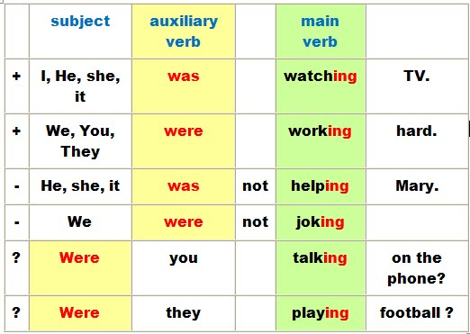
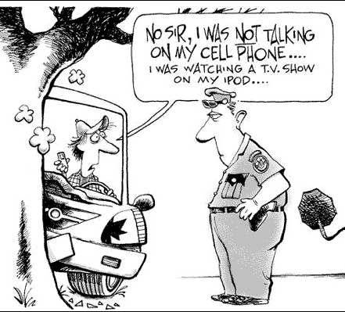
Elektronická učebnice - II. stupeň Základní škola Děčín VI, Na Stráni 879/2 – příspěvková organizace Anglický jazyk
26.4 Past continuous - FORM
WAS / WERE + present participle (-ing form) of the main verb
She was sleeping at 5 o´clock yesterday.
We were watching TV when he arrived.
For spelling exceptions in present participle forms see DUM 12.
When do we use past continuous? See slide 6

Slide 5
Elektronická učebnice - II. stupeň Základní škola Děčín VI, Na Stráni 879/2 – příspěvková organizace Anglický jazyk
26.5 Exercises
What were these people doing yesterday at 7 a.m.? Use the same pictures to make negatives and questions.
Carol
Tim
Andrew
Mary
Helen
Ellis, Ben
Harry
Susan
Sue, William
Emily
Fill in the sentences with the correct reflexive pronouns.
The man is talking to ____________ .
Me and my sister enjoyed ____________ at the party.
I cleaned the house ____________ .
You should be proud of ____________ .
Let me introduce ___________ .
They look at ____________ in the mirror.
She´s hurt ____________ .

Slide 6
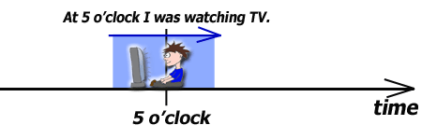
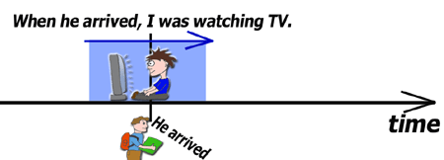
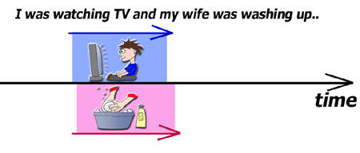
Elektronická učebnice - II. stupeň Základní škola Děčín VI, Na Stráni 879/2 – příspěvková organizace Anglický jazyk
26.6 Past continuous x Past simple – USE
Both these tenses refer to COMPLETED actions in the past. Past simple is more common.
PAST CONTINUOUS
a) Something happening at the specific time in the past
b) Two actions happening at the same time in the past
c) To emphasize the duration of the process
I was waiting there for two hours!
I was playing tennis the whole afternoon.
SIGNAL WORDS
when (když used with PS)
while (zatímco used with PC)
as long as
Expressed by time
Expressed by action
=While I was watching TV, he arrived.
PAST SIMPLE
It is not important when EXACTLY the action happened.
SIGNAL WORDS
last summer, yesterday, two days ago, in 1965, on Monday

Slide 7
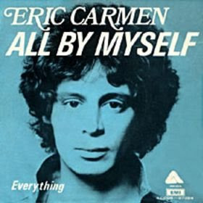
Elektronická učebnice - II. stupeň Základní škola Děčín VI, Na Stráni 879/2 – příspěvková organizace Anglický jazyk
26.7 All By Myself – Eric Carmen
When I was young
I never needed anyone
And makin' love was just for fun
Those days are gone
Livin' alone
I think of all the friends I've known
But when I dial the telephone
Nobody's home
Chorus:
All by myself
Don't wanna be, all by myself anymore
All by myself
Don't wanna live, all by myself anymore
Hard to be sure
Sometimes I feel so insecure
And love so distant and obscure
Remains the cure
Chorus
When I was young
I never needed anyone
And makin' love was just for fun
Those days are gone
Chorus 2x
What is the singer´s main feeling?
Explain the words: dial, insecure, distant, obscure, remain
Watch the video with lyrics HERE

Slide 8
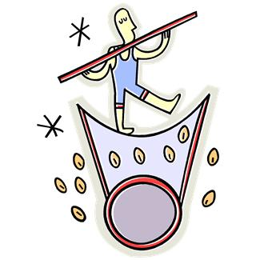
Elektronická učebnice - II. stupeň Základní škola Děčín VI, Na Stráni 879/2 – příspěvková organizace Anglický jazyk
Elektronická učebnice - II. stupeň Základní škola Děčín VI, Na Stráni 879/2 – příspěvková organizace Anglický jazyk
26.8 Test
Which sentence is NOT correct?
The machine does it itself.
Forget it, I´ll do it myself.
Ashley and Tom, take care of yourselves.
Harry locked herself in the room.
3. Which signal word is not typical for past continuous?
yesterday
while
when
as long as
2. In which sentence is the tense mistake?
I was having a shower when my father came.
While I wrote my homework, he was calling me.
We were walking our dog yesterday at 3 o´clock.
We went to Croatia last summer.
4. What is the correct reflexive pronoun? Trust________ .
himself
themselves
yourself
ourselves
Correct answers: 1d, 2b, 3a, 4c

Slide 9
Elektronická učebnice - II. stupeň Základní škola Děčín VI, Na Stráni 879/2 – příspěvková organizace Anglický jazyk
26.9 Použité zdroje, citace
http://grammarworm.blogspot.cz/2009/11/past-continuous-tense-past-progressive.html - slide 4
http://elblogdeinglesdelaaxarquia.blogspot.cz/p/past-simple-past-continuous.html - slide 4
http://www.helpforenglish.cz/gramatika/slovesa/casy/minule/c2006123001-minuly-prubehovy-cas--past-continuous-.html - slide 6
http://davehilljournal.blogspot.cz/2008/12/flat-eric-carmen.html - slide 7
Obrázky z databáze klipart

Slide 10
Elektronická učebnice - II. stupeň Základní škola Děčín VI, Na Stráni 879/2 – příspěvková organizace Anglický jazyk
26.10 Anotace
Autor | Mgr. Michaela Kaplanová
Období | 01 – 06/2012
Ročník | 8. ročník
Klíčová slova | Past continuous, reflexive pronouns
Anotace | Prezentace vysvětlující formu minulého průběhového času, jeho užití v porovnání s minulým časem prostým a uvádějící anglická zvratná zájmena a pravidla pro jejich užití.

