Slide 1
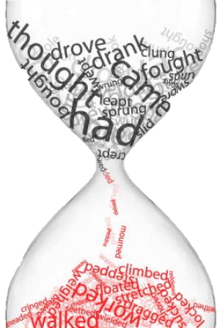
Elektronická učebnice - II. stupeň Základní škola Děčín VI, Na Stráni 879/2 – příspěvková organizace Anglický jazyk
24.1 Past simple – irregular verbs, last, ago (Minulý čas prostý – nepravidelná slovesa, last, ago)
Here is a list of all irregular verbs.
You don´t have to study them all.
There are also links to their meanings and pronunciation.
IRREGULAR VERBS
Autor: Mgr. Michaela Wernerová

Slide 2
Elektronická učebnice - II. stupeň Základní škola Děčín VI, Na Stráni 879/2 – příspěvková organizace Anglický jazyk
24.2 What do we already know?
Past simple tense – use
We use past simple for actions that happened at a definite time in the past. It is often used with the time expressions like in 1988, yesterday, in May, last winter…
2. Questions and negatives in past simple
DID you see that?
I DIDN´T go there yesterday.
3. Regular verbs
listen+ed, work+ed, talk+ed, open+ed, wash+ed, play+ed, work+ed, stay+ed, watch+ed
4. Past simple of the verb "to be "
The main verb is in the base form (present tense)
I was | we were
you were | you were
he, she, it was | they were
I was not (wasn´t) | we were not (weren´t)
you were not (weren´t) | you were not (weren´t)
he, she, it was not (wasn´t ) | they were not (weren´t)
Was I…? | Were we…?
Were you…? | Were you…?
Was he/she/it…? | Were they…?
You can practise was/were here.

Slide 3
Elektronická učebnice - II. stupeň Základní škola Děčín VI, Na Stráni 879/2 – příspěvková organizace Anglický jazyk
24.3 Irregular verbs I.
INFINITIVE | PAST SIMPLE | PAST PARTICIPLE | INFINITIVE | PAST SIMPLE | PAST PARTICIPLE
be | was/were | been | eat | ate | eaten
become | became | become | fall | fell | fallen
begin | began | begun | feel | felt | felt
bite | bit | bitten | find | found | found
break | broke | broken | fly | flew | flown
bring | brought | brought | forget | forgot | forgotten
build | built | built | get | got | got
burn | burned/burnt | burned/burnt | give | gave | given
buy | bought | bought | go | went | gone
catch | cought | cought | have | had | had
choose | chose | chosen | hear | heard | heard
come | came | come | hit | hit | hit
cost | cost | cost | hold | held | held
cut | cut | cut | keep | kept | kept
do | did | done | know | knew | known
drink | drank | drunk | learn | learned/learnt | learned/learnt
drive | drove | driven | leave | left | left

Slide 4
Elektronická učebnice - II. stupeň Základní škola Děčín VI, Na Stráni 879/2 – příspěvková organizace Anglický jazyk
24.4 Irregular verbs II.
INFINITIVE | PAST SIMPLE | PAST PARTICIPLE | INFINITIVE | PAST SIMPLE | PAST PARTICIPLE
let | let | let | sit | sat | sat
lose | lost | lost | sleep | slept | slept
make | made | made | speak | spoke | spoken
meet | met | met | spend | spent | spent
pay | paid | paid | stand | stood | stood
put | put | put | swim | swam | swum
read [ri:d] | read [red] | read [red] | swing | swung | swung
ride | rode | ridden | take | took | taken
ring | rang | rung | teach | taught | taught
run | ran | run | tell | told | told
say | said | said | thing | thought | thought
see | saw | seen | throw | threw | thrown
send | sent | sent | understand | understood | understood
shoot | shot | shot | wake up | woke up | woken up
shut | shut | shut | wear | wore | worn
sing | sang | sung | win | won | won
sink | sank | sunk | write | wrote | written

Slide 5
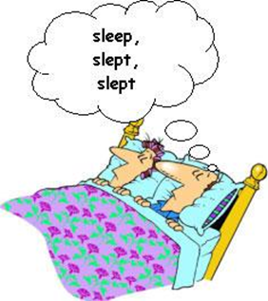
Elektronická učebnice - II. stupeň Základní škola Děčín VI, Na Stráni 879/2 – příspěvková organizace Anglický jazyk
24.5 Exercises
1. Try to fill in the correct irregular verb in past simple
1. Yesterday I ___________ to the movies.
2. My sister ___________ a birthday cake for me last week.
3. Steve ___________ his bicycle to school yesterday.
4. My friends ___________ to Los Angeles two weeks ago.
5. Elizabeth ___________ some flowers to her mother last Saturday.
6. Kevin ___________ his leg while he was playing football.
7. Last week my aunt ___________ birth to a baby.
8. When we cleaned the yard, we ___________ a lot of work.
9. The child ___________ some milk last night.
10. My teacher ___________ some new books last month.
2. Use the following verbs to make a story in past simple
VISIT, EAT, SWIM, DRINK, WRITE, WORK

Slide 6
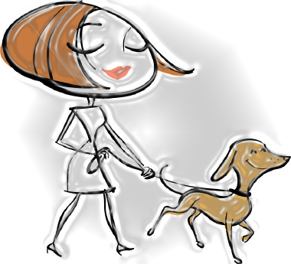
Elektronická učebnice - II. stupeň Základní škola Děčín VI, Na Stráni 879/2 – příspěvková organizace Anglický jazyk
24.6 Something more difficult – LAST, AGO
With past simple, we use these two words very often.
LAST (naposledy)
E.g. When did you last see her?
I last took my dog for a walk three days ago.
My mother last cooked dinner for me three months ago.
We always place LAST after the subject.
AGO (před) E.g. He was there ten minutes ago. (= ten minutes before now)
I read this book two years ago. (= two years before now)
How long ago did you call her?
I saw her many years ago. I don´t remember her name.
We always use AGO with period of time.

Slide 7
Elektronická učebnice - II. stupeň Základní škola Děčín VI, Na Stráni 879/2 – příspěvková organizace Anglický jazyk
24.7 CLIL
Match the verbs with the school subjects (the number is the number of verbs for each subject) and think out a sentence for each of them. There is 1 regular verb. Which one is it?
You can also study the irregular verbs with help of these videos: 1, 2, 3 or many others.
GEOGRAPHY 1
travel
HISTORY 2
win, become
burn
catch
win
become
understand
cut
swim
run
sing
make
travel
MATHS 1
understand
MUSIC 1
sing
CHEMISTRY 1
burn
PHYSICAL EDUCATION 3
catch, swim, run
ART 2
cut, make

Slide 8
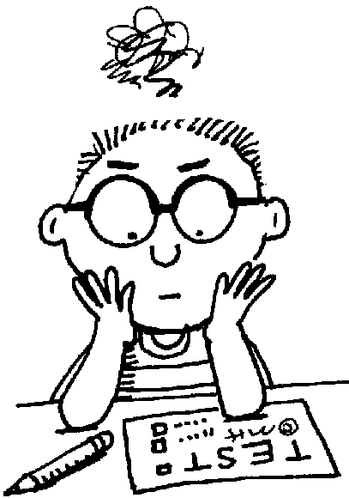
Elektronická učebnice - II. stupeň Základní škola Děčín VI, Na Stráni 879/2 – příspěvková organizace Anglický jazyk
24.8 Test
4. Which possibility IS correct?
fly – flow – flown
swim – swum – swam
give – gave – given
get – get - get
Which verb can be regular?
learn
do
be
have
2. What is past simple of BREAK?
break
broken
broke
Broked
3. Which possibility is NOT correct?
hit – hit – hit
cut – cut – cut
put – put – put
win – win – win
Correct answers: 1a, 2c, 3d, 4c

Slide 9
Elektronická učebnice - II. stupeň Základní škola Děčín VI, Na Stráni 879/2 – příspěvková organizace Anglický jazyk
24.9 Použité zdroje, citace
http://carmenlaffon.blogspot.com/2011/05/irregular-verbs.html
http://inesworkshop.blogspot.com/2011/02/irregular-verbs.html
http://school.discoveryeducation.com/clipart/clip/dmbtest.html

Slide 10
Elektronická učebnice - II. stupeň Základní škola Děčín VI, Na Stráni 879/2 – příspěvková organizace Anglický jazyk
24.10 Anotace
Autor | Mgr. Michaela Kaplanová
Období | 07 – 12/2011
Ročník | 8. ročník
Klíčová slova | Past, irregular, last, ago
Anotace | Prezentace popisující tvoření a použití minulého času prostého – nepravidelný tvar

