Slide 1
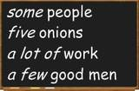
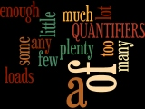
Elektronická učebnice - II. stupeň Základní škola Děčín VI, Na Stráni 879/2 – příspěvková organizace Anglický jazyk
23.1 Expressions of quantity, Food
(Vyjadřování množství, Jídlo)
You can study more e.g. here
Autor: Mgr. Michaela Kaplanová

Slide 2
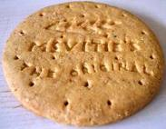
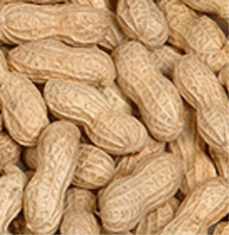
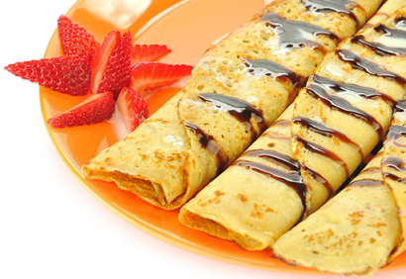
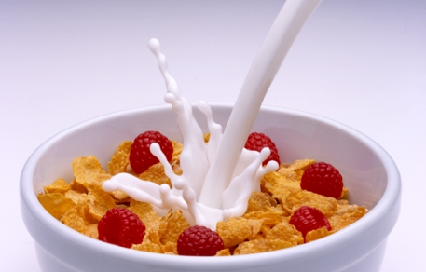
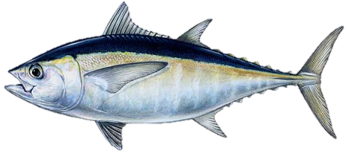
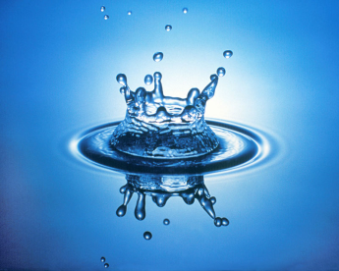
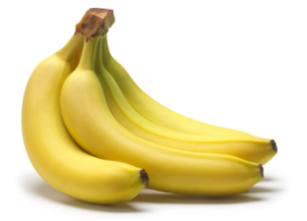
Elektronická učebnice - II. stupeň Základní škola Děčín VI, Na Stráni 879/2 – příspěvková organizace Anglický jazyk
23.2 What do we already know?
Countability of nouns (# 15)
2. Some words connected to food and drink (# 15)
3. The difference between HOW MUCH and HOW MANY (# 18)
In questions, we use HOW MUCH for uncountable and HOW MANY for
countable nouns to ask about the quantity of things.
HOW MANY …? HOW MUCH …?
Countable nouns (apple,child) | Uncountable nouns (rice, water)
Have plural | Don´t have plural
Indefinite article a/an in sg., some in pl. | some

Slide 3
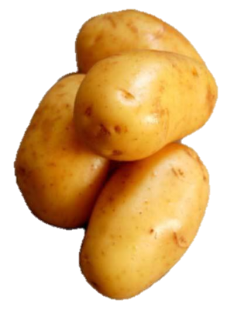
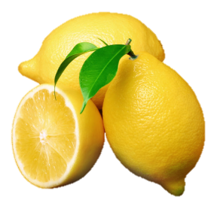
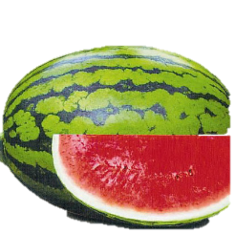
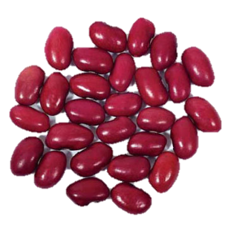
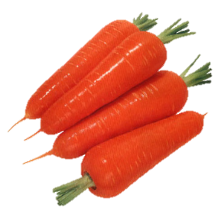
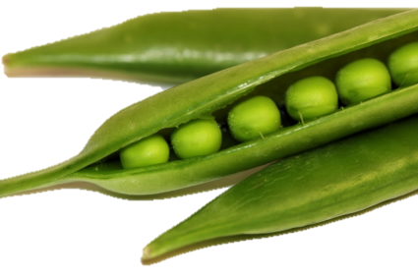
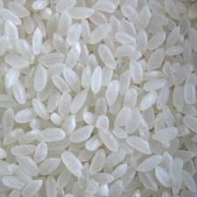
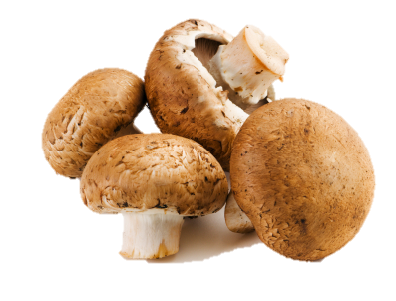
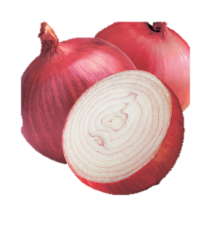
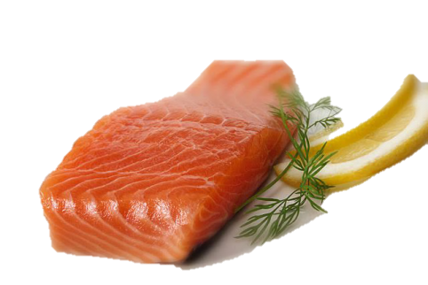
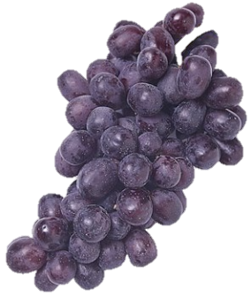
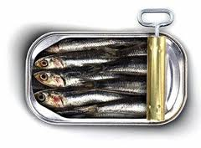
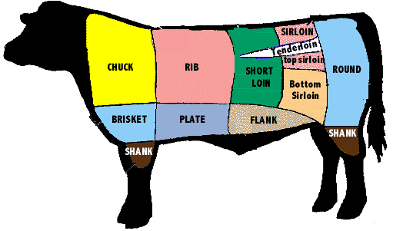
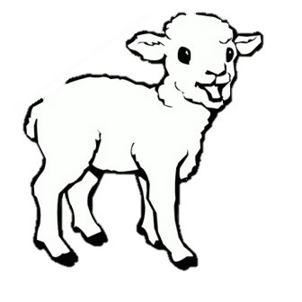
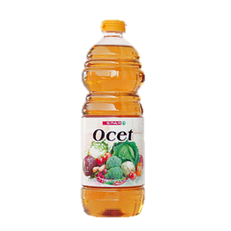
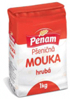
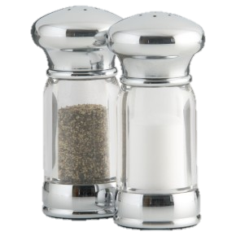
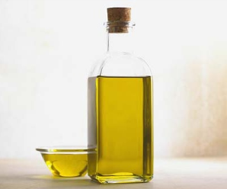
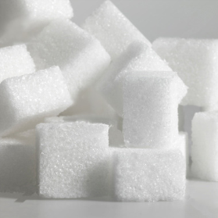
Elektronická učebnice - II. stupeň Základní škola Děčín VI, Na Stráni 879/2 – příspěvková organizace Anglický jazyk
23.3 New terms - FOOD
potatoes lemons melon beans peas carrot
rice mushrooms grapes onions sardines salmon
beef lamb oil vinegar flour pepper, salt sugar

Slide 4
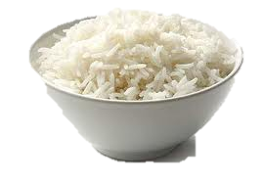
Elektronická učebnice - II. stupeň Základní škola Děčín VI, Na Stráni 879/2 – příspěvková organizace Anglický jazyk
23.4 Expressions of quantity
 | Affirmative + | Negative - | Questions ?
Plural countable nouns | a lot of / lots of plenty of a few (málo) | many | plenty of many
Uncountable nouns | a lot of / lots of plenty of a little (málo) | much | plenty of much
Examples:
Plural countable nouns
I know a lot of / lots of / plenty of / a few people in this town.
I can´t speak many languages.
Do you read many English books?
Uncountable nouns
I eat a lot of / lots of / plenty of / a little rice.
We haven´t got much time.
Wow much money do you spend every day?

Slide 5
Elektronická učebnice - II. stupeň Základní škola Děčín VI, Na Stráni 879/2 – příspěvková organizace Anglický jazyk
23.5 Exercises
Fill in much, many, a little or a few: 1. He isn't very popular. He has ________ friends 2. Ann is very busy these days. She has ________ free time. 3. Did you take ________ photographs when you were on holidays? 4. I'm not very busy today. I haven't got ________ to do. 5. The museum was very crowded. There were too ________ people. 6. Most of the town is modern. There are ________ old buildings. 7. The weather has been very dry recently. We've had ________ rain.
Write down 10 countable and 10 uncountable nouns.
Complete the expressions and make them true for you:
I have plenty of _____________ .
I haven´t got much _____________ .
I don´t know many _____________ .
I eat a few _____________ every day.
I drink a little _____________ . I don´t like it.

Slide 6
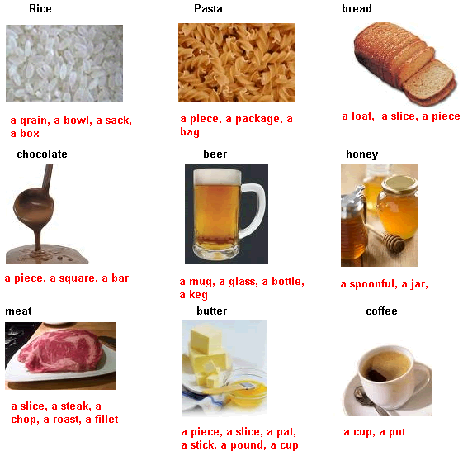
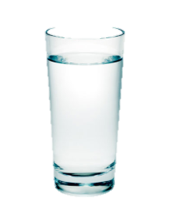
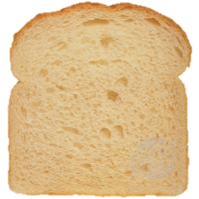
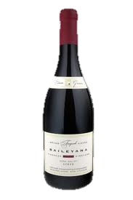
Elektronická učebnice - II. stupeň Základní škola Děčín VI, Na Stráni 879/2 – příspěvková organizace Anglický jazyk
23.6 Something more difficult – making U nouns C
Sometimes we can make uncountable nouns countable by
adding a counable noun before an uncountable one.
e.g.
a glass of water
a slice of bread
a bottle of wine
With words like these you also recognize the quantity of the things.

Slide 7
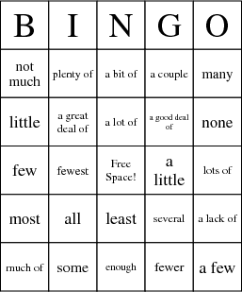
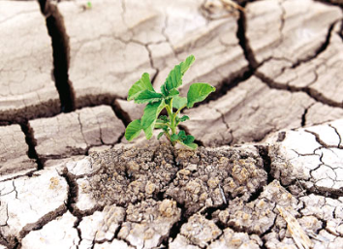
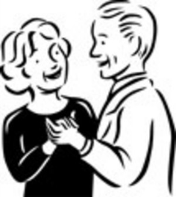
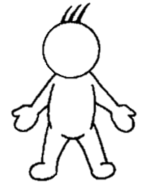
Elektronická učebnice - II. stupeň Základní škola Děčín VI, Na Stráni 879/2 – příspěvková organizace Anglický jazyk
23.7 CLIL
Now you know a lot of expressions of quantity. There are many others. Try to guess the meanings of these or find them in the dictionary and then you can play BINGO. Here are some hints:
a lack of
a couple
none

Slide 8
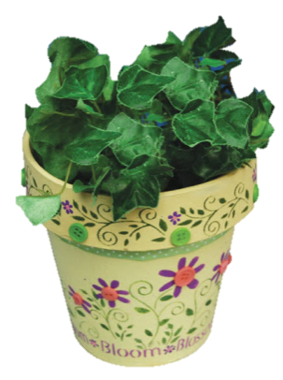
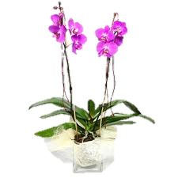
Elektronická učebnice - II. stupeň Základní škola Děčín VI, Na Stráni 879/2 – příspěvková organizace Anglický jazyk
23.8 Test
How do we call a young sheep?
calf
beef
lamb
Pork
2. I have got ________ flowers at home.
many
much
a little
a few
3. Which word doesn´t mean
the same as the others?
many
plenty of
much
a few
Which word can´t be used in a question?
a lot of
plenty of
many
much
Correct answers: 1c, 2d, 3d, 4a

Slide 9
Elektronická učebnice - II. stupeň Základní škola Děčín VI, Na Stráni 879/2 – příspěvková organizace Anglický jazyk
23.9 Použité zdroje, citace
http://www.bingocardcreator.com/bingo-cards/english/quantifiers
http://grammar.about.com/od/pq/g/Quantifier.htm
http://rkmp.co.in/general-domain/rice-in-human-nutrition/
http://en.wikipedia.org/wiki/Beef
http://tholec.blogspot.com/2011/09/lemon-reminder.html
http://www.poundgetsome.com/graffiti/human-sardines/
http://www.pafarmcsa.com/Mushroom_CSA.html
http://www.vinetowineguide.com/planting-grapes.html
http://www.bohemikum.cz/potraviny%20do%20domu%20don%C3%A1%C5%A1ka%20j%C3%ADdla%20praha/mouka/hruba-mouka-[mcs-m03]?ItemIdx=4
http://www.megabludicka.cz/news/rady-pro-vsedni-den/

Slide 10
Elektronická učebnice - II. stupeň Základní škola Děčín VI, Na Stráni 879/2 – příspěvková organizace Anglický jazyk
23.10 Anotace
Autor | Mgr. Michaela Kaplanová
Období | 07 – 12/2011
Ročník | 8. ročník
Klíčová slova | Plural, countable + uncoutable nouns
Anotace | Prezentace popisující vyjadřování množství u podstatných jmen a potravin

