Slide 1
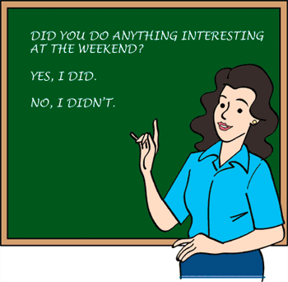
Elektronická učebnice - II. stupeň Základní škola Děčín VI, Na Stráni 879/2 – příspěvková organizace Anglický jazyk
22.1 Past simple – be + regular verbs (Minulý čas prostý – být + pravidelná slovesa)
http://www.englishpage.com/verbpage/
simplepast.html
http://www.ego4u.com/en/cram-up/grammar/simple-past
Autor: Mgr. Michaela Wernerová

Slide 2
Elektronická učebnice - II. stupeň Základní škola Děčín VI, Na Stráni 879/2 – příspěvková organizace Anglický jazyk
22.2 What do we already know?
Form and use of:
Present simple
Present continuous
Future tenses (will, going to, present continuous for the future)
2. How we form questions and negative sentences in present simple
Questions – Do you speak English?
Does he know my brother?
Negatives – I don´t like this song.
She doesn´t drink alcohol.

Slide 3
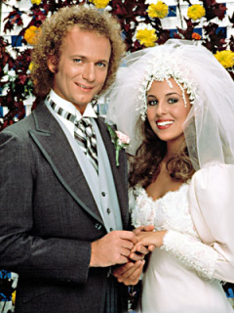
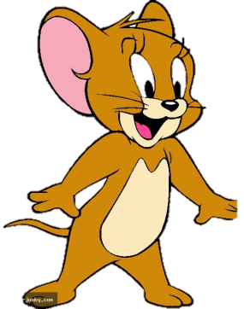
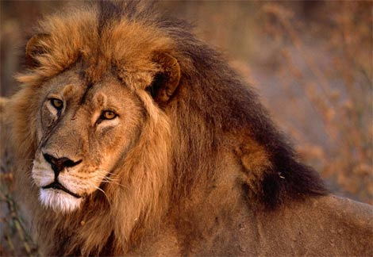
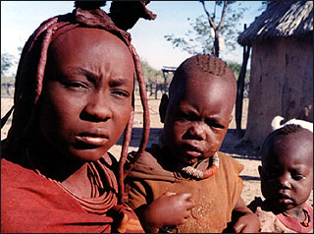
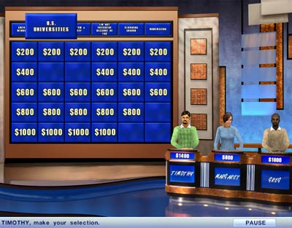
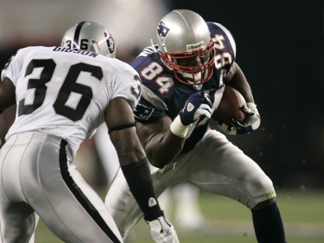
Elektronická učebnice - II. stupeň Základní škola Děčín VI, Na Stráni 879/2 – příspěvková organizace Anglický jazyk
22.3 New terms
past – minulý
regular – pravidelný
news
weather
comedy programme
cartoon
film (movie)
sports programme
soap opera
documentary
nature programme
quiz show
music programme
advert

Slide 4
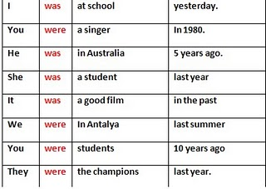
Elektronická učebnice - II. stupeň Základní škola Děčín VI, Na Stráni 879/2 – příspěvková organizace Anglický jazyk
22.4 Past simple – USE and FORM 1. USE – použití
We use past simple for actions that happened in a definite time in the past (yesterday,
last summer, in 1995, in May…)
2. FORM (be + regular verbs)
A) The verb ´to be´ - for positive sentences see the chart ==>
- negative sentences – I was NOT at school (=I wasn´t at school.)
You were NOT a singer (=You weren´t …)
- questions – Were you a singer ?
Was he in Australia?
Short answers – Yes, I was. No, I wasn´t.
Yes, you were. No, you weren´t .
B) Regular verbs – we form regular verbs in past simple by adding -ED to the verb
for example visited, played, worked, watched,…
There are some SPELLING RULES: like – liked, phone – phoned => we add only –D when the verb ends in –E
cry – cried, try – tried => we change – Y after a consonant in –IED
stop – stopped, clap - clapped => sometimes we double the final consonant
positive sentences – I played football. You watched TV. She arrived home.
negative sentences – I DIDN´T play football. You DIDN´T watch TV. She DIDN´T arrive home. (didn´t = did not)
!!! DIDN´T has the same form for all persons!!!
!!! The verb after DIDN´T is in the base form (infinitive without ´to´) => it is NOT in the past!!!
questions – DID I play football? DID you watch TV? DID she arrive home?
!!! DID has the same form for all persons!!!
!!! The verb after the subject is in the base form (infinitive without ´to´) => it is NOT in the past!!!
Short answers – Yes, I did. No, I didn´t.
Yes, he did. No, he didn´t.

Slide 5
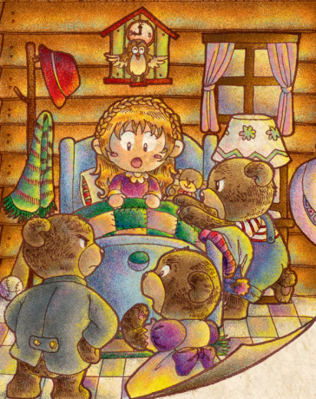
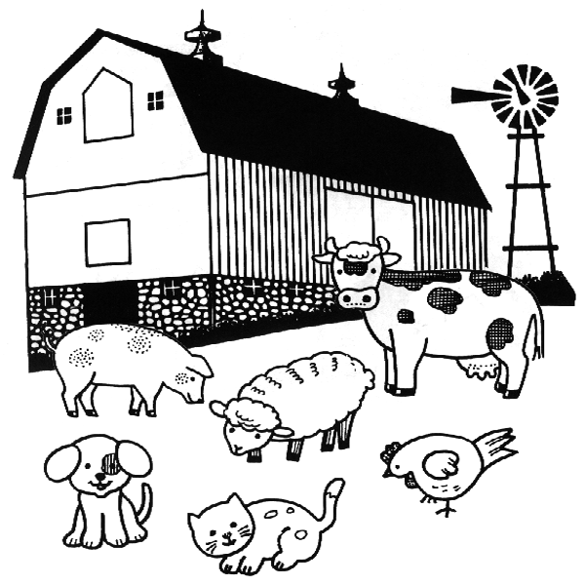
Elektronická učebnice - II. stupeň Základní škola Děčín VI, Na Stráni 879/2 – příspěvková organizace Anglický jazyk
22.5 Exercises
1. Complete the sentences with WAS or WERE
I______ happy. You ______ angry. She ______ in London last week. He ______ on holiday. It ______ cold. We ______ at school. You ______ at the cinema. They ______ at home. The cat ______ on the roof. The children ______ in the garden.
2. Fill in the verbs in past simple
Once upon a time there (be) ______ three bears: huge Papa Bear, Mama Bear and tiny little Baby
Bear. They (live) ______ in a great big wood. One day, Mama Bear (cook) ______ a delicious porridge
for her family and put it into bowls. Then they (walk) ______ out. Near the great big wood, there
(live) ______ a little girl called Goldilocks. She (be) ______ not allowed to go into the wood. But one
day, she (sneak) ______ out of the house and ran into the great big wood. She (knock) ______ at the
door of the bears´ house. She (look) ______ through the windows. But nobody (seem) ______ to be
there. So, little Goldilocks (step) ______ inside.
3. Make questions or negative sentences in past simple
1) I________ my Maths homework yesterday. (not do)
2) ________ Susan________ to England by plane? (go)
3) They________ a farm two weeks ago. (visit)
4) Jenny and Peggy ________ their brother. (not help)
5) The children ________ at home last weekend. (not be)
6) When________ you________ this wonderful skirt? (buy)
7) My mother________ into the car. (not crash)
8) The boys________ their bicycles. (not take)
9) ________ you________ your aunt last week? (phone)
10) He________ milk at school. (not drink)

Slide 6
Elektronická učebnice - II. stupeň Základní škola Děčín VI, Na Stráni 879/2 – příspěvková organizace Anglický jazyk
22.6 Something more difficult – pronouncing -ED
Different regular verbs in past simple can be pronounced in 3 different ways. Can you sort the verbs according to the last sound? What are the rules?
liked, wanted, ended, hoped, washed, played, watched, listened
http://www.englishclub.com/pronunciation/-ed.htm
http://www.youtube.com/watch?v=zh_DM7qJGWo&feature=fvw
/t/ | /d/ | /id/

Slide 7
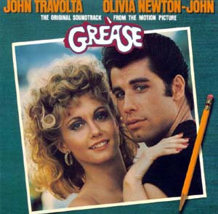
http://www.youtube.com/watch?v=hG_XYQZikWc
Elektronická učebnice - II. stupeň Základní škola Děčín VI, Na Stráni 879/2 – příspěvková organizace Anglický jazyk
22.7 Summer nights
Past simple is a very common tense. You can find some examples of it even in many famous songs. Here is one of them – Summer Nights from the musical Grease. Find all the examples of regular verbs and questions and the verb ´to be´ in past simple in the lyrics. Then you can listen to the song.
Summer lovin' had me a blast Summer lovin', happened so fast I met a girl crazy for me I met a boy, cute as can be (1) Summer days driftin' away, To uh-oh those summer nights Tell me more, tell me more, Did you get very far? Tell me more, tell me more, Like, does he have a car? (1) She swam by me, she got a cramp He went by me, got my suit damp I saved her life, she nearly drowned He showed off, splashing around Summer sun, something's begun, But uh-oh those summer nights (3) Tell me more, tell me more, Was it love at first sight? Tell me more, tell me more, Did she put up a fight? Took her bowlin' in the Arcade We went strollin', drank lemonade We made out under the dock we stayed up until ten o'clock (3)
Summer fling don't mean a thing, But uh-oh those summer nights Tell me more, tell me more, But you don't gotta brag Tell me more, tell me more, Cause he sounds like a drag (0) He got friendly, holdin' my hand Well she got friendly, down in the sand He was sweet, just turned eighteen Well she was good, you know what I mean (3) Summer heat, boy and girl meet, But uh-oh those summer nights Tell me more, tell me more, How much dough did he spend? Tell me more, tell me more, Could she get me a friend? (1) It turned colder, that's where it ends So I told her we'd still be friends Then we made our true love vow Wonder what she's doin' now (1) Summer dreams ripped at the seams, But oh, those summer nights (1)

Slide 8
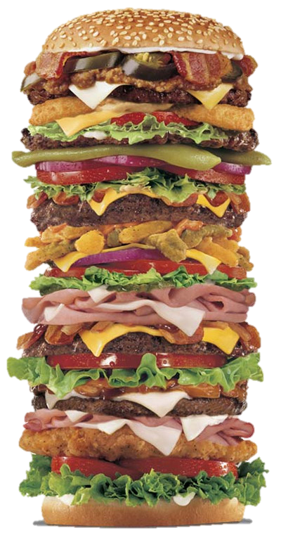
Correct answers: 1a, 2c, 3d, 4a
Elektronická učebnice - II. stupeň Základní škola Děčín VI, Na Stráni 879/2 – příspěvková organizace Anglický jazyk
22.8 Test
1. One day I ________________ down the street. I ________________ into the shop windows.
2. I ________________ hungry so I bought a hamburger. Then I ________________ hungry any more.
3. I ________________ to meet my sister so I ________________ her.
________________ you ________________ this text?
Read the text and then fill in the best fitting word.
1.
a) walked, looked
b) walkd, lookd
c) looked, walked
d) lookd, walkd
2.
a) were, wasn´t
b) was, wasn´t
c) was, wasn´t
d) weren´t, was
3.
a) wantid, called
b) phoned, wanted
c) want, phone
d) wanted, phoned
4.
a) Did, understand
b) Did, understood
c) Have, understand
d) Have, understood

Slide 9
Elektronická učebnice - II. stupeň Základní škola Děčín VI, Na Stráni 879/2 – příspěvková organizace Anglický jazyk
22.9 Použité zdroje, citace
http://www.flo-joe.co.uk/preliminaryenglish/comparatives-and-superlatives.htm
http://www.datingadvice4christiansingles.com/Christian-dating-question.html
http://www.crystalinks.com/soapopera.html
http://www.picgifs.com/clip-art/tom-and-jerry/
http://animals.nationalgeographic.com/animals/mammals/african-lion/
http://commons.wikimedia.org/wiki/User:Robbiemuffin/Using_English_Grammar_Graphics
http://yehachan.deviantart.com/art/goldilock-and-the-three-bears-114285993¨
http://www.ego4u.com/en/cram-up/grammar/simple-past/goldilocks
http://www.soundtrackcollector.com/title/6283/Grease

Slide 10
Elektronická učebnice - II. stupeň Základní škola Děčín VI, Na Stráni 879/2 – příspěvková organizace Anglický jazyk
22.10 Anotace
Autor | Mgr. Michaela Kaplanová
Období | 07 – 12/2011
Ročník | 7. ročník
Klíčová slova | Past, regular
Anotace | Prezentace popisující tvoření minulého času prostého – pravidelný tvar

