Slide 1
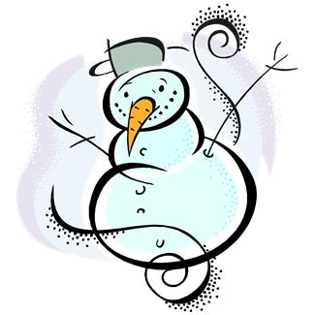
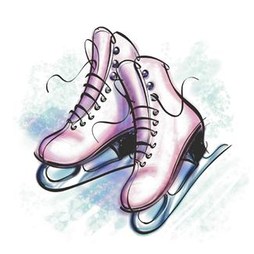
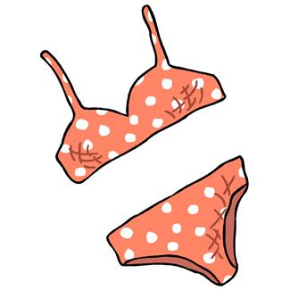
Elektronická učebnice - II. stupeň Základní škola Děčín VI, Na Stráni 879/2 – příspěvková organizace Anglický jazyk
20.1 Expressing the future, weather
(vyjadřování budoucnosti, počasí)
How many pictures can you name?
Find the rest in the dictionary.
Autor: Mgr. Michaela Kaplanová

Slide 2
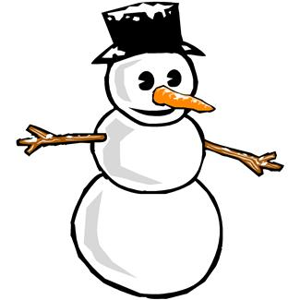
Elektronická učebnice - II. stupeň Základní škola Děčín VI, Na Stráni 879/2 – příspěvková organizace Anglický jazyk
20.2 What do we already know?
We know that there are:
PAST
PRESENT
FUTURE
We know some weather expressions:
It´s cold.
It´s warm.
The sun is shining.
tenses in English
We know some time expressions:
YESTERDAY
TODAY
TOMORROW
now, at the moment
We know PRESENT SIMPLE and PRESENT CONTINUOUS tenses
She doesn´t cook dinner.
She isn´t cooking dinner.

Slide 3
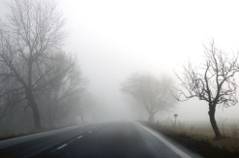
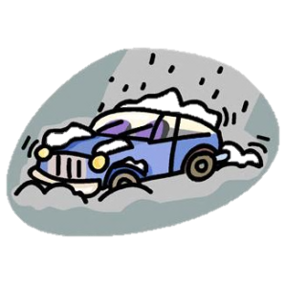
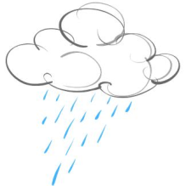
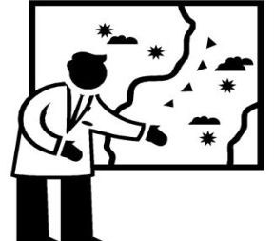
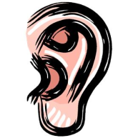
Elektronická učebnice - II. stupeň Základní škola Děčín VI, Na Stráni 879/2 – příspěvková organizace Anglický jazyk
20.3 New terms - WEATHER
Print your own weather bookmark.
It´s cloudy. It´s foggy. It´s hot. It´s sunny.
blizzard hail rainbow shower weather forecast
sněhová kroupy duha přeháňka
vánice předpověď
počasí
STORM
THUNDER
LIGHTNING
You can hear the thunder.
You can see the lightning.
COMPARE:
TEMPERATURE
20°C = 20 degrees centigrade
boiling hot warm cool chilly cold freezing
hot
It´s windy.
It´s sunny.
It´s rainy.
It´s snowy.
The wind is blowing.
The sun is shining.
It´s raining.
It´s snowing.
What´s the weather like today?

Slide 4
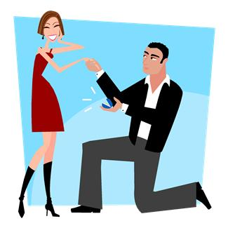
Elektronická učebnice - II. stupeň Základní škola Děčín VI, Na Stráni 879/2 – příspěvková organizace Anglický jazyk
20.4 Future with will and be going to
WILL – we use will for
• offers (nabídky)
e.g. I will help you with the bags.
• decisions (rozhodnutí)
e.g. We will go by bus.
• predictions (předpovědi)
e.g. You will like my friend.
(BUT we are not sure!!!)
QUESTION: Will you marry me?
NEGATIVE: I will not (won´t) go there.
Short form after pronouns: I´ll call her.
The form is the same for all persons.
BE GOING TO – we use be going to for
• planned future (plánovaná budoucnost)
e.g. I´m going to visit my parents tomorrow.
• more certain predictions (jistější předpovědi, na základě známé okolnosti)
e.g. There are dark clouds, it´s going to rain.
QUESTION: Are you going to watch TV?
NEGATIVE: It´s not going to snow.
You aren´t going to be there.
!!! Be careful about the correct form of the verb BE!!!
We can use will or be going to for weather forecast. Both is correct.

Slide 5
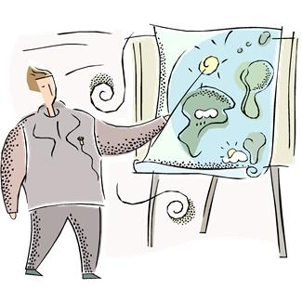
Elektronická učebnice - II. stupeň Základní škola Děčín VI, Na Stráni 879/2 – příspěvková organizace Anglický jazyk
20.5 Exercises
WILL or BE GOING TO?
1. Can I borrow your bike? I ________be back in 2 hours.
2. What would you like? – I ________ have a cup of coffee, please.
3. My sister ________ have a baby.
4. I'm really tired. – I ________ take you home if you want.
5. He ________ move to London, he found a new job there last month.
6. I´m not sure about my plans for the weekend. Maybe I ________ visit my parents.
7. ________ you buy some bread for me, please?
8. Look at the clouds, it ________ rain soon.
9. On Tuesday there ________ hot and sunny in Boston, temperature 26-30°C.
10. In 2156 people ________ live on Mars.
Which future tense would you use with these expressions? You can use the dictionary.
I think
in 2378
certainly
perhaps
help
this afternoon
maybe
Prepare a weather forecast for your class.

Slide 6
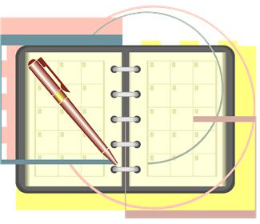
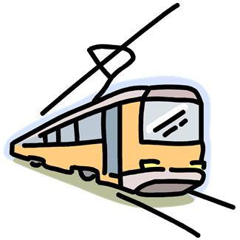
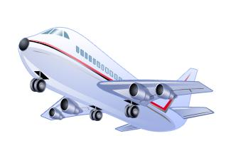
Elektronická učebnice - II. stupeň Základní škola Děčín VI, Na Stráni 879/2 – příspěvková organizace Anglický jazyk
20.6 Something more difficult
We can use also present continuous and present simple to express future.
for fixed arrangements for the future
we know the details (place, time)
e.g. I´m not coming to the party tomorrow.
I´m playing tennis on Friday at ten o´clock.
Be careful about the spelling rules:
dance – dancing swim - swimming
write – writing sit – sitting
What are your fixed plans for this week?
for timetables, schedules, itineraries
planned events that are not likely to change
e.g. The last bus leaves at 11.30.
Christmas Eve is on Saturday this year.
The train arrives at 9.15.
At what time does your school bus leave?

Slide 7
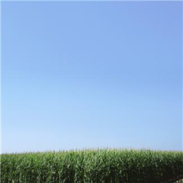
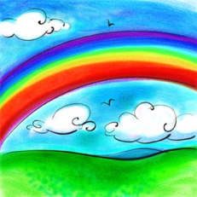
Elektronická učebnice - II. stupeň Základní škola Děčín VI, Na Stráni 879/2 – příspěvková organizace Anglický jazyk
20.7 I Can See Clearly Now – Jimmy Cliff
Fill in the missing words
I can see clearly now the _______ is gone. I can see all obstacles in my way. gone are the _______that had me blind.
CHORUS: (2x) It's gonna be a _______
_______ _______ day.
Oh yes, I can make it now, the pain is gone. All of the bad feelings have disappeared. Here is that _______ I've been praying for!
CHORUS
Look all around there's nothing but _______. Look straight ahead there's nothing but _______.
I can see clearly now the _______ is gone. I can see all obstacles in my way. Here is that _______ I've been praying for!
CHORUS
IT´S GONNA BE = IT´S GOING TO BE
This expression is used in informal, spoken English (as well as e.g. WANNA, GOTTA)
Study THIS

Slide 8
Elektronická učebnice - II. stupeň Základní škola Děčín VI, Na Stráni 879/2 – příspěvková organizace Anglický jazyk
Elektronická učebnice - II. stupeň Základní škola Děčín VI, Na Stráni 879/2 – příspěvková organizace Anglický jazyk
20.8 Test
Which sentence is NOT correct?
It´s going to be rainy on Friday.
It will be rainy on Friday.
It is usually rainy on Friday.
It is being rainy on Friday.
3. Which tense or expression can´t be used for the future?
past continuous
present continuous
present simple
be going to
2. Which word doesn´t belong to the others?
thunder
lightning
rainbow
storm
4. Which sentence expressing future is correct?
I helped you with the bags.
I help you with the bags.
Wait, I am going to help you.
Wait, I will help you.
Correct answers: 1d, 2c, 3a, 4d

Slide 9
Elektronická učebnice - II. stupeň Základní škola Děčín VI, Na Stráni 879/2 – příspěvková organizace Anglický jazyk
20.9 Použité zdroje, citace
http://weather.wikia.com/wiki/Fog_and_Mist - slide 3
http://www.edupic.net/weather_gr.htm - slide 3
Obrázky z databáze klipart

Slide 10
Elektronická učebnice - II. stupeň Základní škola Děčín VI, Na Stráni 879/2 – příspěvková organizace Anglický jazyk
20.10 Anotace
Autor | Mgr. Michaela Kaplanová
Období | 07 – 12/2012
Ročník | 7. ročník
Klíčová slova | future tenses, weather
Anotace | Prezentace shrnující různé způsoby vyjadřování budoucnosti v angličtině a uvádějící slovní zásobu z tématu počasí.

