Slide 1
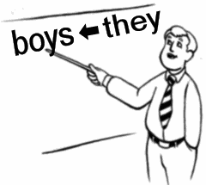
Elektronická učebnice - II. stupeň Základní škola Děčín VI, Na Stráni 879/2 – příspěvková organizace Anglický jazyk
19.1 Pronouns, the verb LET (Zájmena, sloveso LET - nechat)
http://eslus.com/LESSONS/GRAMMAR/POS/pos6.htm
Autor: Mgr. Michaela Wernerová

Slide 2
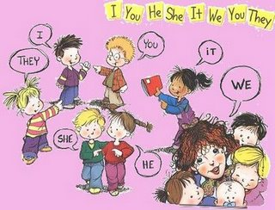
Elektronická učebnice - II. stupeň Základní škola Děčín VI, Na Stráni 879/2 – příspěvková organizace Anglický jazyk
19.2 What do we already know?
1. We know that PRONOUNS replace NOUNS => My brother is very
clever .
He is very clever.
2. We know the SUBJECT PRONOUNS:
 | singular | plural
1st | I | we
2nd | you | you
3rd | he, she, it | they

Slide 3
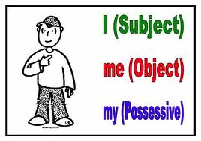
Elektronická učebnice - II. stupeň Základní škola Děčín VI, Na Stráni 879/2 – příspěvková organizace Anglický jazyk
19.3 New terms
Pronoun - zájmeno
Adjective – přídavné jméno
Subject - podmět
Object - předmět
Possessive – přivlastňovací
Let – dovolit, nechat
Me – mně, mě, mi, mnou
You – tě, tebe, tobě, tebou
Him – jemu, jím, jeho, jej
Her – její, jí, jejími, ji
It – tomu, toho, tím
Us – nás, nám, námi
You – vás, vámi, vám
Them – je, jim, jich, jimi

Slide 4
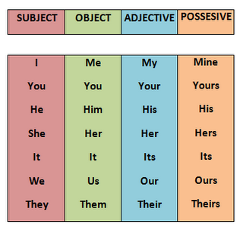
Elektronická učebnice - II. stupeň Základní škola Děčín VI, Na Stráni 879/2 – příspěvková organizace Anglický jazyk
19.4 Object pronouns and possessive adjectives, LET
(there is a difference between possessive pronouns and possessive adjective – see slide 6)
1. Object pronouns – we use them as objects in a sentence
For example: He sees me at school. They invite us to the party.
I love you. My mum hates you.
They look at him. He wants to talk to them.
I give it to her.
I can see it in the book.
We use object pronouns with the verb LET:
My parents let me go out with my friends.
Her sisters don´t let her borrow their clothes.
Our teacher lets us write homeworks at school.
My boyfriend doesn´t let me dance with other boys.
2. Possessive adjectives – we use them to say that something
BELONGS to somebody
For example: It is my brother. We write our homework.
I like your family. She likes your photo.
It is his idea. We have got our problems.
Her new dress is beautiful.
It´s its food.

Slide 5
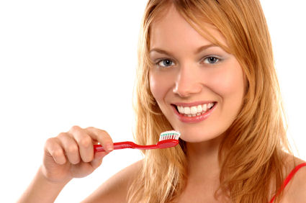
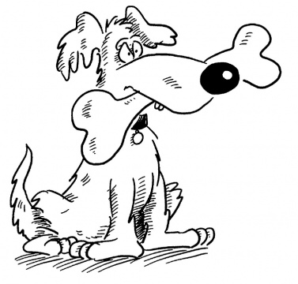
Elektronická učebnice - II. stupeň Základní škola Děčín VI, Na Stráni 879/2 – příspěvková organizace Anglický jazyk
19.5 Exercises
Steve is not English, __________is Australian
Dominic and Kaye are in love, __________ are going to get married.
This is Harry's first job and __________ is very nervous.
Have __________ seen my new car? No, __________ haven't.
Help __________ to prepare for my exam please.
Your dog always barks at night, please tell __________ to stop.
Give __________ some water please, we are thirsty.
Alfred and Henry are in __________ car.
She is cleaning __________ teeth.
Tom is drinking __________ drink.
I am working on __________ homework.
Please give the dog __________ bone now.

Slide 6
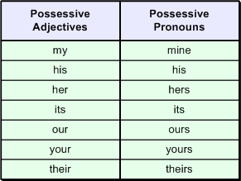
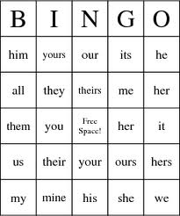
Elektronická učebnice - II. stupeň Základní škola Děčín VI, Na Stráni 879/2 – příspěvková organizace Anglický jazyk
19.6 Something more difficult
Possessive adjectives x possessive pronouns
1. Compare these sentences and
find the possessive word:
This is my book. X This book is mine.
It´s your T-shirt. X This T-shirt is your.
What is the difference?
http://www.englishlanguageguide.com/
english/grammar/possessive-pronoun.asp
2. Play BINGO

Slide 7
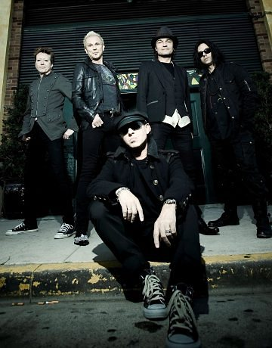
Elektronická učebnice - II. stupeň Základní škola Děčín VI, Na Stráni 879/2 – příspěvková organizace Anglický jazyk
19.7 You and I – the Scorpions
Find all different kinds of pronouns that you know. How may pronouns can you see?
I lose control because of you babe I lose control when you look at me like this there's something in your eyes that is sayin' tonight I'm not a child anymore, life has opened the door to a new exciting life I lose control when I'm close to you babe I lose control don't look at me like this there's something in your eyes, is this love at first sight like a flower that grows, life just wants you to know all the secrets of life It's all written down in your lifelines it's written down inside your heart You and I just have a dream to find our love a place where we can hide away you and I were just made to love each other now forever and a day

Slide 8
19.8 Test
Elektronická učebnice - II. stupeň Základní škola Děčín VI, Na Stráni 879/2 – příspěvková organizace Anglický jazyk
Which sentence is correct?
My teacher don´t let me speak in the class.
Your parents don´t let their children to watch the movie.
My friends let him invite his family to the party.
My friends lets him invite his friends to the party.
2. Find the object pronouns
my, your, their
mine, yours, ours
I, he, they
him, her, us
________ don´t ________ __________ show________
________ new car.
They, let, me, him, my
She, me, let, my, him
I, lets, me, her, your
Why, you, let, me, my
4. Which sentence is incorrect?
a) Let him go there, please.
b) My parents don´t let me buy that.
c) Look at me!
d) Does your parents let you see
their tests?
Správné odpovědi : 1c, 2d, 3a, 4d

Slide 9
Elektronická učebnice - II. stupeň Základní škola Děčín VI, Na Stráni 879/2 – příspěvková organizace Anglický jazyk
19.9 Použité zdroje, citace
http://frenchfrogslittleenglishpond.blogspot.com/2010/08/pronouns-and-possessives-posters.html
http://www.englishexercises.org/makeagame/viewgame.asp?id=2410
http://thebingomaker.com/index.php/bingo-cards/grammar-bingo-cards/pronoun-bingo-cards.html
http://ourbasic1.blogspot.com/2010/03/possessive-pronouns.html
http://soundtracksandmore.blogspot.com/2008/01/scorpions-discography.html
http://www.techbites.com/201005042668/myblog/blog/z0002-writing-4-engineers-possessive-adjectives-and-possessive-pronouns.html
http://www.hcglobalsummit.com/tag/teeth/

Slide 10
Elektronická učebnice - II. stupeň Základní škola Děčín VI, Na Stráni 879/2 – příspěvková organizace Anglický jazyk
19.10 Anotace
Autor | Mgr. Michaela Kaplanová
Období | 07 – 12/2011
Ročník | 7. ročník
Klíčová slova | Pronoun, subject, object, possessive, adjective, let
Anotace | Prezentace popisující tvoření a použití přivlastňovacích zájmen a pádových tvarů zájmen

