Slide 1
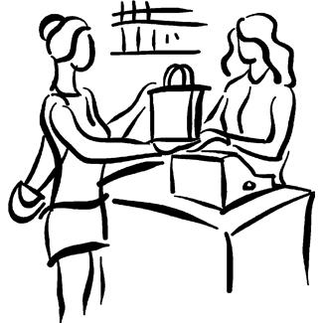
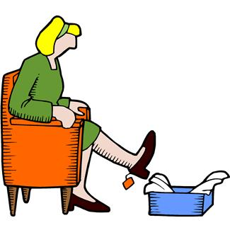
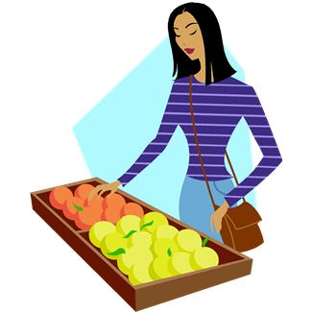
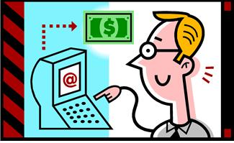
Elektronická učebnice - II. stupeň Základní škola Děčín VI, Na Stráni 879/2 – příspěvková organizace Anglický jazyk
18.1 Shops, shopping phrases (+how much, how many) (obchody, fráze užívané při nakupování)
Can you describe the pictures? Where are the people? What are they doing?
Study some shopping phrases HERE.
Autor: Mgr. Michaela Kaplanová

Slide 2
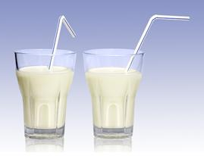
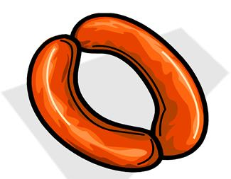
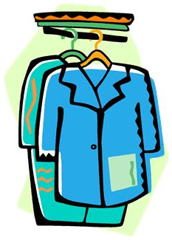
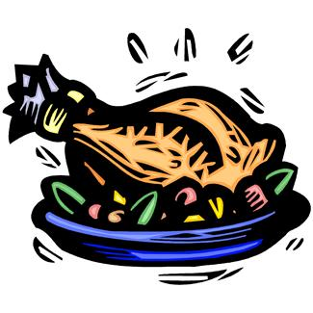
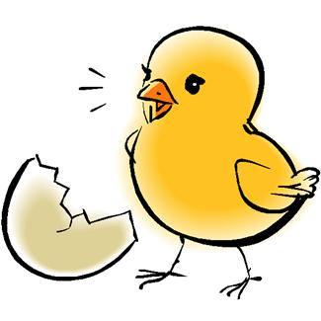
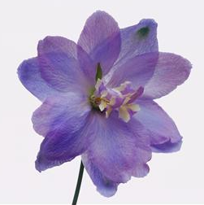
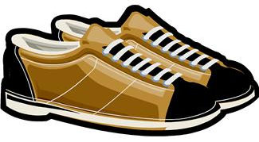
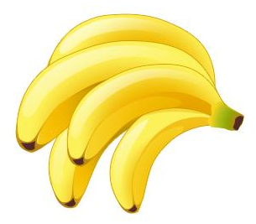
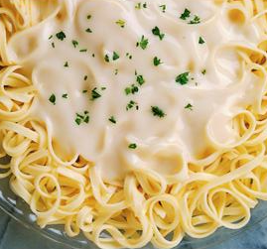
Elektronická učebnice - II. stupeň Základní škola Děčín VI, Na Stráni 879/2 – příspěvková organizace Anglický jazyk
18.2 What do we already know?
Name the shops:
Revise (un)countable nouns (DUM 15):
What are the rules for using them (articles, plural…)?

Slide 3
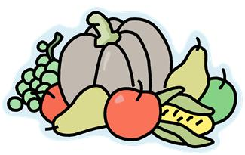
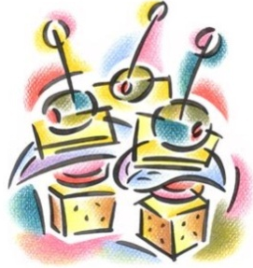
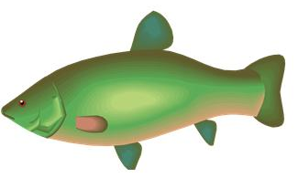
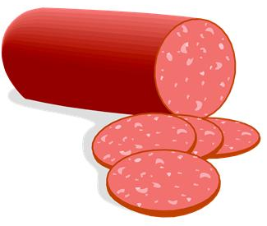
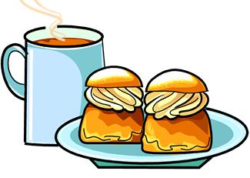
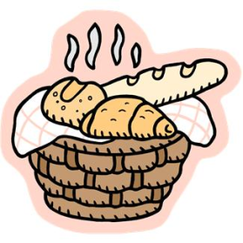
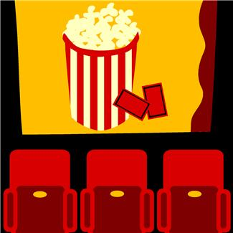
Elektronická učebnice - II. stupeň Základní škola Děčín VI, Na Stráni 879/2 – příspěvková organizace Anglický jazyk
18.3 New terms
chemist´s
fruit and vegetables
jeweller´s
delicatessen
newsagent´s
bookshop
fishmonger´s
butcher´s
hairdresser´s
café
bakery
music store
cinema
shopping centre
department store
supermarket
market

Slide 4
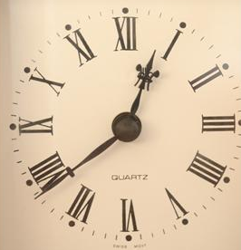
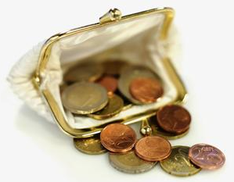
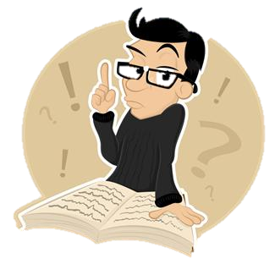
Elektronická učebnice - II. stupeň Základní škola Děčín VI, Na Stráni 879/2 – příspěvková organizace Anglický jazyk
18.4 How much, how many
Asking questions about quantity
HOW MUCH + uncountable nouns
e.g.
How much time do you need to finish the test?
How much milk should I buy?
How much money do you spend every month?
HOW MANY + plural countabe nouns
e.g.
How many people are there in the shop?
How many books do you read every year?
How many hours do you spend watching TV every day?
HOW MANY TIMES
How many times a week do you write your homework?
(asking about frequency)
HOW MUCH IS / ARE
How much is this skirt?
How much are those trousers?
(asking about price)

Slide 5
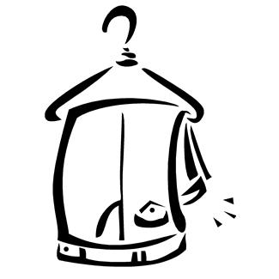
Elektronická učebnice - II. stupeň Základní škola Děčín VI, Na Stráni 879/2 – příspěvková organizace Anglický jazyk
18.5 Exercises
Fill in the missing words or phrases. Use a dictionary if necessary.
Shop assistant: Not at all. These jeans _______ you very well.
Customer: Well, I think I _______ a blue pair. The shop assistant brings a pair of blue jeans and the customer tries the jeans on.
Customer: They are very _______ and I don't like blue jeans, anyway. Do you mind _______ me another pair in black?
Shop assistant: No, not at all. ...
Shop assistant: Hello, can I _______ you?
Customer: I _______ for a pair of jeans.
Shop assistant: What _______ do you take?
Customer: Twenty-nine.
Shop assistant: We have some very nice blue jeans here.
Customer: Where can I _______ them on?
Shop assistant: The _______ room is over there. The customer tries the jeans on.
Customer: They're _______ big.
Shop assistant: Would you like a _______ size?
Customer: Yes, _______.
The customer tries the jeans on.
Customer: These _______ rather well. But I think I look _______ in them. Don't you think?
FINISH THE DIALOGUE.
How could it continue?
Write a shopping dialogue with your friend (at least 20 sentences).

Slide 6
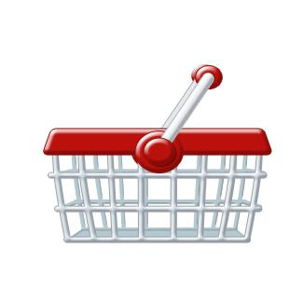
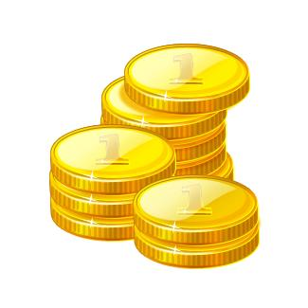
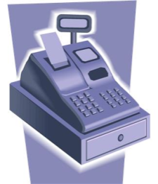
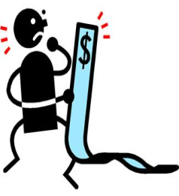
Elektronická učebnice - II. stupeň Základní škola Děčín VI, Na Stráni 879/2 – příspěvková organizace Anglický jazyk
18.6 Something more difficult
BE CAREFUL !!! PRICE x PRIZE !!!
SHOPPING PHRASES
I´m looking for…
Can I try it on?
The changing rooms are over there.
I need a bigger/smaller size.
I´ll take it. / I´ll leave it.
I´ll pay in cash / by credit card.
Keep the change.
SPECIAL OFFER
GOOD VALUE
SALE
HALF PRICE
REDUCED
shopping basket
shopping trolley
note (BrE)
bill (AmE)
coins
cash
desk
bill
shopping list

Slide 7
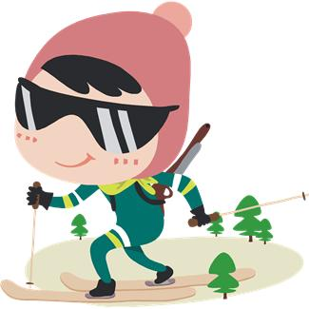
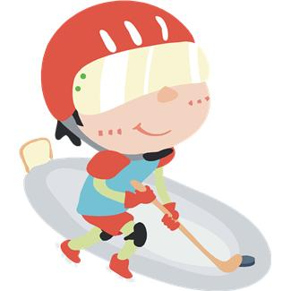
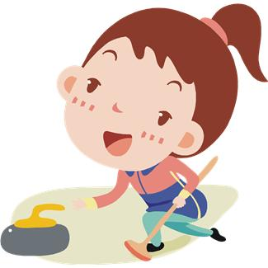
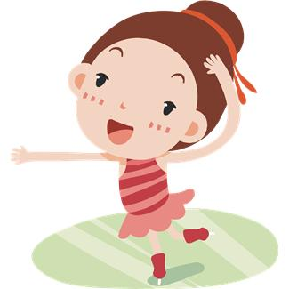
Elektronická učebnice - II. stupeň Základní škola Děčín VI, Na Stráni 879/2 – příspěvková organizace Anglický jazyk
18.7 How sporty are you?
Answer the following questions, ask two of your classmates and write down their answers.
 | QUESTION | YOU | YOUR FRIEND 1 | YOUR FRIEND 2
1. | How many sports do you play?
2. | How many times a week do you do exercise?
3. | How much time do you spend playing computer games every day?
4. | How many kilometres do you run every week?
5. | How much sugar do you eat? (a lot of/a little...)
6. | How many players are there on the football pitch during the match?
Who is the sportiest boy and girl in your class?
Think of 3 other similar questions.

Slide 8
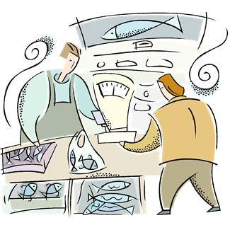
Elektronická učebnice - II. stupeň Základní škola Děčín VI, Na Stráni 879/2 – příspěvková organizace Anglický jazyk
Elektronická učebnice - II. stupeň Základní škola Děčín VI, Na Stráni 879/2 – příspěvková organizace Anglický jazyk
18.8 Test
You can spend your money in the …
fishbone´s
fishmonger´s
fishfinger´s
fisherman´s
3. Which question is not correct?
How much times do you visit her every week?
How many fish did you catch?
How much is this jacket?
How much time did you spend there?
2. What is the correct reaction?
Can I try it on?
It fits you well.
The changing rooms are over there.
Will you pay in cash?
Keep the change.
4. Where can you go to buy a magazine?
chemist´s
fruit and vegetables
newsagent´s
butcher´s
Correct answers: 1b, 2b, 3a, 4c

Slide 9
Elektronická učebnice - II. stupeň Základní škola Děčín VI, Na Stráni 879/2 – příspěvková organizace Anglický jazyk
18.9 Použité zdroje, citace
http://www.ego4u.com/en/cram-up/vocabulary/shopping/exercises - slide 5
Obrázky z databáze klipart

Slide 10
Elektronická učebnice - II. stupeň Základní škola Děčín VI, Na Stráni 879/2 – příspěvková organizace Anglický jazyk
18.10 Anotace
Autor | Mgr. Michaela Kaplanová
Období | 07 – 12/2012
Ročník | 7. ročník
Klíčová slova | shopping, shopping phrases, kinds of shops, how many, how much
Anotace | Prezentace uvádějící názvy obchodů, shrnující fráze užívané při nakupování a vysvětlující rozdíl mezi slovy many a much v otázkách zaměřených na množství.

