Slide 1
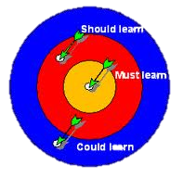
Elektronická učebnice - II. stupeň Základní škola Děčín VI, Na Stráni 879/2 – příspěvková organizace Anglický jazyk
16.1 Must, mustn´t, should, shouldn´t (modální slovesa must a should)
More exercises
Autor: Mgr. Michaela Kaplanová

Slide 2
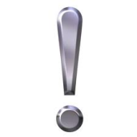
Elektronická učebnice - II. stupeň Základní škola Děčín VI, Na Stráni 879/2 – příspěvková organizace Anglický jazyk
16.2 What do we already know?
We know the modal verb CAN
We know that it has the same form in all persons (I can sing. He can sing.).
We now that we make negative by adding NOT, we don´t use don´t or doesn´t.
(We can not go out. We can´t go out.)
We know that this verb is followed by the main verb in the base form.
(The pupils can play football during the break.)
ALL THESE RULES APPLY TO THE VERBS MUST AND SHOULD AS WELL.

Slide 3
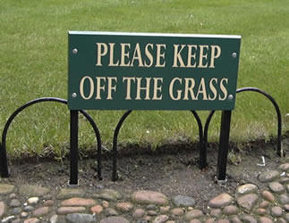
Elektronická učebnice - II. stupeň Základní škola Děčín VI, Na Stráni 879/2 – příspěvková organizace Anglický jazyk
16.3 New terms
modal verb – modální sloveso
necessary – nutný
forbidden – zakázaný
obligation – povinnost
prohibition – zákaz
advice – rada
advise – poradit
permission – povolení
must – muset
mustn´t – nesmět
you should – měl(a) bys
you shouldn´t – neměl(a) bys
have to – muset
don´t have to – nemuset

Slide 4
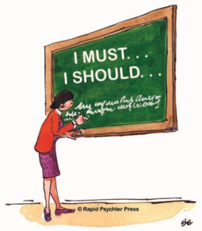
Elektronická učebnice - II. stupeň Základní škola Děčín VI, Na Stráni 879/2 – příspěvková organizace Anglický jazyk
16.4 Must, should
both these verbs are MODAL verbs (they express e.g. ability, permission, obligation…)
MUST
we use must to say that something is necessary (in affirmative sentences)
(I must see the doctor, my knee hurts so much.)
forbidden (in negative sentences)
(You must not tell him the secret.)
I must go. You must wait for him. He must call her.
I must not (mustn´t ) be late. They must not (mustn´t) go to the party.
Must you go now? Must he wash the car?
SHOULD
we use should/shouldn´t to give advice.
I should go. You should wait for him. He should call her.
I should not (shouldn´t ) be late. They should not (shouldn´t) go to the party.
Should you go now? Should he wash the car?

Slide 5
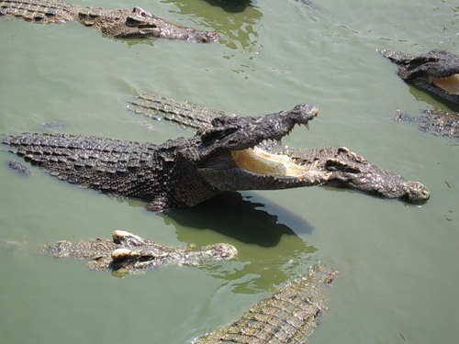
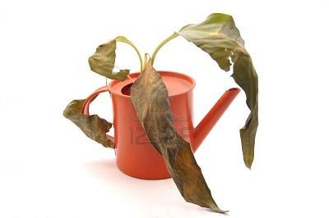
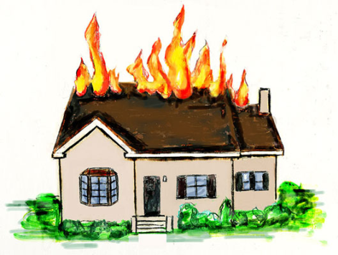
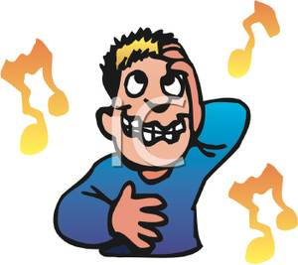
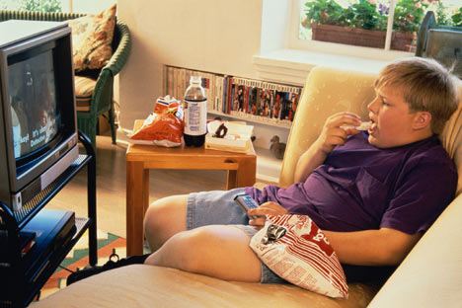
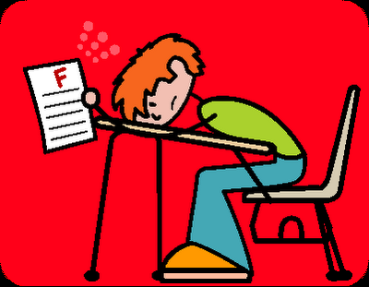
Elektronická učebnice - II. stupeň Základní škola Děčín VI, Na Stráni 879/2 – příspěvková organizace Anglický jazyk
16.5 Exercises
What you must, mustn´t, should or shouldn´t do?

Slide 6
Elektronická učebnice - II. stupeň Základní škola Děčín VI, Na Stráni 879/2 – příspěvková organizace Anglický jazyk
16.6 Something more difficult – HAVE TO
To express obligation we can use also the verb HAVE TO
e.g. I have to go now, it´s too late.
HAVE TO – somebody told us to do so
You have to write your homework.
MUST – we (the speaker) wants to do it himself (herself)
I must study for the next test. I don´t want to have bad marks any more.
The negative is DON´T HAVE TO --> it is not necessary to do it.
I don´t have to buy milk. There is some in the fridge.

Slide 7
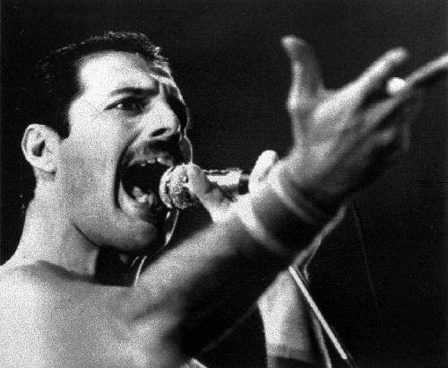
Elektronická učebnice - II. stupeň Základní škola Děčín VI, Na Stráni 879/2 – příspěvková organizace Anglický jazyk
16.7 CLIL – Show must go on – Queen
Listen to the song and fill in the blank spaces.
Empty _________ - what are we living for Abandoned places - I guess we know the score On and on, does anybody know what we are _________
Another hero, another mindless crime _________ the curtain, in the pantomime Hold the line, does anybody want to take it anymore The show must go on The show must go on Inside my heart is _________ My make-up may be flaking But my _________ still stays on Whatever happens, I'll leave it all to _________ Another heartache, another failed romance On and on, does anybody know what we are _________
I guess I'm _________, I must be warmer now I'll soon be turning, round the corner now _________ the dawn is breaking But inside in the dark I'm aching to be free Ch.
My _________ is painted like the wings of butterflies Fairytales of yesterday will grow but never die I can fly - my friends The show must go on The show must go on I'll face it with a grin I'm _________ giving in On - with the show - I'll top the bill, I'll overkill I have to find the will to _________ On with the - On with the show - The show must go on

Slide 8
Elektronická učebnice - II. stupeň Základní škola Děčín VI, Na Stráni 879/2 – příspěvková organizace Anglický jazyk
16.8 Test
Which sentence is not correct?
You should wear warm clothes.
My sister must leave now.
They must to send the letter.
You should not go to school.
2. "You mustn´t go to the cinema "means:
It is forbidden.
You can go there.
You shouldn´t go there.
You have to go there.
3. To say that somebody CAN´T do something we use:
Have to
Shouldn´t
Should
Mustn´t
4. The verb with opposite meaning of the verb MUST is:
Should
Don´t have to
Can
Mustn´t
Correct answers: 1c, 2a, 3d, 4b

Slide 9
Elektronická učebnice - II. stupeň Základní škola Děčín VI, Na Stráni 879/2 – příspěvková organizace Anglický jazyk
16.9 Použité zdroje, citace
http://www.learningandteaching.info/teaching/must_should_could.htm
http://www.steelarena.sk/index.php?context=278&p=170
http://egregores.wordpress.com/2009/11/22/more-on-freddie-mercury-and-zoroastrianism/
http://helen-scribbles.com/2011/09/09/fridayflash-warning%E2%80%94dont-walk-on-the-grass/
http://slowburn.typepad.com/my_weblog/childhood-obesity/

Slide 10
Elektronická učebnice - II. stupeň Základní škola Děčín VI, Na Stráni 879/2 – příspěvková organizace Anglický jazyk
16.10 Anotace
Autor | Mgr. Michaela Kaplanová
Období | 07 – 12/2011
Ročník | 7. ročník
Klíčová slova | must, mustn´t, should, shouldn´t
Anotace | Prezentace vysvětlující tvary modálních sloves must a should a významový rozdíl mezi nimi.

