Slide 1
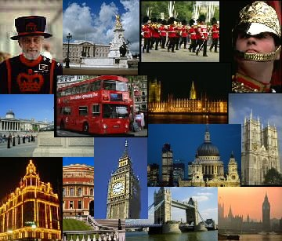
Elektronická učebnice - II. stupeň Základní škola Děčín VI, Na Stráni 879/2 – příspěvková organizace Anglický jazyk
14.1 London
http://www.visitlondon.com/
http://en.wikipedia.org/wiki/London
http://www.ukguide.org/london.html
http://www.camvista.com/england/london/trafsq.php3
Autor: Mgr. Michaela Wernerová

Slide 2
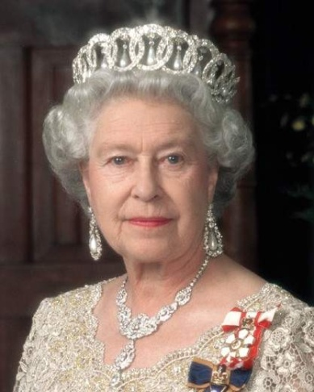
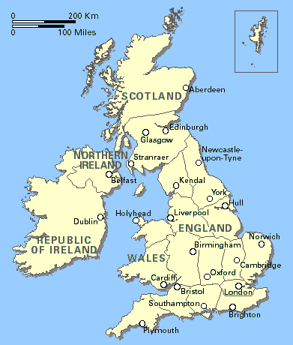
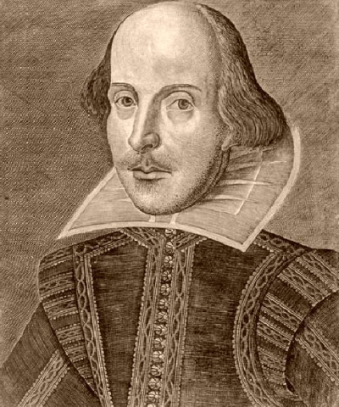
Elektronická učebnice - II. stupeň Základní škola Děčín VI, Na Stráni 879/2 – příspěvková organizace Anglický jazyk
14.2 What do we already know?
The British flag looks like this:
London is the capital of the United Kingdom.
The head of the state is the queen Elisabeth II.
The United Kingdom consists of England, Scotland, Wales and Northern Ireland.
The most famous playwright William Shakespeare lived in London.
Popular movies about Harry Potter were filmed in London. ☺

Slide 3
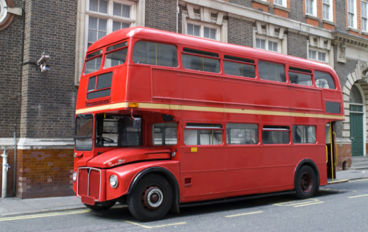
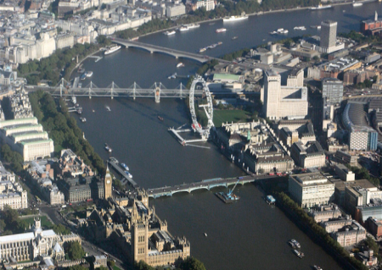
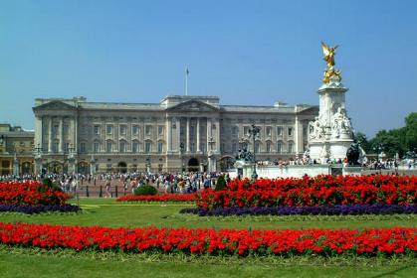
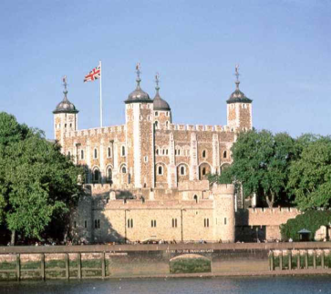
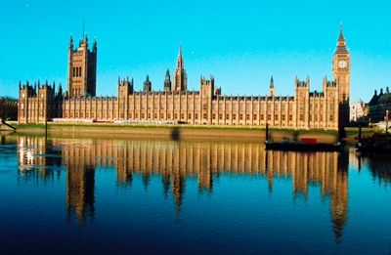
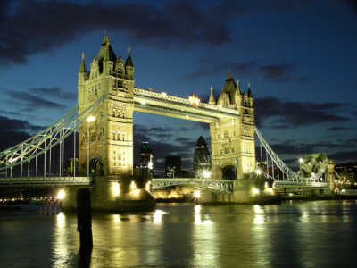
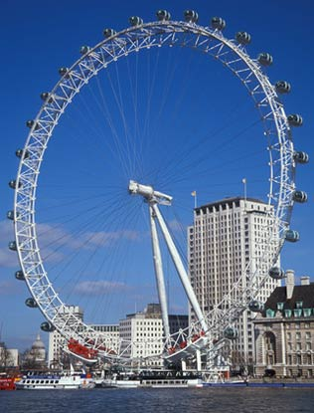
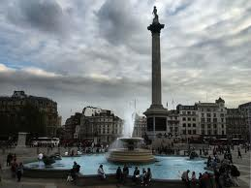
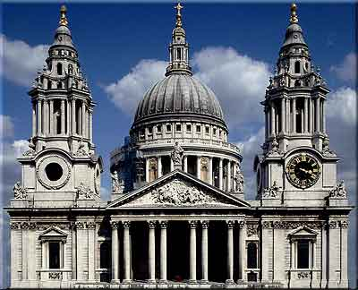
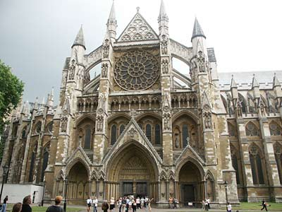
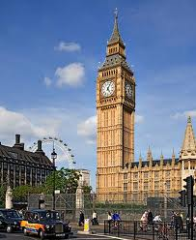
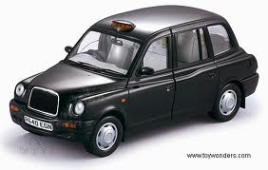
Elektronická učebnice - II. stupeň Základní škola Děčín VI, Na Stráni 879/2 – příspěvková organizace Anglický jazyk
14.3 New terms theTower
double-decker the Thames Buckingham Palace of London
the Houses of Parliament Tower Bridge London Eye Trafalgar Square
St. Paul´s Cathedral Westminster Abbey Big Ben
London taxi

Slide 4
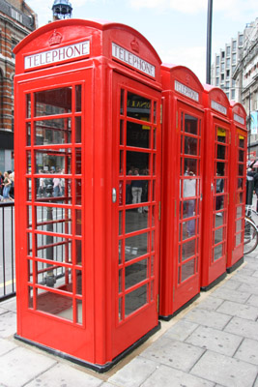
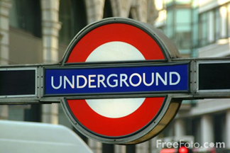
Elektronická učebnice - II. stupeň Základní škola Děčín VI, Na Stráni 879/2 – příspěvková organizace Anglický jazyk
14.4 London
London is the capital of the United Kingdom. There are many
monuments and landmarks. The British queen (Elisabeth II)
lives in Buckingham Palace. The UK is a monarchy. The Tower of
London is the next famous monument. It is a castle and it was
used as a prison. The most famous bridge in London is Tower
Bridge. The two parts of it can be raised to let big ships go
through. It was built over the river Thames. There is a beautiful
view from London Eye, a big wheel that turns around. Big Ben is
a famous clock tower, a part of the Houses of Parliament.
London is also famous for black taxi cars, London underground
(the oldest underground in the world), special red buses with two
levels and red telephone boxes.

Slide 5
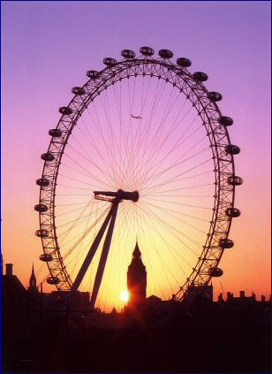
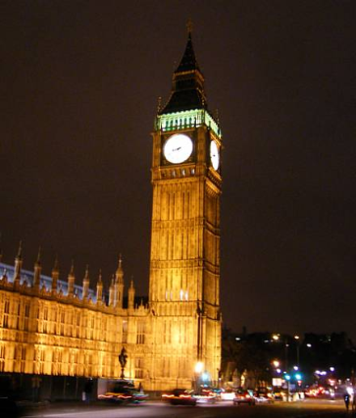
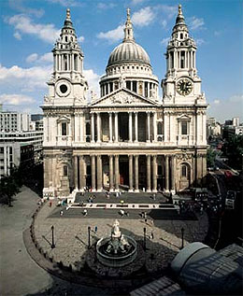
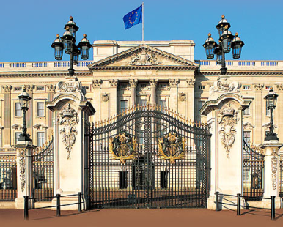
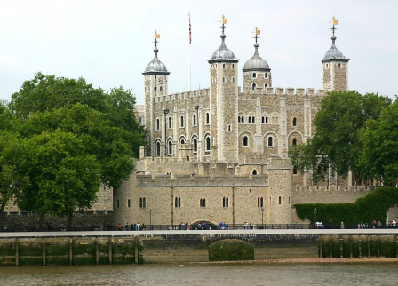
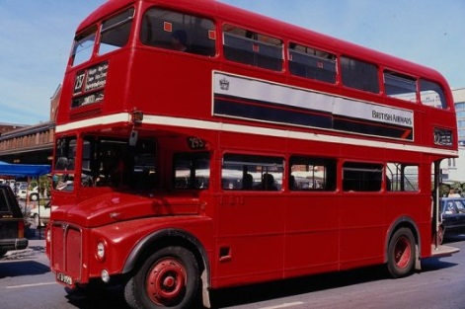
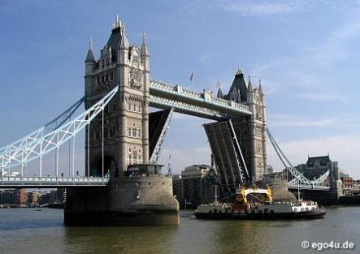
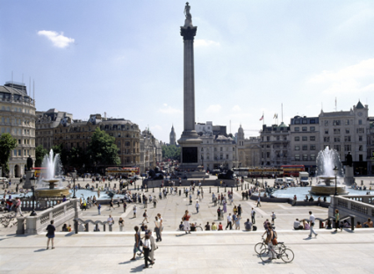
Elektronická učebnice - II. stupeň Základní škola Děčín VI, Na Stráni 879/2 – příspěvková organizace Anglický jazyk
14.5 Exercises
1. Name the pictures
2. Fill in the correct word
The British queen lives in ______________ . There is a nice wiev from _____________ . The river _________ runs through London. The famous clock tower is called___________ . The taxi cars in London are (colour) ________ . British queen´s name is ________. The most famous London bridge is _________ . ___________ and __________ are always red in London.

Slide 6
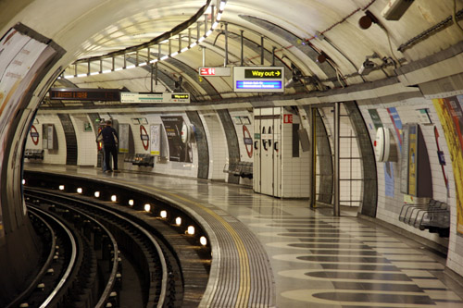
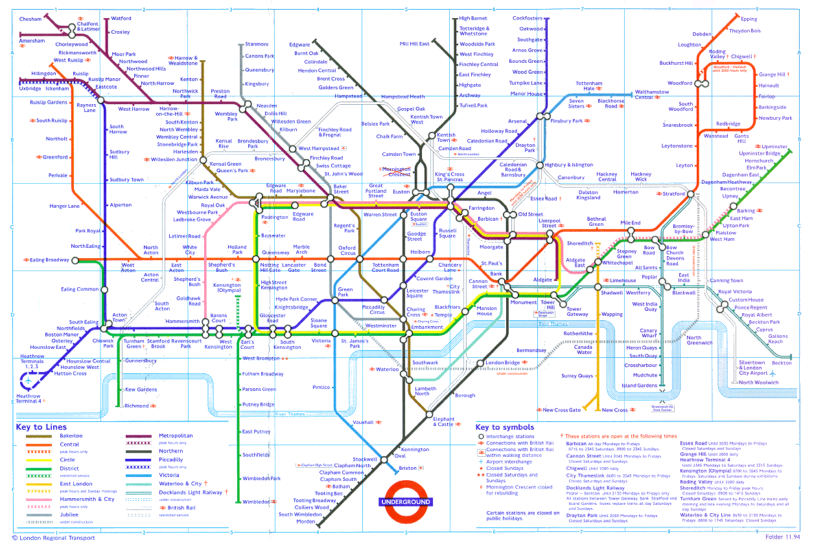
Elektronická učebnice - II. stupeň Základní škola Děčín VI, Na Stráni 879/2 – příspěvková organizace Anglický jazyk
14.6 Something more difficult
Study the following text and answer the questions
http://en.wikipedia.org/wiki/London_Underground
1. What is the nickname for the underground?
2. How many lines are there in the London underground?
3. Find the date when the London underground started to work.
4. How much money do you pay to the ticket inspector if you travel without a ticket?
5. Name 5 stations of the London underground.
6. How many people travel there every
day?
7. Where is the only one larger
underground system in the world?
http://www.tfl.gov.uk/modalpages/2625.aspx

Slide 7
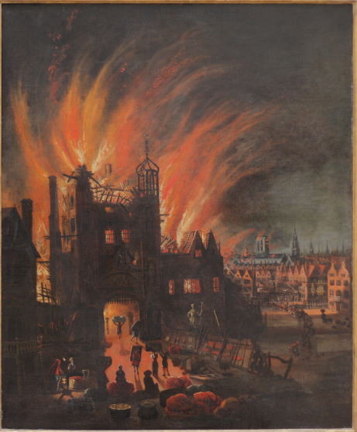
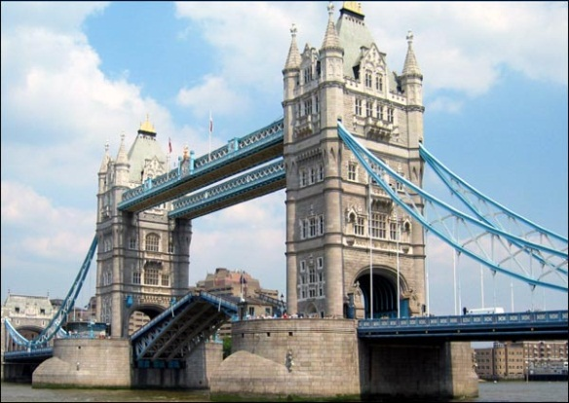
14.7 London´s Burning
Elektronická učebnice - II. stupeň Základní škola Děčín VI, Na Stráni 879/2 – příspěvková organizace Anglický jazyk
There is a famous song ´London´s Burning´ inspired
by the great fire of London in 1666 which destroyed
the original St. Paul´s Cathedral. You can sing it as a
canon. Explain the bold words in English.
Another song connected with London is ´London Bridge Is Falling Down´. What is ´wood´ and ´clay´?
How do we call London Bridge today?
Both these songs are NURSERY RHYMES. What is it?
London's burning, London's burning. Fetch the engines, fetch the engines. Fire fire, Fire Fire! Pour on water, pour on water.
London Bridge is falling down, Falling down, falling down, London Bridge is falling down, My fair Lady. Build it up with wood and clay, Wood and clay, wood and clay, Build it up with wood and clay, My fair Lady. Wood and clay will wash away, Wash away, wash away, Wood and clay will wash away, My fair Lady.
…
http://www.youtube.com/watch?v=2iQ3TmkSRj8
http://www.youtube.com/watch?v=NkzGSr41_Wk&feature=fvw

Slide 8
14.8 Test
Elektronická učebnice - II. stupeň Základní škola Děčín VI, Na Stráni 879/2 – příspěvková organizace Anglický jazyk
The name of the British queen is:
Victoria II
Elisabeth I
Elisabeth II
Diana
2. The United Kingdom is a:
republic
monarchy
confederation
federation
Which of these monuments is NOT in London?
the Houses of Parliament
White House
St. Paul ´s Cathedral
Trafalgar Square
4. The castle that used to be a prison is called:
the Tower of London
clock tower
the Thames
Buckingham Palace
Correct answers: 1c, 2b, 3b, 4a

Slide 9
Elektronická učebnice - II. stupeň Základní škola Děčín VI, Na Stráni 879/2 – příspěvková organizace Anglický jazyk
14.9 Použité zdroje, citace
http://en.wikipedia.org/wiki/File:London_Thames_Sunset_panorama_-_Feb_2008.jpg
http://www.freefoto.com/preview/31-02-3/Buckingham-Palace--London--United-Kingdom
http://bandzone.cz/modelbazaar?at=news
http://www.freshlysocial.com/festivals-london/londonthamesfestival/
http://www.toywonders.com/site09/diecast/Sun_Star_TX1_London_Taxi_Cab_1998_1_18_Black_1120_94p5063.html
http://www.toywonders.com/site09/diecast/Sun_Star_TX1_London_Taxi_Cab_1998_1_18_Black_1120_94p5063.html
http://www.theculturedtraveler.com/Picks/Archives/St_Pauls_Cathedral.htm
http://www.kudlanka.cz/index.php?option=com_content&task=view&id=4224&Itemid=1
http://favouritemovie.webnode.cz/news/tower-bridge/
http://www.freshturf.co.uk/london.html
http://www.afn.org/~alplatt/tube.html
http://en.wikipedia.org/wiki/File:The_Great_Fire_of_London,_with_Ludgate_and_Old_St._Paul's.JPG

Slide 10
Elektronická učebnice - II. stupeň Základní škola Děčín VI, Na Stráni 879/2 – příspěvková organizace Anglický jazyk
14.10 Anotace
Autor | Mgr. Michaela Kaplanová
Období | 07 – 12/2011
Ročník | 7. ročník
Klíčová slova | London, capitol, landmark, monuments, castle, bridge, prison, wheel, clock tower, underground
Anotace | Prezentace popisující Londýn jako hlavní město Velké Británie a jeho zajímavá místa

