Slide 1
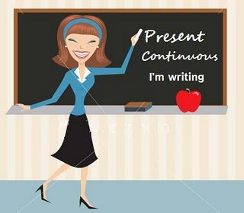
12.1 Present continuous (Přítomný čas průběhový)
Elektronická učebnice - II. stupeň Základní škola Děčín VI, Na Stráni 879/2 – příspěvková organizace Anglický jazyk
http://www.englishpage.com/verbpage/
presentcontinuous.html
http://www.eclecticenglish.com/grammar/PresentContinuous1F.html
Autor: Mgr. Michaela Wernerová

Slide 2
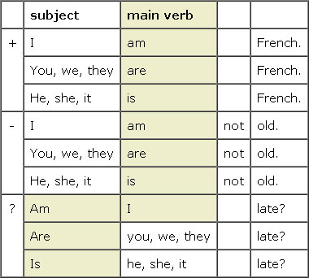
Elektronick Anglický jazyk
Elektronická učebnice - II. stupeň Základní škola Děčín VI, Na Stráni 879/2 – příspěvková organizace Anglický jazyk
12.2 What do we already know?
When we can use present simple tense - with adverbs of frequency – sometimes, usually, often…
- for repeated actions or actions that are always true
For example : I sometimes go to the cinema with my brother.
California is in America.
Forms of the verb ´to BE´ C) How to make questions and negatives
with the verb ´to BE´
The verb ´to BE´
I am (I´m) | we are (we´re)
you are (you´re) | you are (you´re)
he/she/it is (he´s) | they are (they´re)

Slide 3
12.3 New terms
Elektronická učebnice - II. stupeň Základní škola Děčín VI, Na Stráni 879/2 – příspěvková organizace Anglický jazyk
Present – přítomnost, přítomný
Continuous – průběhový, pokračující
3. –ING form - e.g. going, listening, speaking…
MIND THE SPELLING RULES!
At the moment = now
Consonant - souhláska

Slide 4
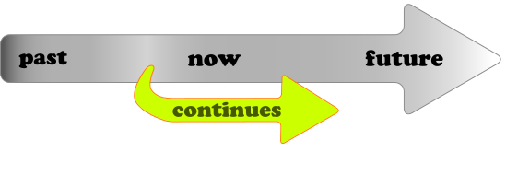
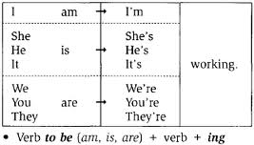
Elektronická učebnice - II. stupeň Základní škola Děčín VI, Na Stráni 879/2 – příspěvková organizace Anglický jazyk
12.4 Present continuous – USE and FORM
1. USE – použití
We use P.C. for actions that are happening NOW, at the moment of speaking (e.g. Look! The shark is swimming towards us.) or actions happening around the present period (e.g. I´m studying English.). We use it also to describe pictures and photos (In this picture, the girl is cooking dinner.).
2. FORM – tvar slovesa
Positive sentences - BE + verb + ING-I am writing. You are listening. He is reading.
Negative sentences – I am NOT writing. You are NOT listening. He is NOT reading.
Questions – Am I writing? Are you listening? Is he reading?
Short answers: Yes, I am x No, I am not.
Yes, you are. x No, you aren´t.
Yes, she is. x No, she isn´t.
Spelling exeptions: - the verb ends in -e => write – writing, dance – dancing, ride – riding
- a short verb ends in a consonant (n,m,t…) => run – running, swim – swimming, sit – sitting
- the verb ends in –ie => lie – lying, die - dying

Slide 5
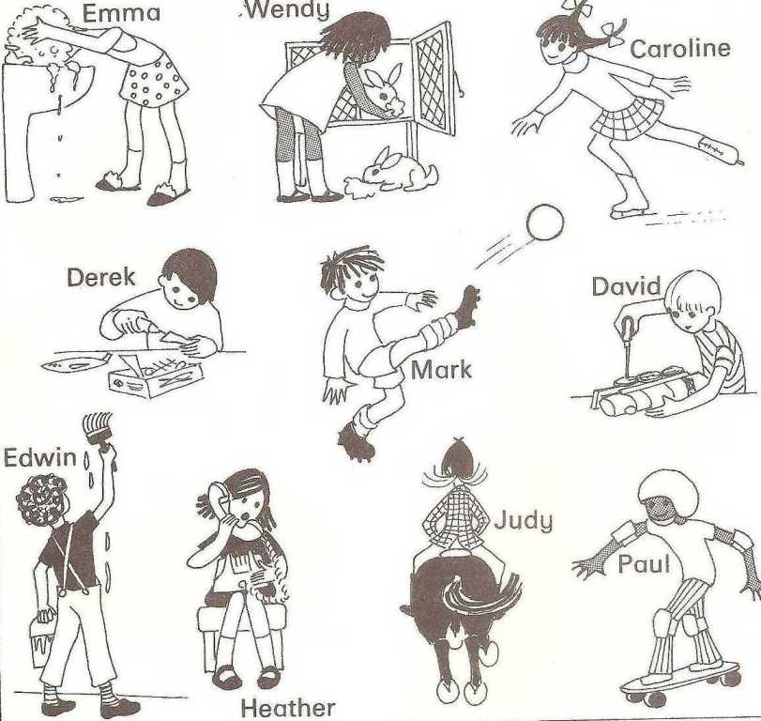
Elektronická učebnice - II. stupeň Základní škola Děčín VI, Na Stráni 879/2 – příspěvková organizace Anglický jazyk
12.5 Exercises
1. What are the people doing? 2. Fill in the verbs in present simple
John (read) a book now.
What (you do) tonight?
Jack and Peter (work) late today.
Silvia (not listen) to music.
Maria (sit) next to Paul.
How many other students (you study) with?
The phone (not ring).
3. What are you doing at the moment?
4. Present simple or present continuous?
you / always / write your homework ?
he / watch TV / now ?
Jack / sometimes / go shopping together
I / sit / at school / at the moment
http://www.youtube.com/watch?v=4rQqdSagoOU

Slide 6
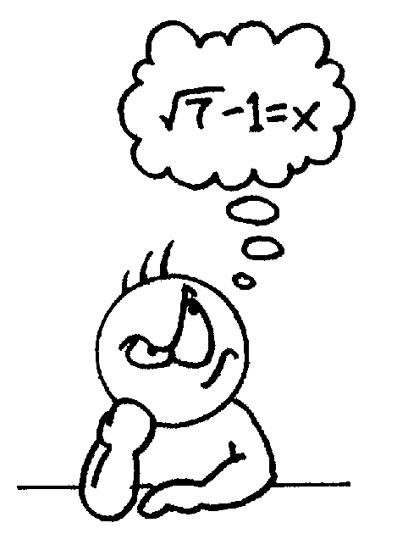
Elektronická učebnice - II. stupeň Základní škola Děčín VI, Na Stráni 879/2 – příspěvková organizace Anglický jazyk
12.6 Something more difficult
Do you know what is the difference between the questions:
What do you do?
What are you doing?
Sometimes we use P.C. to express something special. What is it?
She is always telling my secrets to everyone.
He is always coming late.
They are talking all the time. It´s terrible!
3. There are some verbs that can´t be used in –ING form
love, hate, want, need, like… WHY?
4. What does P.C. express in these examples?
I´m playing tennis with Sam tomorrow.
He is meeting Suzan on Tuesday.
They are going to Paris in the summer.

Slide 7
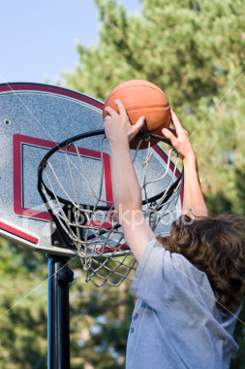
Elektronická učebnice - II. stupeň Základní škola Děčín VI, Na Stráni 879/2 – příspěvková organizace Anglický jazyk
12.7 Present simple or present continuous?
'My name________ (to be) Peter; l ________(to live) in the suburbs of Boston with my family. Most people ________(to believe) we ________ (to be) rich because we ________ (to live) in a big house. But our family ________(to seem) to be like any other one. Have a look: Maggy, my wife, ________(to like) cooking. She ________ (to enjoy) being in the kitchen with her friends. At the moment she ________(to make) a cake and you can't talk to her. What really ________ (to worry) her is our daughter who ________(to prefer) to chat in front of her computer instead of cooking with her. It's 5 pm. Paul, my son, ________(to play) basketball in the garden and I ________(to watch) TV, I ________(to wait) for this delicious cake that Maggy ________(to cook) . I told you, a family as yours. '

Slide 8
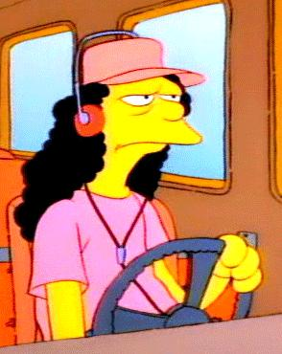
Elektronická učebnice - II. stupeň Základní škola Děčín VI, Na Stráni 879/2 – příspěvková organizace Anglický jazyk
12.8 Test
Find the present continuous tense
He will be doing his homework.
They are writing the letter.
What were you doing?
I like swimming.
Fill in the correct form in PC: Mary………………..to the radio.
is listening
are listening
is listenning
are listenning
3. Which question is in present continuous?
Are you studying English?
Do you studying English?
Is you studying English?
Were you studying English?
With which word or phrase can you use present continuous?
sometimes
at the moment
yesterday
tomorrow
Correct answers: 1b, 2a, 3a, 4b

Slide 9
Elektronická učebnice - II. stupeň Základní škola Děčín VI, Na Stráni 879/2 – příspěvková organizace Anglický jazyk
12.9 Použité zdroje, citace
http://englishkidsfun.blogspot.com/2011/02/present-continuous-online-worksheets.html
http://www.onegoalenglish.mex.tl/365572_Present-Continuous.html
http://lidibre.wordpress.com/2011/08/23/present-continuous-tense/
http://www.google.cz/imgres?q=verb+be&um=1&hl=cs&rls=com.microsoft:cs&biw=1280&bih=666&tbm=isch&tbnid=TPlmzAJUYKNJwM:&imgrefurl=http://www.wix.com/mukemmel/english/gl5&docid=Keno45Fvv13uOM&imgurl=http://static.wix.com/media/83c825b54072ada6c142bc15685f3f02.wix_mp&w=391&h=350&ei=QDvRTqSFLtCaOrmAvY0P&zoom=1&iact=rc&dur=259&sig=115828955252018999933&page=12&tbnh=136&tbnw=152&start=214&ndsp=20&ved=1t:429,r:8,s:214&tx=55&ty=35
https://commons.wikimedia.org/wiki/File:EGG_Present_continuous.svg
http://www.youtube.com/watch?v=4rQqdSagoOU
http://www.babble.com/CS/blogs/strollerderby/archive/tags/school+bus/default.aspx

Slide 10
Elektronická učebnice - II. stupeň Základní škola Děčín VI, Na Stráni 879/2 – příspěvková organizace Anglický jazyk
12.10 Anotace
Autor | Mgr. Michaela Kaplanová
Období | 07 – 12/2011
Ročník | 7. ročník
Klíčová slova | Present, continuous, ing-form, at the moment, consonant
Anotace | Prezentace popisující tvoření a použití průběhového času přítomného

